Slide 1
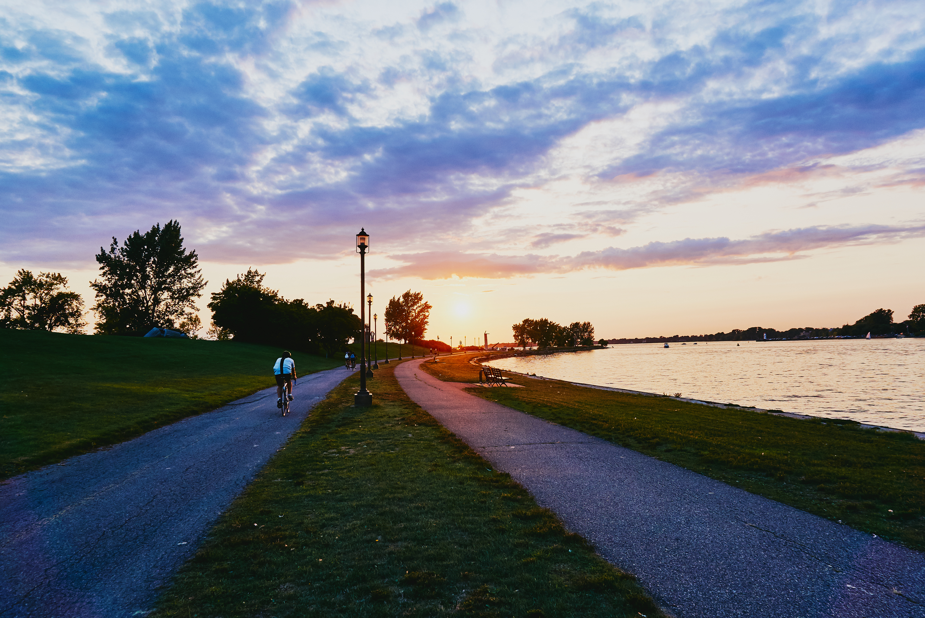

A Tamarack Institute Webinar
Advancing the Sustainable Development Goals in your Community
Launching a new publication on localizing the SDGs
Moderator: Laura Schnurr
Community Climate Transitions

Slide 2


Slide 3

Gratitude & Acknowledgement
We begin this workshop by acknowledging that we are meeting on Indigenous land. As settlers, we are grateful for the opportunity to meet and we thank all the generations of Indigenous peoples who have taken care of this land.
As settlers, this recognition of the contributions and historic importance of Indigenous peoples must be clearly and overtly connected to our collective commitment to make the promise and the challenge of Truth and Reconciliation real in our communities.
We didn’t hear back from the community after we left

Slide 4
Technical Considerations
We've got you covered - You will receive a full recording of the call, the slides as well as a collection of links & resources.
Join the conversation - Use the Q&A panel on your Zoom client to submit and vote for questions you'd like us to discuss.
Technical Support - You can use the chat panel to ask for technical support throughout the webinar.
We didn’t hear back from the community after we left

Slide 5
Check-in
Introduce yourself in the chat box
Please share your name, organization/affiliation, and where you are calling in from.
Notes:
Explain technical considerations

Slide 6
Today’s Agenda (times in EDT)
Welcome | 12:00 – 12:05
Tony Pipa | 12:05 – 12:15
Highlights from the 10 Guide | 12:15 – 12:25
Community stories: Kelowna, Winnipeg, Quebec, London | 1:25 – 1:50
Q&A & Closing | 12:50 – 1:00
We didn’t hear back from the community after we left

Slide 7
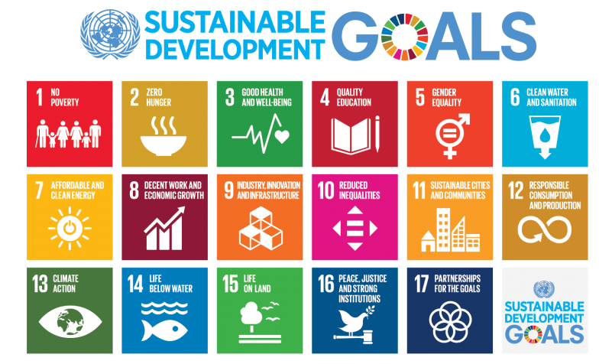
Why the SDGs?
Notes:
Explain technical considerations

Slide 8
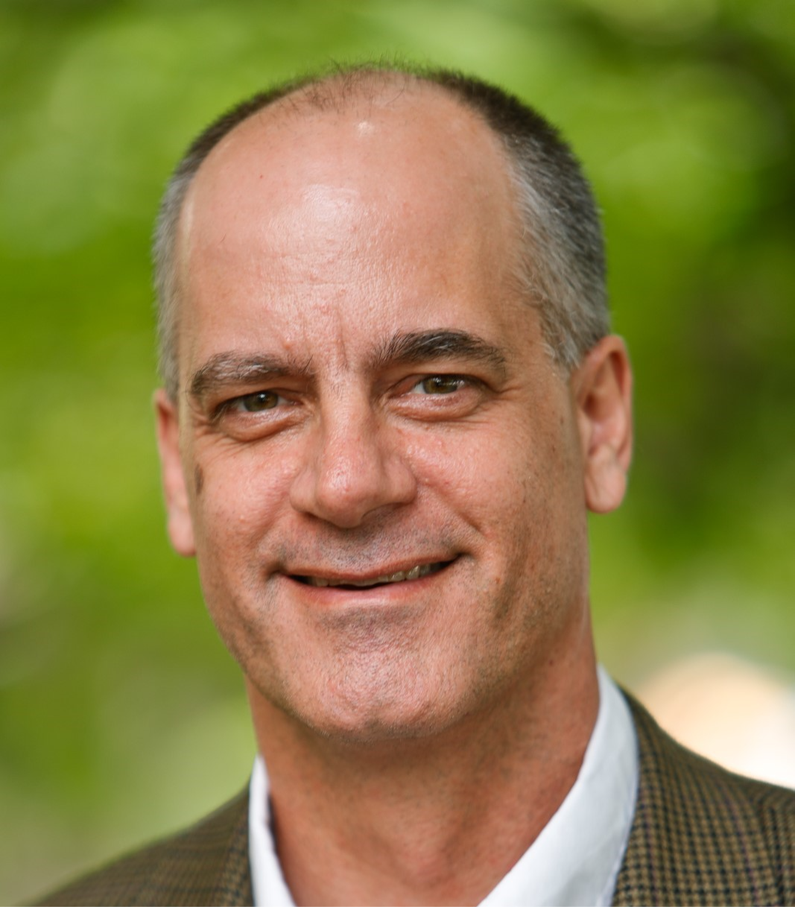
We didn’t hear back from the community after we left
Tony Pipa
Senior Fellow, Centre for Sustainable Development at Brookings

Slide 9
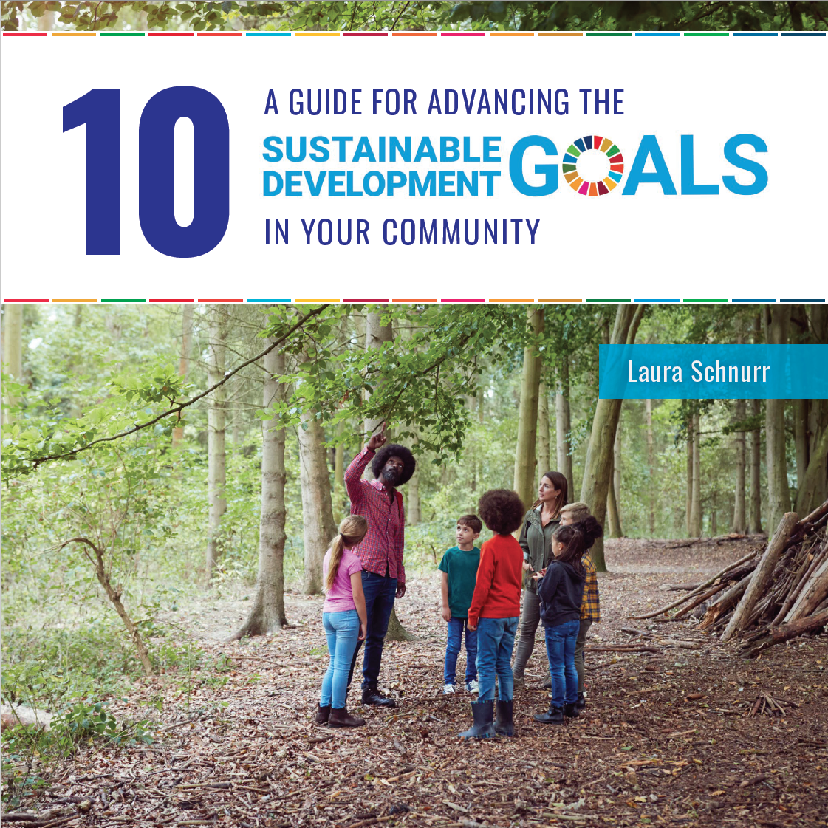

A new resource on localizing the SDG in Canada

Slide 10
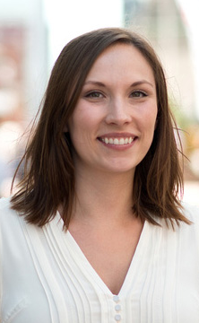
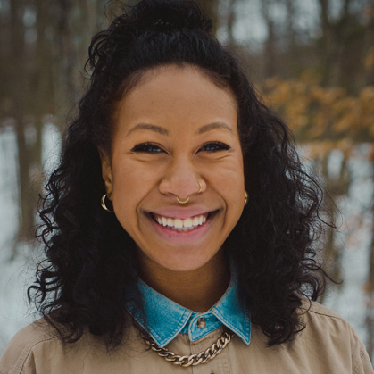
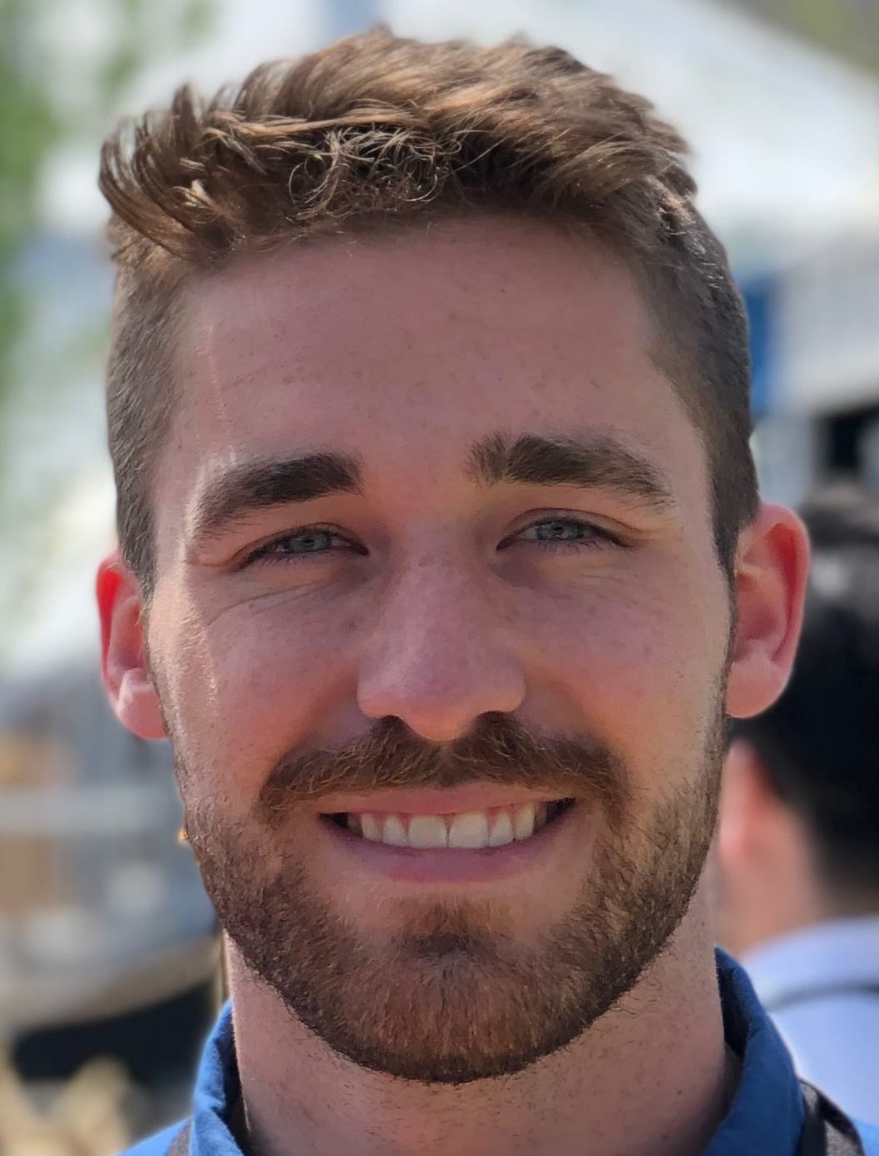
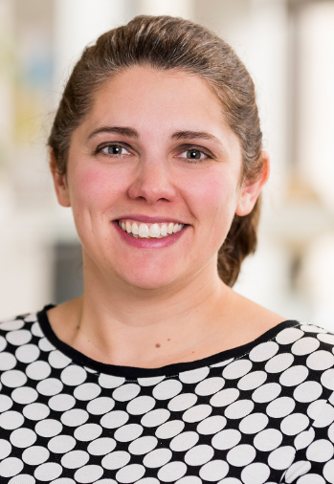
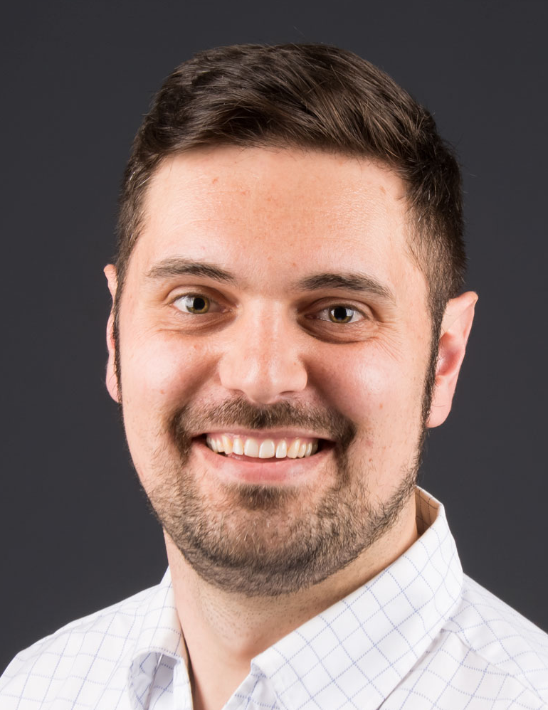
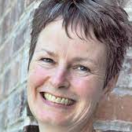
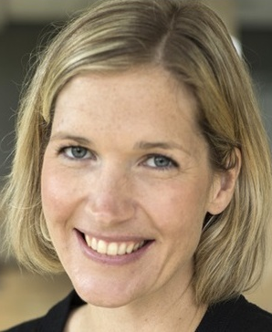
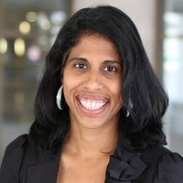
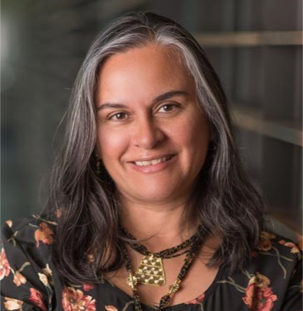
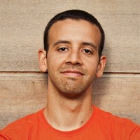
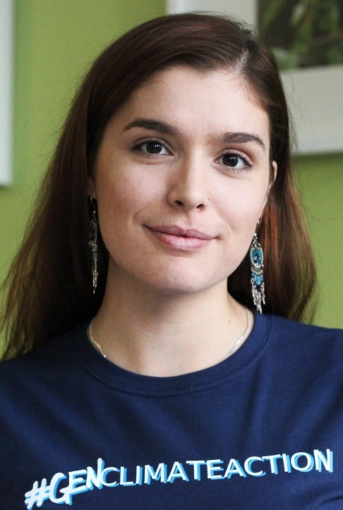
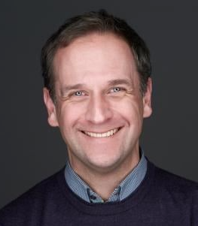
10 Guide Advisory Group
Alison Sidney, Community Foundations of Canada
Celeste Alcena, Youth Climate Lab
Charles Beaudry, Accélérer 2030
Elena Pierce, Federation of Canadian Municipalities
Jon Beale, Sustainable Development Solutions Network Canada
Julie Cosgrove, Kawartha World Issues Centre
Julie Wright, University of Waterloo
Kusum Wijesekera, BC Council for International Cooperation
Liliana Diaz, University of Laval
Luis Patricio, Pillar Nonprofit Network
Shaelyn Wabegijig, Kawartha World Issues Centre
Stefan Jungcurt, International Institute for Sustainable Development

Slide 11
10 Questions for Assessing Your Self-Readiness
Are you/your organization familiar with the SDGs and their potential as a shared vision and framework for action, both globally and locally?
Are members of your community aware of the SDGs and how they are relevant locally? Has there been public engagement or other educational efforts related to the SDGs?
Has your community developed a long-term vision – including shared, local goals for inclusive community wellbeing – that could be mapped to the SDGs?
Do you have a strong, diverse network of people and organizations from across industries and sectors that can contribute to your long-term vision and form a coalition to advance this work?
Do you know who in your community is most at risk of being 'left behind' and why?
Have you developed the relationships and partnerships needed to welcome in and centre the voices of vulnerable communities? Have you invited them to join you on this work?
Is there sufficient trust across sectors and between community members for people to have open and honest conversations about the future they want and the actions needed to achieve it?
Does your community use data to track and report progress on local goals or other projects that align well with the SDGs?
Are there regular opportunities in your community to participate in planning, monitoring and review?
Do you know who in your network might have access to resourcing (funding, human capital, data) and an interest in partnering/funding this work?

Slide 12
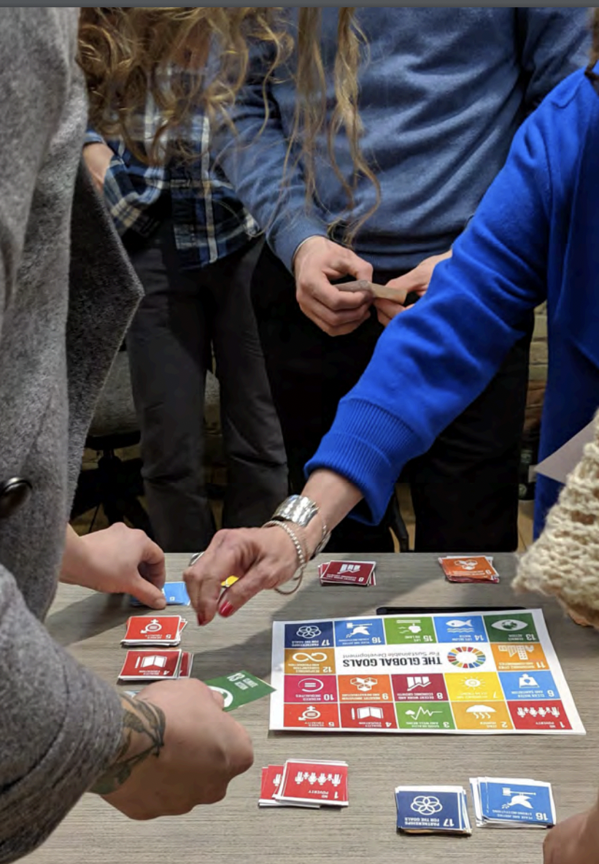
10 Really Good Ideas
Raise awareness through broad community engagement, connecting the SDGs to community issues to inspire and build momentum for change
Consult on local priorities to develop a shared vision
Understand your community’s progress to celebrate success and galvanize action
Align existing local plans with the Global Goals
Develop a community plan for advancing priority goals, such as ending poverty and tackling climate change
Invite diverse voices to lead, offering support to enable participation
Identify meaningful indicators that resonate with your community to measure progress
Conduct a Voluntary Local Review to affirm commitment to the SDGs and report on progress
Track progress through an open and transparent approach
Share stories from your community to inspire and connect with others

Slide 13
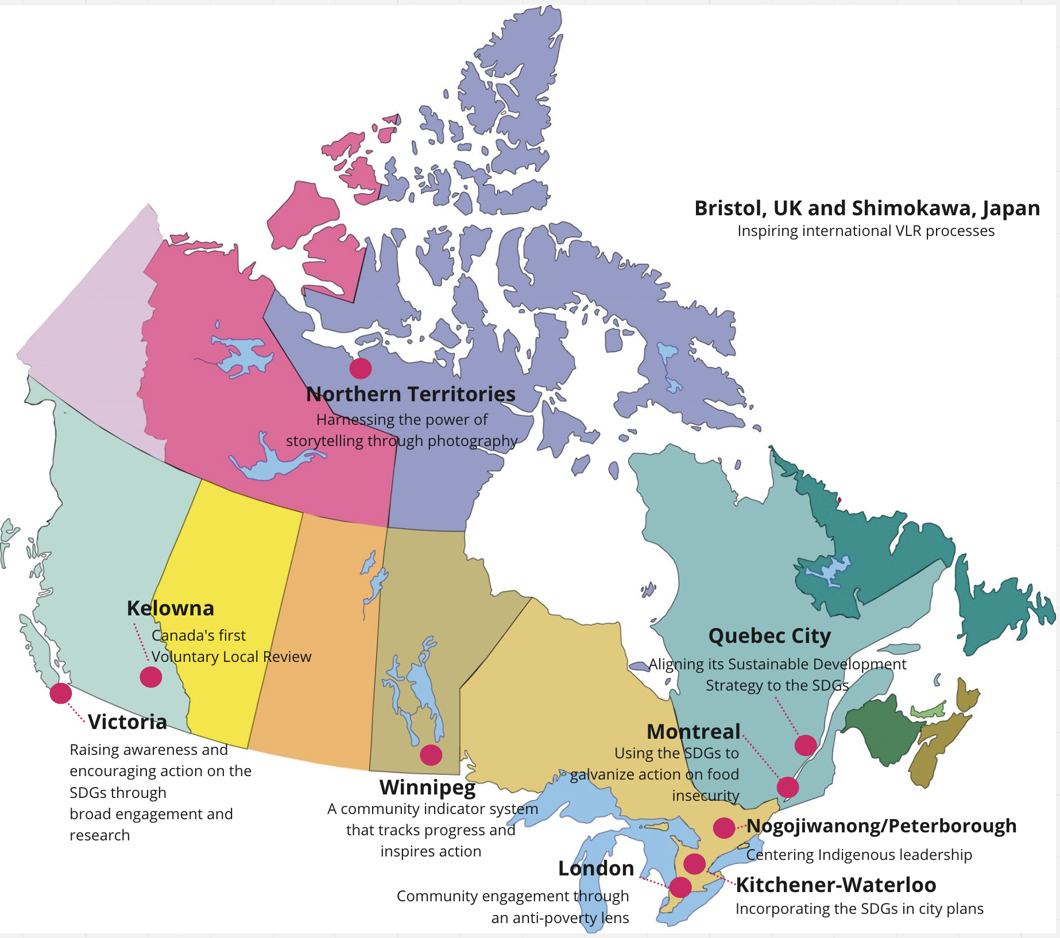
10 Inspiring Stories

Slide 14

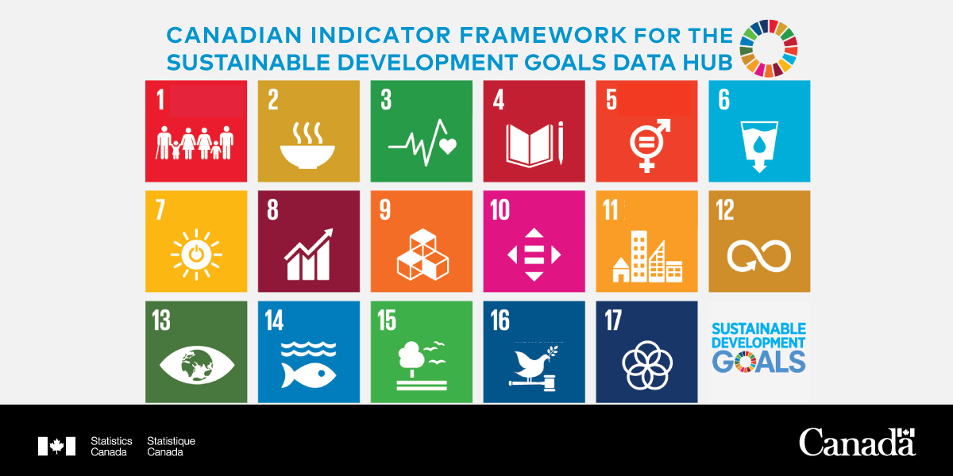
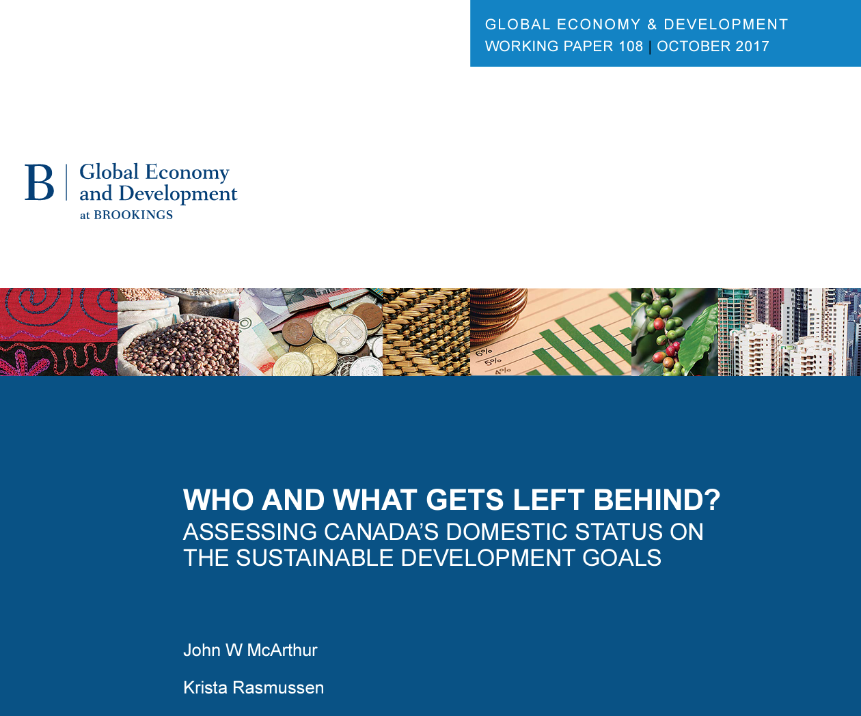

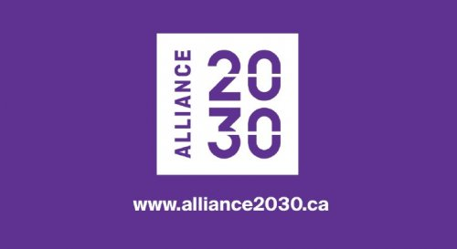


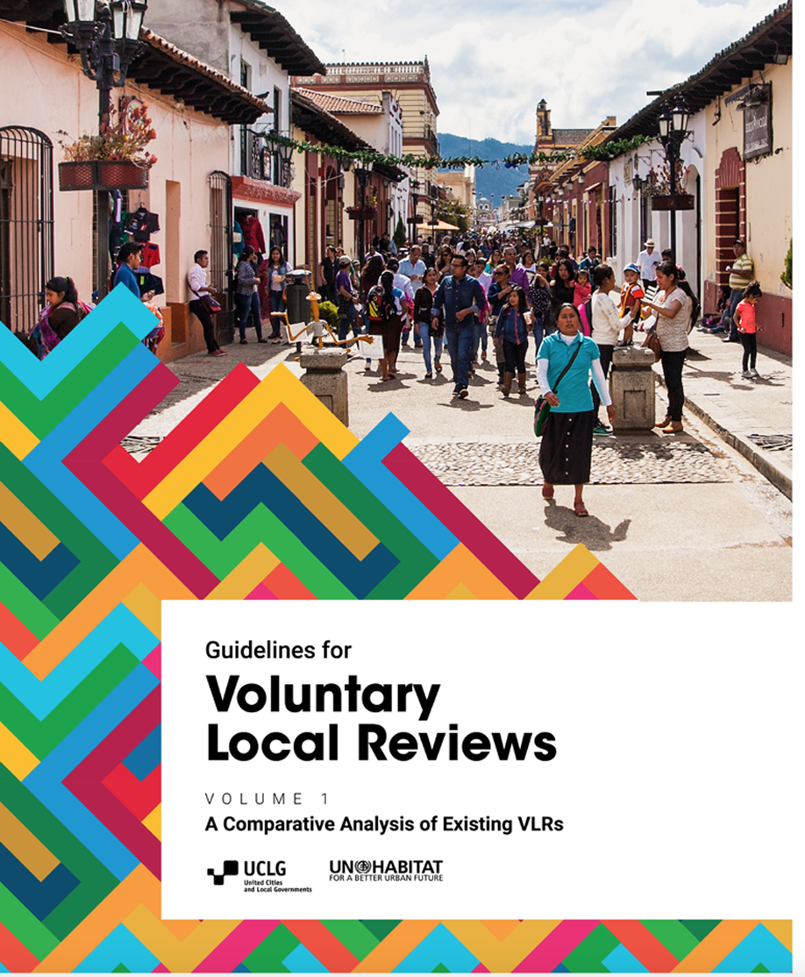
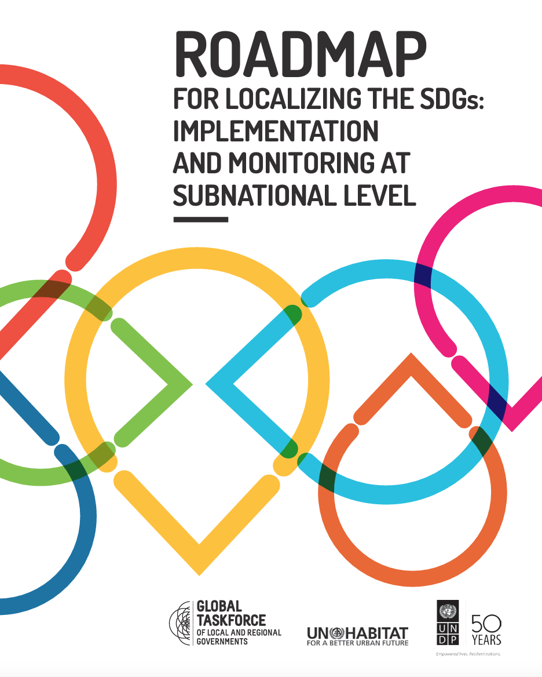
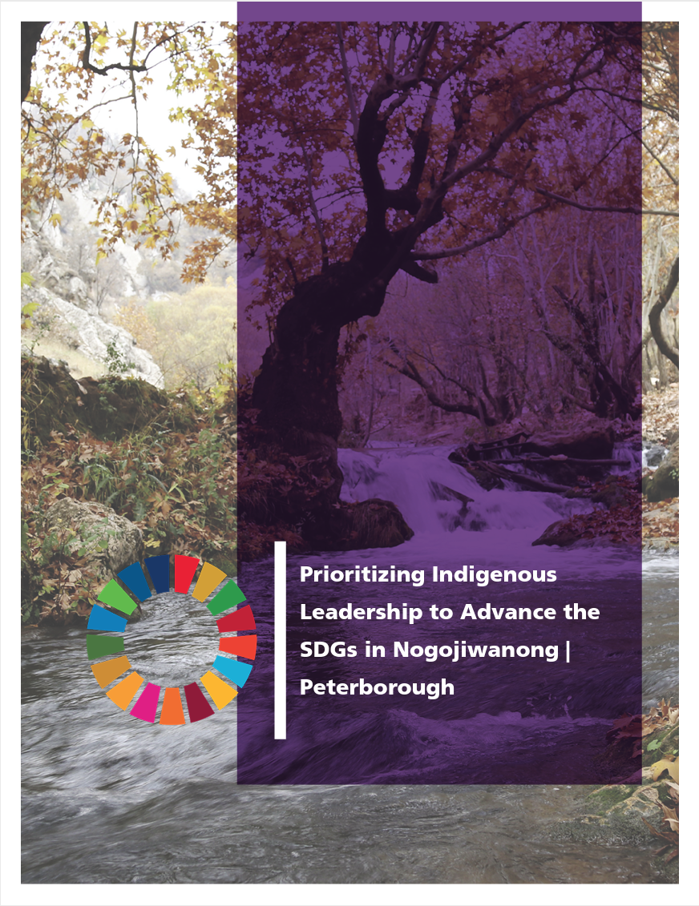
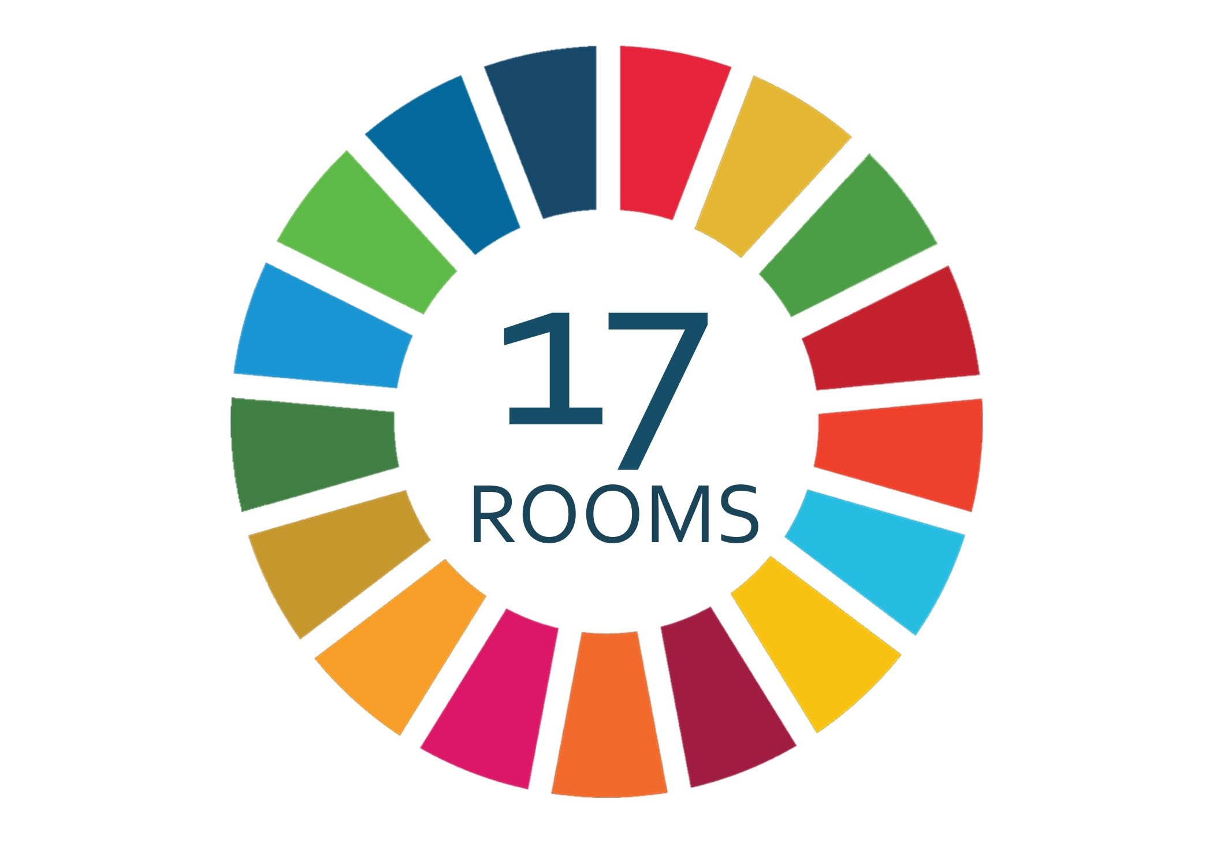
10 Useful Resources

Slide 15






Additional Resources in French
Grille de priorisation des cibles des ODD
En France

Slide 16
We didn’t hear back from the community after we left
Kusum Wijesekera
Author and Project Manager of Kelowna's Voluntary Local Review
Stefan Jungcurt
Lead, SDG Indicators and Data, International Institute for Sustainable Development
Liliana Diaz
Scientific Coordinator, Institute for Environment, Development and Society (EDS Institute), Université Laval
Luis Patricio
SDG Cities Project Co-Lead, Pillar Nonprofit Network

Slide 17
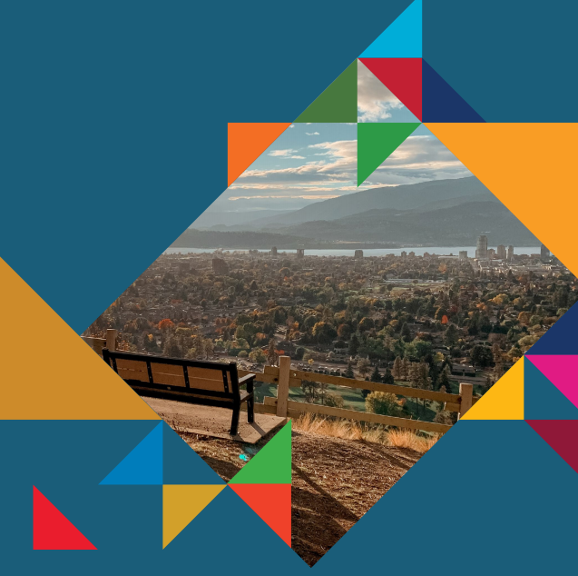
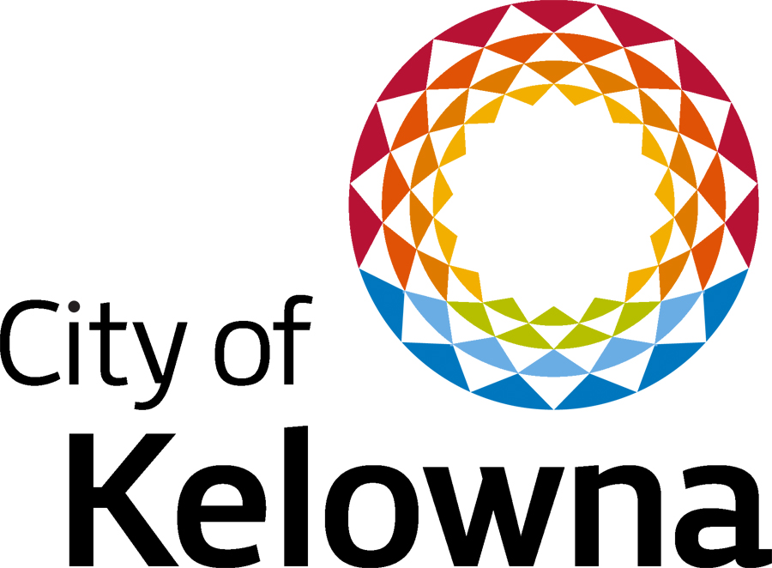

GLOBAL GOALS, LOCAL ACTION:
Kelowna’s VLR
Kusum Wijesekera and Danielle Noble-Brandt

Slide 18
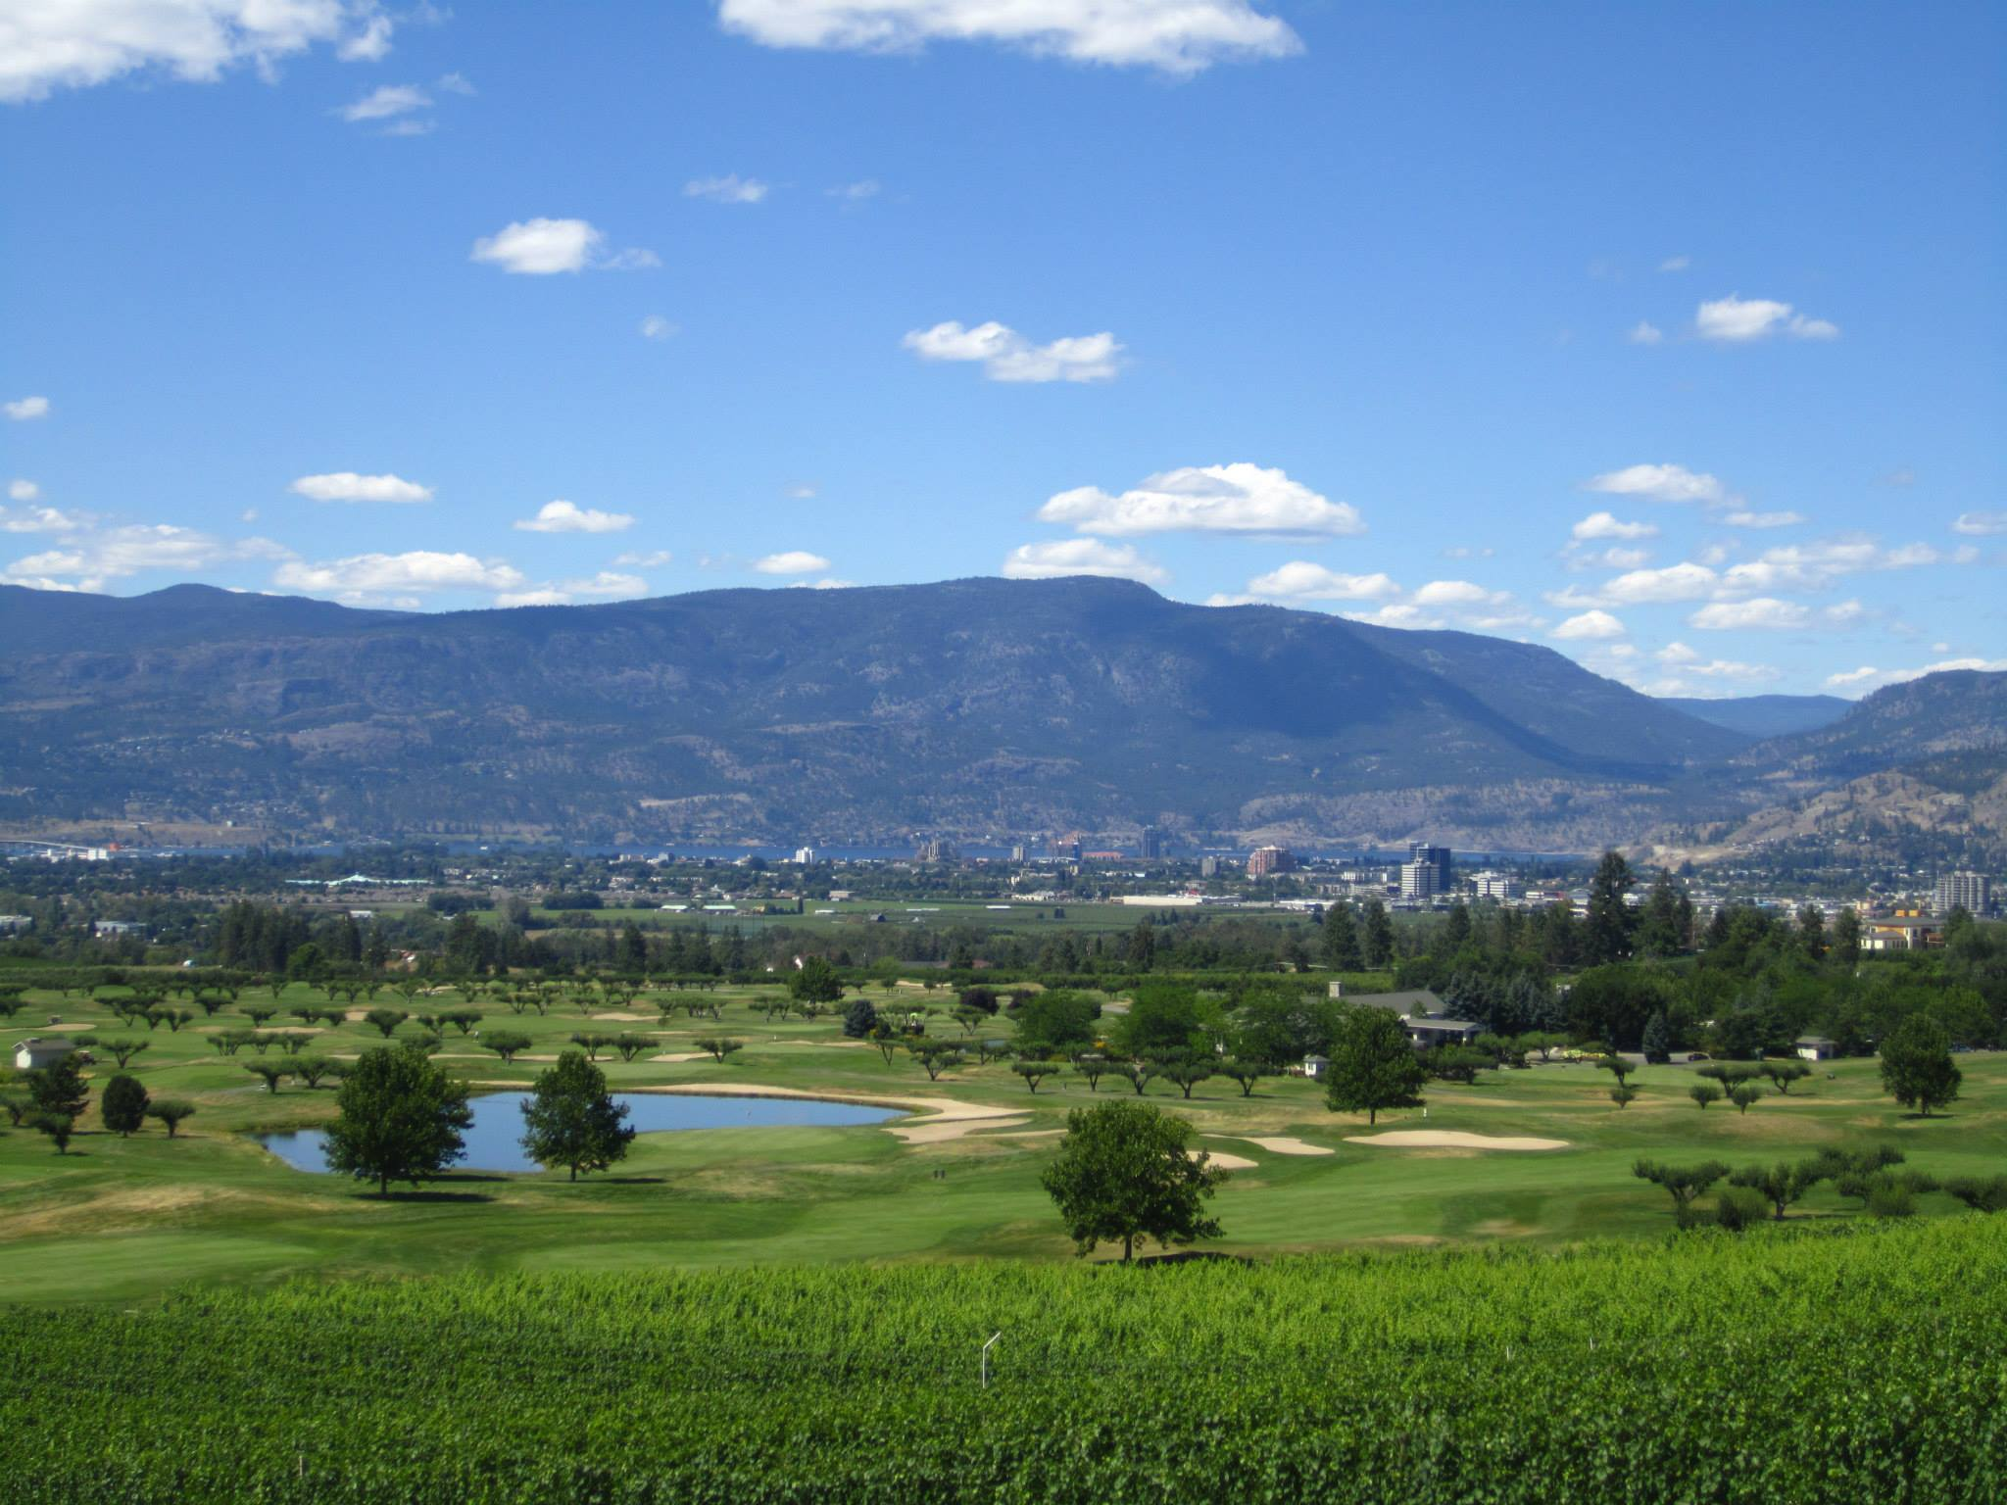
Agenda
Kelowna 101
Methodology: Approach 1
Methodology: Approach 2
Leave No One Behind (Truth and Reconciliation)
Final Indicator Selection

Slide 19
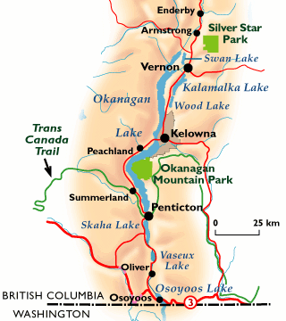
Kelowna
First Peoples: Sylix / Okanagan
Population:
    2020: 138,500
    2040: 183,500
Industry:
    Tourism
    Agriculture
    Construction
    Healthcare
    Technology
Academic Institutions:
    University of British Columbia Okanagan
    Okanagan College

Slide 20
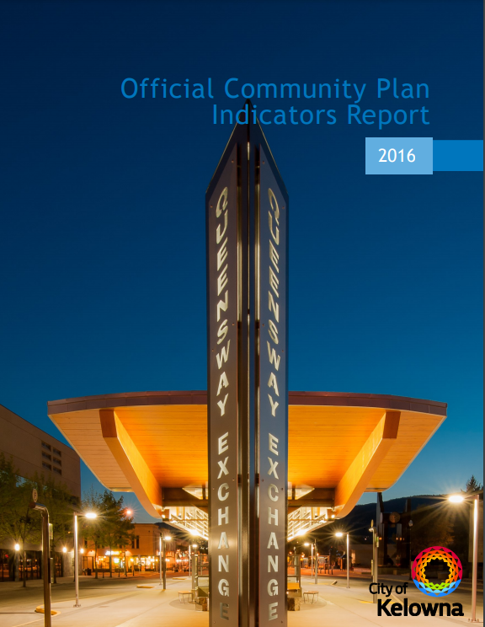
Methodology: Approach 1
Researched projects localizing SDGs
    Brookings Report
    BCCIC
    IISD
    World Council on City Data
    VLRs (Baltimore, NYC, etc.)
Analyzed municipal documents (Approach 1)
    Official Community Plan, Climate Action, Clean Air Strategy, etc.
    Identified targets and indicators aligned with SDG targets and indicators

Slide 21
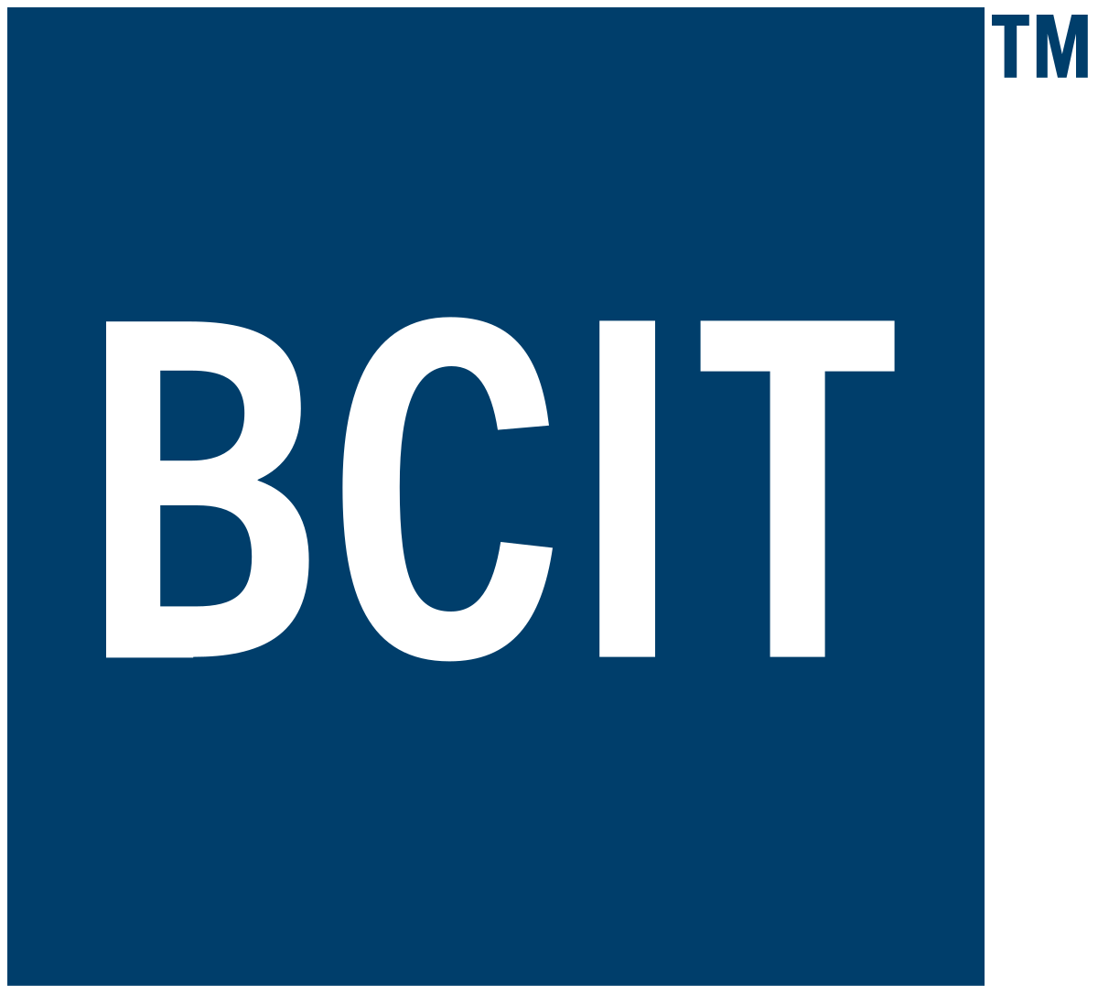





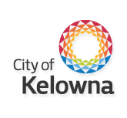





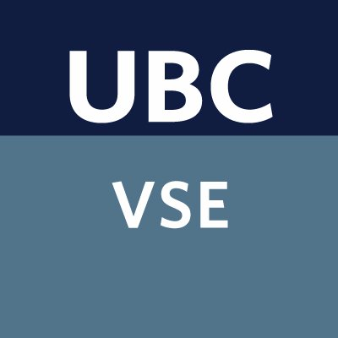




Methodology:
Approach 2
Review of available subnational data
    Federal and provincial sustainable development strategies
    Reviewed reports from academia, researchers, think tanks, etc.
    Discussions with CSOs (quantitative and qualitative data)

Slide 22

Methodology: TRC
Analyzed TRC Calls to Action
    Identified targets and indicators aligned with SDGs
    Consulted Indigenous organizations to gain insight on how to incorporate meaningful change

Slide 23
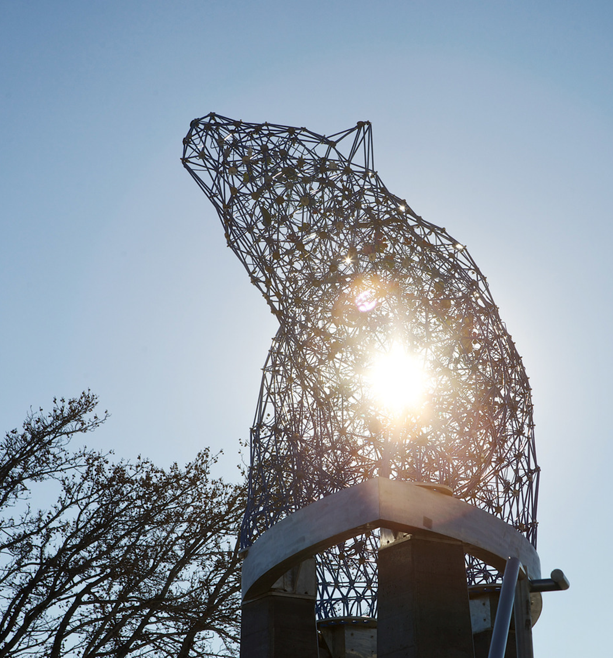
Methodology: Indicator Selection
5. Finalizing 28-indicators
    Amalgamated data from both approaches
    Shortlisted based on feedback from experts (govt officials, CSOs, academia, Indigenous organizations, etc.)
      Who is being captured?
      Who is being left behind?
    Feasibility (ideal vs realistic)
        Limited resources
        Can an existing municipal indicator be supplemented?

Slide 24
Thank You!
Kusum Wijesekera: okanagan@bccic.ca
Danielle Noble-Brandt: dnoble-brandt@kelowna.ca

Slide 25
We didn’t hear back from the community after we left
Kusum Wijesekera
Author and Project Manager of Kelowna's Voluntary Local Review
Stefan Jungcurt
Lead, SDG Indicators and Data, International Institute for Sustainable Development
Liliana Diaz
Scientific Coordinator, Institute for Environment, Development and Society (EDS Institute), Université Laval
Luis Patricio
SDG Cities Project Co-Lead, Pillar Nonprofit Network

Slide 26

Thank You
To learn more please get in touch with us
Laura Schnurr: laura@tamarackcommunity.ca
Sign up to our Community of Practice:
https://www.tamarackcommunity.ca/cct-cop-sdg-localization

