Slide 2

Gratitude & Acknowledgement
We begin this webinar by acknowledging that we are meeting on Indigenous land. As settlers, we are grateful for the opportunity to meet and we thank all the generations of Indigenous peoples who have taken care of this land.
As settlers, this recognition of the contributions and historic importance of Indigenous peoples must be clearly and overtly connected to our collective commitment to make the promise and the challenge of Truth and Reconciliation real in our communities.
We didn’t hear back from the community after we left

Slide 3
Technical Considerations
We’ve got you covered - You will receive a full recording of the call, the slides as well as a collection of links & resources.
Join the conversation - Use the Q&A panel on your Zoom client to submit and vote for questions you’d like us to discuss.
Technical Support - You can use the chat panel to ask for technical support throughout the webinar.
We didn’t hear back from the community after we left

Slide 4
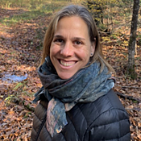
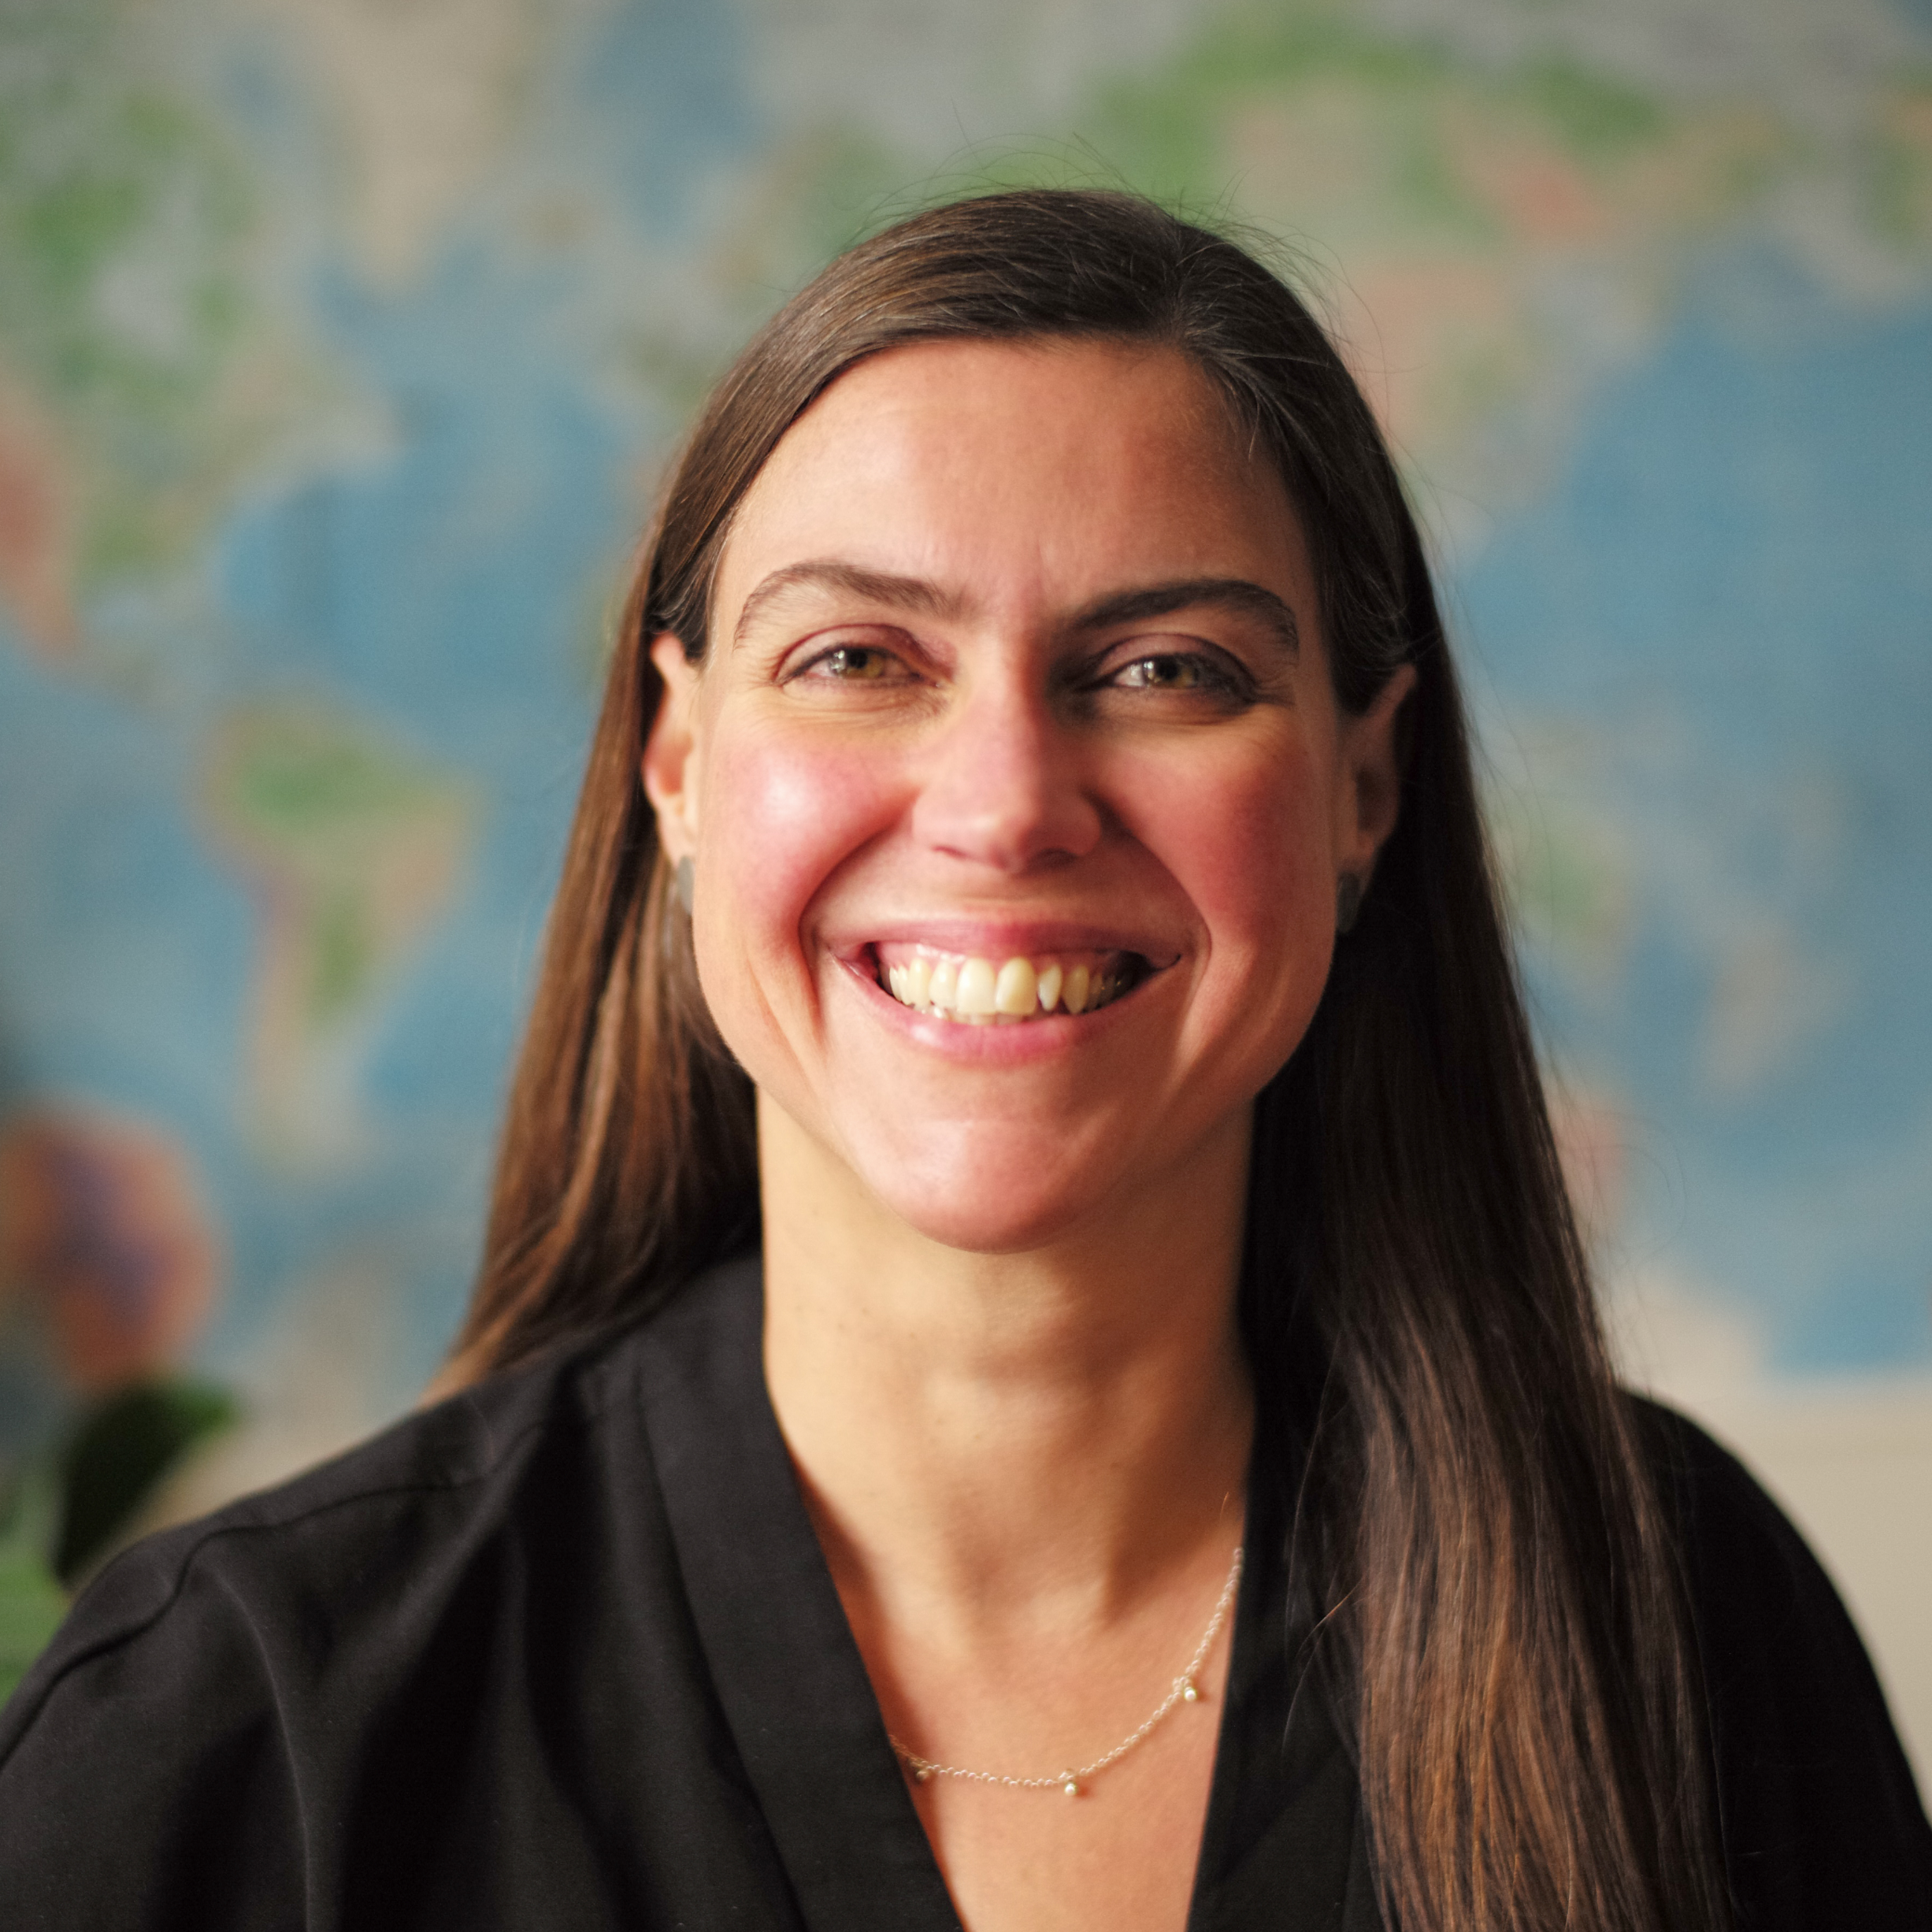
We didn’t hear back from the community after we left
Rotem Ayalon
Patricia Rossi
Tasha Lackman
Myriam Bérubé

Slide 5

FRAMING THE CONVERSATION
What is important to you about Place-based Philanthropy?

Slide 6
THE COLLECTIVE IMPACT PROJECT – MONTRÉAL
Can you share a concrete example of place-based philanthropy?
What are some of the benefits and challenges of this approach from a community’s perspective?

Slide 7
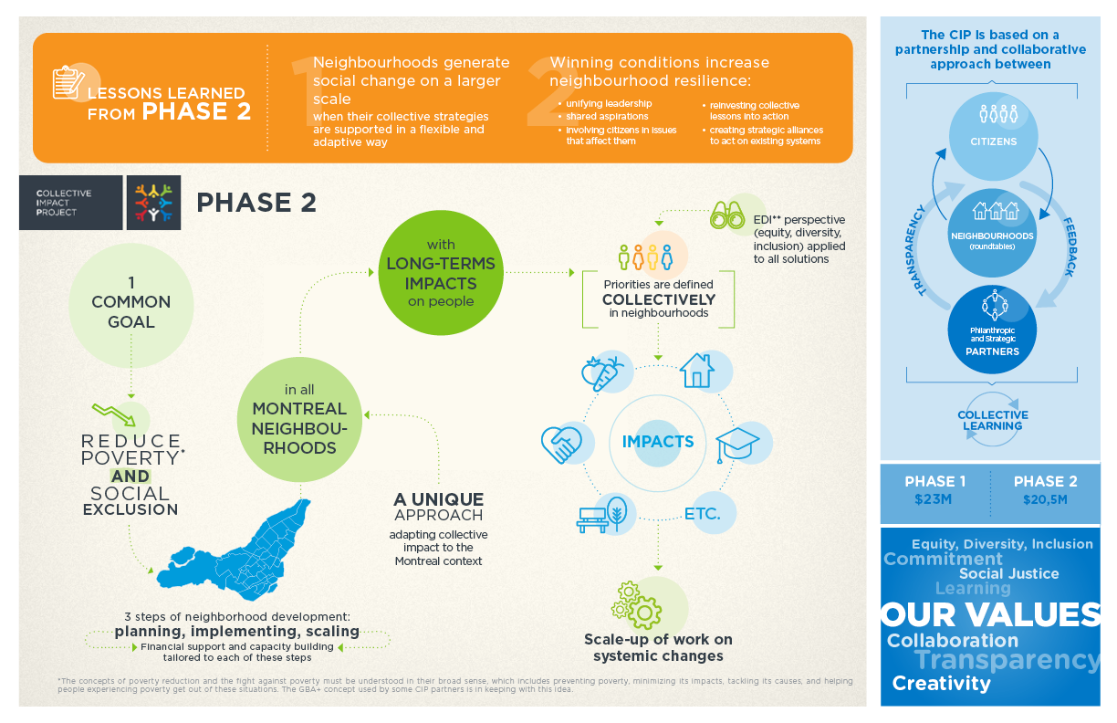

Slide 8
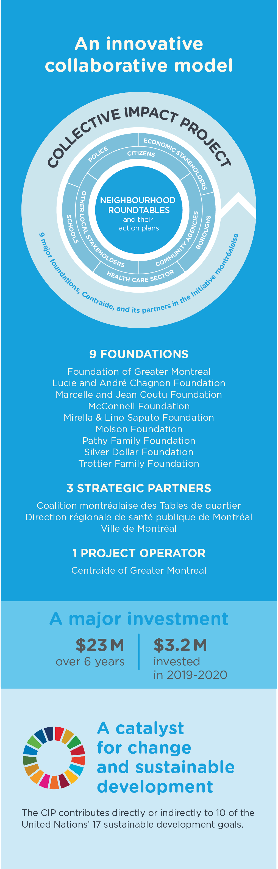

Slide 9
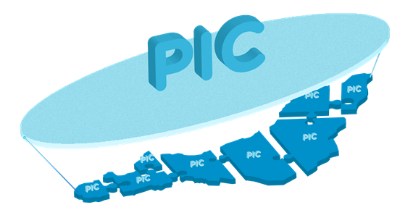
A project larger than the sum of its parts!
The large number of collective impact initiatives initiated in all of the Montreal neighborhoods is a strength allowing to spread and deepen the effects of collective work to fight poverty and social exclusion on a regional scale.
It allows for transversal learning and changes on a larger scale.

Slide 10
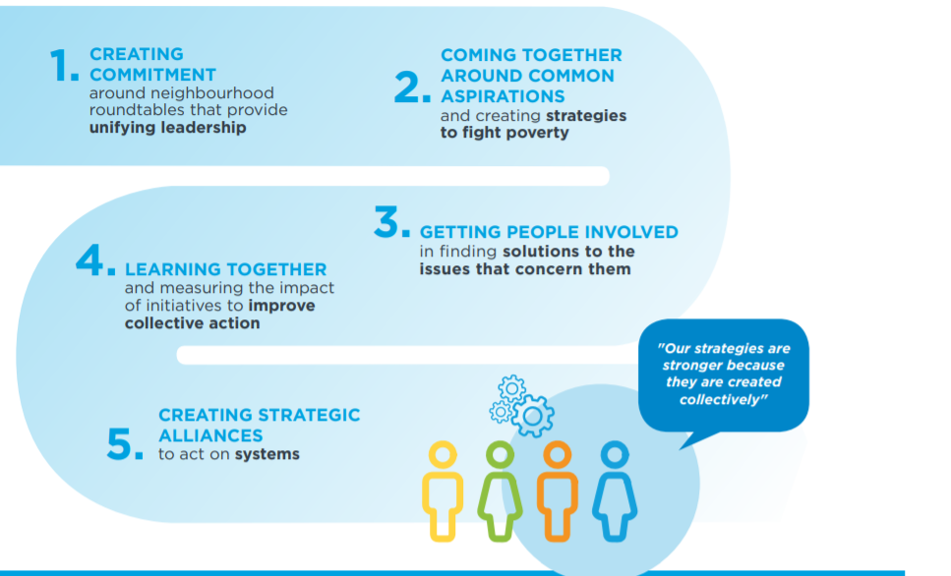
Lessons learned (Benefits and challenges on different levels)
1. Community level
2. Partnership level
3. Systems level

Slide 11
FROM A FUNDER’S PERSPECTIVE
Why is your foundation supporting place-based initiatives (the Collective Impact Project and other initiatives)?
What are some of the benefits and challenges of this approach?

Slide 12

Mission
Our mission is to prevent poverty by helping to create conditions that will enable all young people living in Québec to develop their full potential.
To fulfill this mission, we provide long-term support to organizations and networks that are working together to improve their capacity to develop sustainable initiatives aimed at advancing those conditions.
Guiding principles:
Establish close relationships based on respect, trust and cooperation
Create sustainable conditions to enable all young people living in Québec to develop their full potential by working to prevent poverty and reduce inequities
Recognize that it is our partners who can best identify the issues, solutions, and need for change
Engage in an ongoing learning process with our partners

Slide 13
Place-based approach
What it means to us:
« Bottom-up »
Common vision of transformational change
Proximity
Improve living conditions (housing, food security, transportation, education, employment…), with a focus on marginalized communities
Empowerment
Mobilizing stakeholders and citizens
Why PIC:
We were not doing enough in Montreal considering the needs, the stats etc.
Collaboration with Centraide du Grand Montréal was important for us because of their experience
Building a partnership with other Foundations but also with the roundtables
Accelerating and building on the work already in action

Slide 14
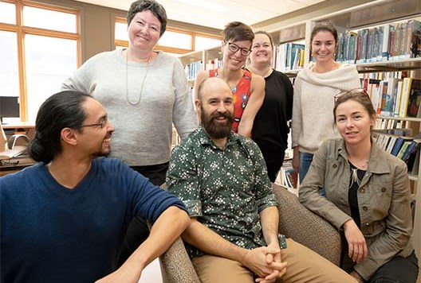
COSMOSS (Bas-St-Laurent region)
COSMOSS = Communauté ouverte et solidaire pour un monde outillé, scolarisé et en santé (An open, supportive community promoting a society that is well-equipped, educated and healthy)

Slide 15
COSMOSS (Bas-St-Laurent region)
Municipalities bordering the St. Lawrence reap benefits from tourism, but some of the interior municipalities, traditionally more rural, are very devitalized.
COSMOSS is a local and regional mobilization that unites close to 150 partner organizations from various sectors: health and social services, education, employment, early childhood and the municipal and community sectors.
The goal of the initiative is to develop the full potential of all the region's children and young people, from conception to age 30, by creating the necessary conditions to give them all an equal chance for success in life.
HOW:
Collectively identified the priorities
Strong mobilization and sense of belonging
Involvement of citizens in the decision making processes

Slide 16
COSMOSS (Bas-St-Laurent region)
Learnings for us:
Long term funding is important
Cannot underestimate the time needed to get structured and implement the necessary governance for the initiative
Our relationship based approach (listening and trust) is important and was tested during the pandemic
Developed a new form of support (giving capital to a community foundation so they may have full control)

Slide 17
COSMOSS (Bas-St-Laurent region)
Municipalities bordering the St. Lawrence reap benefits from tourism, but some of the interior municipalities, traditionally more rural, are very devitalized.
COSMOSS is a local and regional mobilization that unites close to 150 partner organizations from various sectors: health and social services, education, employment, early childhood and the municipal and community sectors.
The goal of the initiative is to develop the full potential of all the region's children and young people, from conception to age 30, by creating the necessary conditions to give them all an equal chance for success in life.
HOW:
Collectively identified the priorities
Strong mobilization and sense of belonging
Involvement of citizens in the decision making processes

Slide 21
LEARNINGS
Can you share some of your learnings from supporting a place-based approach?

Slide 22
ADVICE
What piece of advice do you have for our participants interested in (or already involved) in place-based work?
We didn’t hear back from the community after we left

Slide 23
TRENDS
What trends do you see emerging in the field of philanthropy as it relates to place-based work?

Slide 24
LOOKING AHEAD
Share a final thought/ your hopes for the future

Slide 25


Slide 26

December 8th – Place-based Social Innovation through Living Labs

Slide 27


Upcoming workshops

Slide 28

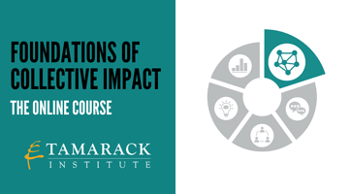

Online courses in French and English

Slide 29

tamarackcommunity.ca
Building a connected force for community change:
Online Learning Communities
Communities of Practice
Monthly online seminars
A monthly online journal – Engage! magazine
Face to face learning events
Visitez notre nouvel Espace francophone: https://www.tamarackcommunity.ca/fr-ca/francophone-de-tamarack
Learn more about our speakers:
https://www.centraide-mtl.org https://pic.centraide.org
https://fondationchagnon.org
http://fgmtl.org

Slide 30


