Slide 1
Accessibility Matrix
From the Tamarack Institute’s
Learning Centre

Slide 2
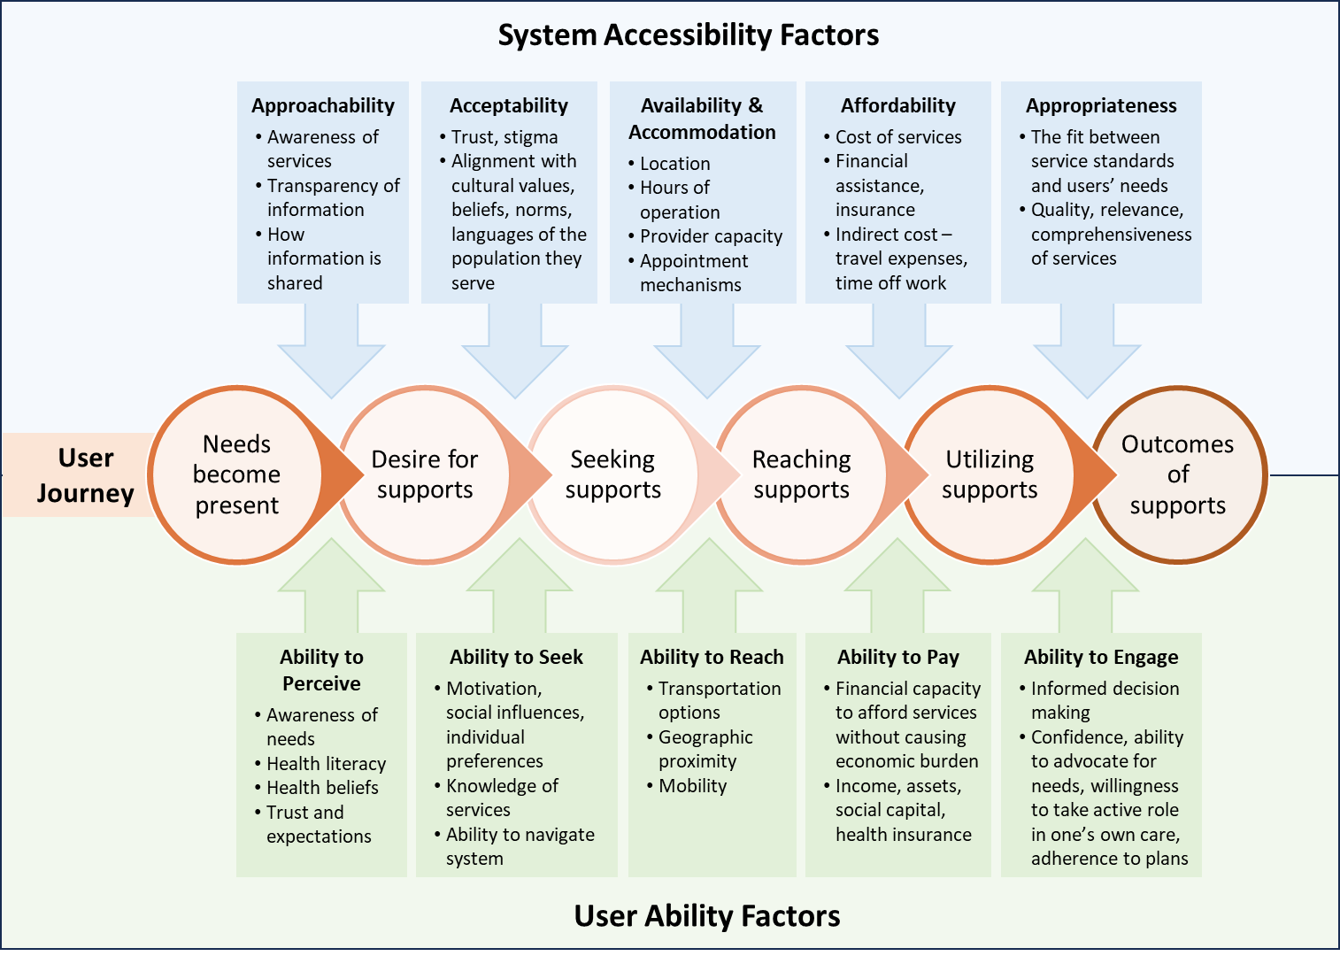
Adapted from Levesque, Harris, and Russell’s conceptual framework for healthcare access

Slide 3
Accessibility Factors
It outlines five accessibility factors that affect a person’s ability to access services:
1. Approachability
Refers to how easily people can find out about available services.
Services are approachable when the population is aware of them, and information about the services is openly communicated.
This factor is influenced by how well information about services is distributed, the transparency of service providers, and the community's level of awareness.
2. Acceptability
Relates to the cultural and social factors that affect whether people feel comfortable using services.
Services are acceptable when they align with the cultural values, beliefs, language, and social norms of the population they serve.
It also considers factors like stigma, trust in the provider and/or system, and the attitudes of both providers and users.
3. Availability and Accommodation
Focuses on the physical and logistical aspects of accessing services, such as the location, opening hours, and the capacity of the provider.
Services are available when there are enough providers, facilities, and resources to meet the needs of the population.
Accommodation involves factors like appointment systems, waiting times, and the flexibility of service delivery to meet users' needs.
4. Affordability
Involves the financial aspects of accessing services, including the cost of services, insurance coverage, and the availability of financial assistance.
Services are affordable when the costs are within the economic reach of individuals, and when there are adequate mechanisms to support those with limited financial resources.
This factor considers direct costs (like fees and charges) and indirect costs (like travel expenses and time off work).
5. Appropriateness
Refers to the fit between healthcare services and patients’ needs, including the quality, relevance, and comprehensiveness of the care provided.
Services are appropriate when they meet professional standards and are tailored to the specific needs of individuals.
It involves providing the right care, at the right time, and in a way that respects user’s preferences and expectations.

Slide 4
Ability Factors
1. Ability to Perceive
Refers to an individual's capacity to recognize their needs and understand that they require attention.
This factor is influenced by health literacy, health beliefs, awareness of symptoms, and the ability to evaluate personal health conditions.
If people are not aware of their health needs, they may not seek healthcare services, even if those services are available.
2. Ability to Seek
Describes the individual's capacity to seek out healthcare services, including the motivation, knowledge of available services, and ability to navigate the healthcare system.
It involves factors like autonomy, health-seeking behavior, social support, and the ability to identify and locate appropriate services.
Cultural norms, social influences, and individual preferences play a significant role in whether someone actively seeks care.
3. Ability to Reach
Relates to the individual's physical and logistical capacity to reach services.
Factors like transportation options, geographic proximity, mobility, and knowledge about how to access services impact a person's ability to physically get to the point of care.
This factor is crucial for individuals living in remote or underserved areas with limited access to facilities.
4. Ability to Pay
Concerns an individual's financial capacity to afford services without causing undue economic burden.
It includes both direct costs (such as fees for services, medications, and treatments) and indirect costs (e.g. transportation expenses, lost income from time off work).
This factor also considers insurance coverage, availability of financial assistance, and the economic resources of individuals and households.
5. Ability to Engage
Refers to the individual's ability to participate actively in their own care, including the ability to adhere to treatment plans, follow instructions, and make informed decisions about their health.
Factors like communication skills, health literacy, confidence in interacting with healthcare providers, and willingness to take an active role in one's own care are crucial.
This factor emphasizes the importance of patient empowerment and engagement in achieving positive health outcomes.

Slide 5
Needs become present
Desire for supports
Seeking supports
Reaching supports
Utilizing supports
Outcomes of supports
Template – Lived Experiences by User Journey
User Journey
Lived Experiences
“Quote”

Slide 6
Template – Lived Experiences by Accessibility Factors
Accessibility Factors | Approachability Services exist that people know about and that they can go to and receive | Acceptability Services are socially and culturally accessible to people who need it | Availability and Accommodation Services are available at a time and place that will be beneficial to people. | Affordability The direct and indirect costs related to accessing services are reasonable. | Appropriateness The experience of services offered meet the needs of individuals
Lived Experiences |  | Example: “It’s not in my language”

