Slide 1

Adam Vasey, Director of Policy, Learning & Evaluation
adam@tamarackcommunity.ca | @adam_vasey
Tamarack Institute | Vibrant Communities
Cities Innovating to Reduce Poverty Summit, Vancouver, BC, June 12, 2018
THE STATE OF CITIES REDUCING POVERTY
DRAFT FOR DISCUSSION

Slide 2
OUTLINE
A BOLD EXPERIMENT AND A NEW IDEA
POVERTY REDUCTION IN CANADA IN THE NEW MILLENNIUM
HAVING IMPACT: VC – CRP’S ROLE IN POVERTY REDUCTION
CHALLENGES AND THE OPPORTUNITY

Slide 3
PART I – A BOLD EXPERIMENT AND A NEW IDEA
A Bold Experiment to Reduce Poverty
A New Idea: Vibrant Communities – Cities Reducing Poverty

Slide 4
PART II – POVERTY REDUCTION IN CANADA IN THE NEW MILLENNIUM
Provincial and Territorial Strategies
Canadian Poverty Reduction Strategy
National Advocacy Movements
The Social Innovation, Financial Empowerment & Housing First Movements
Emerging Ideas

Slide 5
PART III – HAVING IMPACT: VC – CRP’S ROLE IN POVERTY REDUCTION
Collective Impact
Community Will and Capacity
Local Poverty Reduction Strategies
Mayors Reducing Poverty
People with Lived and Living Experience
Business Community
Poverty Reduction and Reconciliation

Slide 6
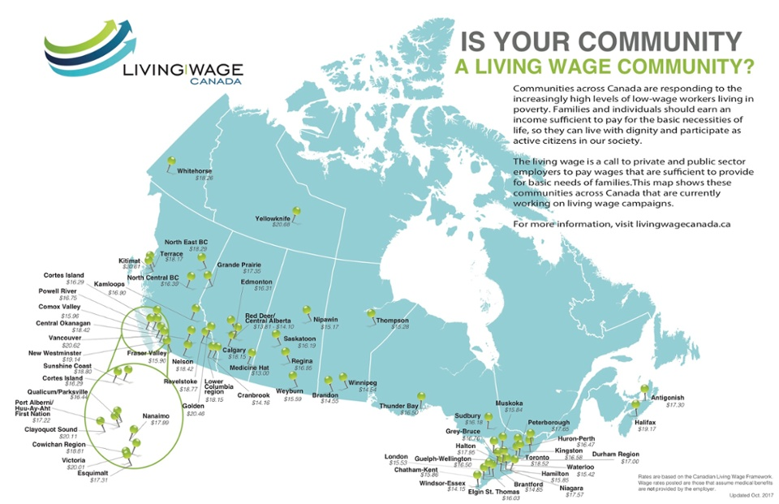
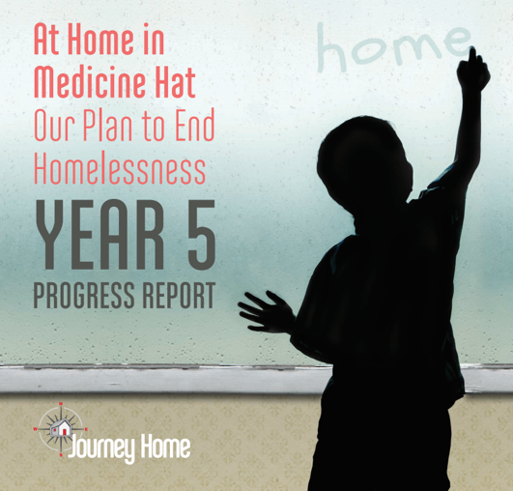

PART III – HAVING IMPACT: VC – CRP’S ROLE IN POVERTY REDUCTION (Cont’d)
Driving Policy & Systems Change
through Local Innovations
Living Wage
Financial Empowerment
Affordable Housing and Housing First
Affordable and Accessible Transportation
Influencing Government Policies
Income Security
Child Care & Early Learning
Post-secondary Education
Predatory Lending

Slide 7
PART IV – CHALLENGES AND THE OPPORTUNITY

Slide 8
adam@tamarackcommunity.ca | 519-562-8668 | @adam_vasey
THANK YOU
DRAFT FOR DISCUSSION

