Slide 1
Homelessness, harm reduction and housing first
By Nick Falvo, PhD
May 7, 2019

Slide 2
Overview
Homelessness in Alberta
Homelessness and substance use
Harm reduction
Housing First
Recovery Services Task Force

Slide 3
Note
References for all sources presented in this slide deck can be found in the “notes” section at the bottom of each slide.

Slide 4
Let’s talk a bit about homelessness.

Slide 5
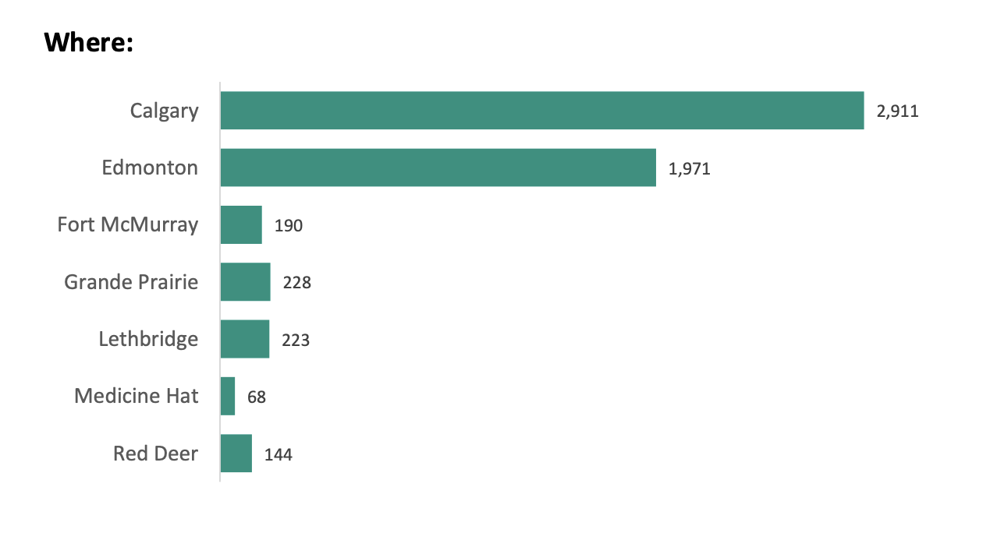
Homelessness in Alberta
Notes:
Source: https://docs.wixstatic.com/ugd/ff2744_5d899dceff12471c835fddf4e5d119fc.pdf

Slide 6
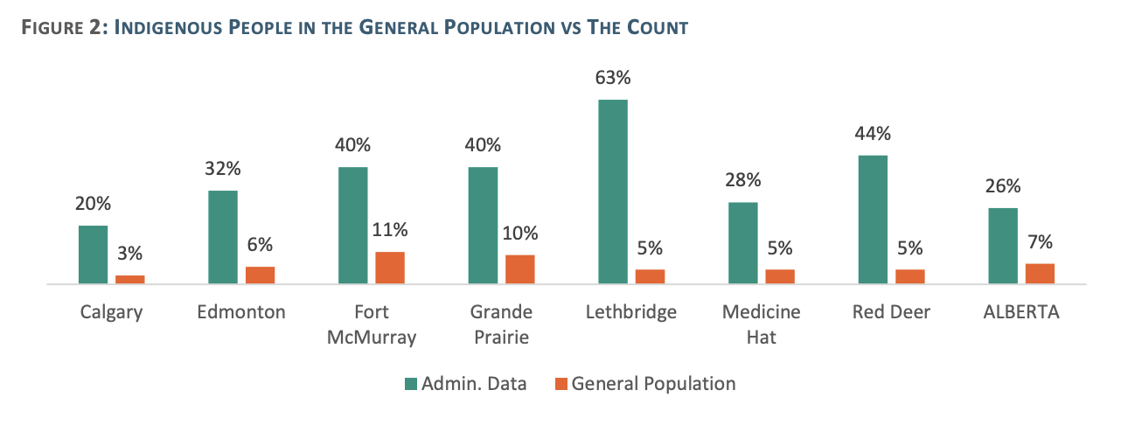
Homelessness in Alberta (cont’d)
Notes:
Source: https://docs.wixstatic.com/ugd/ff2744_5d899dceff12471c835fddf4e5d119fc.pdf

Slide 7
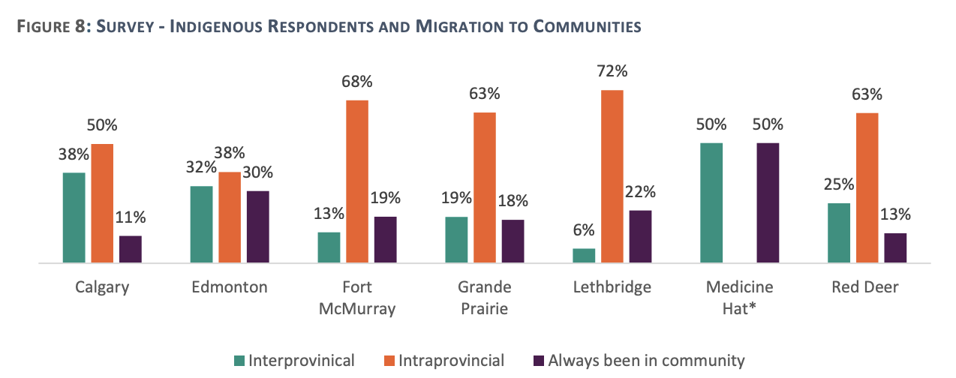
Homelessness in Alberta (cont’d)
Notes:
Source: https://docs.wixstatic.com/ugd/ff2744_5d899dceff12471c835fddf4e5d119fc.pdf
Notes: “Migration is defined as individuals who moved to their respective city in the past year” (p. 26).

Slide 8
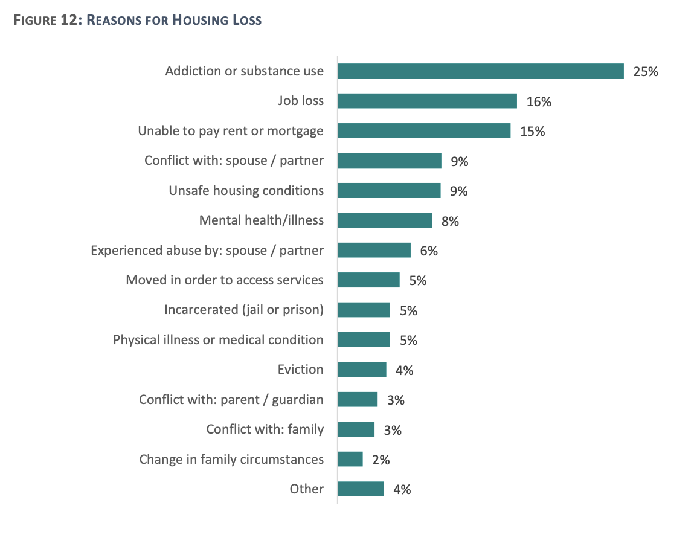
Homelessness in Alberta (cont’d)
Notes:
Source: https://docs.wixstatic.com/ugd/ff2744_5d899dceff12471c835fddf4e5d119fc.pdf

Slide 9
Homelessness in Alberta (cont’d)
All of this data I’ve just presented comes from the province-wide report written after the 2018 Point-in-Time Count.
The Calgary Homeless Foundation (CHF) led the Calgary part of that effort.
CHF has also advocated both across Alberta and Canada to make space for Indigenous respondents to identify by Nation.

Slide 10
Homelessness in Alberta (cont’d)
In 2018, CHF also provided financial support to Kainai Nation (Blood Tribe) so they could participate in the Alberta rural Point-in-Time Count (at the time, criteria to access federal funding excluded reserves).

Slide 11
Homelessness: Substance Use
A 2015 Winnipeg study asked what factors made a homeless person more likely to be a person who uses drugs (PWUD).
Answer:
Traumatic events, esp. residential school history.
Also, mental and physical health conditions.
Notes:
Source: DeBoer, T., Distasio, J., Isaak, C. A., Roos, L. E., Bolton, S. L., Medved, M., ... & Sareen, J. (2015). What are the predictors of volatile substance use in an urban community of adults who are homeless?. Canadian Journal of Community Mental Health, 34(2), 37-51.
Note: The focus of this particular study was inhalation/sniffing.

Slide 12
Homelessness: Substance Use (cont’d)
“In my twelve years of work as a physician in Vancouver’s
Downtown Eastside, I learned a lot from my patients. Many of them…were First Nations people…I saw that the sources of addiction do not originate in the substances people use but in the trauma they endured. In fact, the self-medications my patients employed were an understandable response to a set of unnatural circumstances, namely the historical trauma inflicted on First Nations throughout Canadian history, and up to the present.”
— Dr. Gabor Maté
Notes:
Source: http://www.fnha.ca/newsContent/Documents/FNHA_OverdoseDataAndFirstNationsInBC_PreliminaryFindings_FinalWeb_July2017.pdf

Slide 13
First Nations Health Authority
A recent First Nations Health Authority report out of BC identifies factors that lead to substance use. They include:
Racism
Intergenerational trauma (e.g., residential schools)
Reduced access to mental health and addiction treatment (which is often reported by members of FNs).
Notes:
Source: http://www.fnha.ca/newsContent/Documents/FNHA_OverdoseDataAndFirstNationsInBC_PreliminaryFindings_FinalWeb_July2017.pdf

Slide 14
Homelessness: Shelters
A 2014 study looked at the use of homeless shelters in Atlantic Canada (all 4 prov’s).
It found that shelters focus on providing shelter and that they do not have a strong mandate to fully support PWUDs.
Notes:
Source: Jackson, L. A., McWilliam, S., Martin, F., Dingwell, J., Dykeman, M., Gahagan, J., & Karabanow, J. (2014). Key challenges in providing services to people who use drugs: The perspectives of people working in emergency departments and shelters in Atlantic Canada. Drugs: education, prevention and policy, 21(3), 244-253.

Slide 15
Homeless shelters
A 2018 report found the following barriers in some homeless shelters in Canada:
1. Having to ask staff to access harm reduction supplies.
2. Shelters refusing services to ppl under the influence.
3. Rigid entry process (e.g., extensive paperwork, need
for multiple pieces of documentation).
Notes:
Source: http://outofthecoldhalifax.org/about_42_1447052977.pdf

Slide 16
Homeless shelters (cont’d)
A 2018 study by University of Victoria researchers found it’s very challenging for staff in homeless shelters to properly engage with PWUD, since on-site use of illicit substances is typically prohibited.
Staff give out supplies but forbid its on-site use.
Shelter washrooms can become “de facto unsupervised consumption sites.”
Notes:
Source: https://www.sciencedirect.com/science/article/abs/pii/S0955395917303675
Note: Quote is from p. 87.

Slide 17
Let’s talk a bit about
harm reduction.

Slide 18
Harm reduction
“Harm reduction is both a philosophy and a set of strategies that focuses on reducing the harms of substance use, not reducing consumption per se.”
— Pauly et al., 2013
Notes:
Source: https://www.homelesshub.ca/resource/housing-and-harm-reduction-what-role-harm-reduction-addressing-homelessness. Quote is taken from p. 2.

Slide 19
Harm reduction: A gateway
“Services such as needle exchange and supervised injection often reach those who are the most marginalized in society and are a gateway to other health, housing and social services including referrals to housing, income supports, detoxification, treatment and counselling services.”
— Pauly et al., 2013
Notes:
Source: https://www.homelesshub.ca/resource/housing-and-harm-reduction-what-role-harm-reduction-addressing-homelessness. Quote is taken from p. 4.

Slide 20
Harm reduction: The evidence
Needle distribution services reduce risk-taking behavior
Supervised consumption services prevent overdoses, reduce risk-taking behaviour, and increase referrals to other supports.
Opioid substitution therapy reduces crime and other harms; it also provides regular contact with healthcare services.
Safer inhalation kits reduce the risk of transmission of blood-borne diseases.
Notes:
Source: https://www.homelesshub.ca/resource/housing-and-harm-reduction-what-role-harm-reduction-addressing-homelessness
Notes: Thanks to Lorraine Barnaby for point re: regular contact with healthcare servies.

Slide 21
Supervised Consumption Services
Supervised Consumption Services are one form of harm reduction.
“Supervised consumption services (SCS) consist of providing a safe, hygienic environment in which people can use drugs with sterile equipment under the supervision of trained staff or volunteers.”
Notes:
Source: http://www.aidslaw.ca/site/overdue-for-a-change-full-report/?lang=en
Quote is from p. 2.

Slide 22
SCS in Alberta
During 2018 alone:
Calgary’s SCS site saw nearly 52,000 visits, resulting in more than 700 overdose reversals.
Lethbridge’s saw nearly 128,000 site visits, resulting in more than 1,300 overdose reversals.
Notes:
Source: https://open.alberta.ca/dataset/f4b74c38-88cb-41ed-aa6f-32db93c7c391/resource/be32cc97-4424-4933-b253-5fee0dd573bb/download/opioid-q4-infographic-2019-03-18.pdf

Slide 23
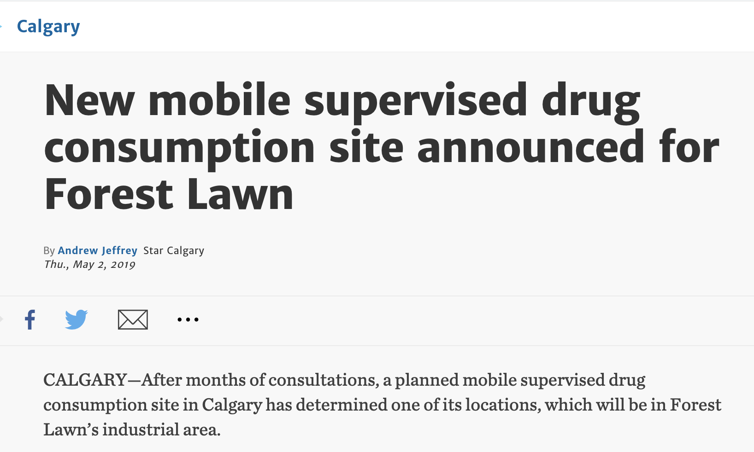
SCS in Alberta (cont’d)
Notes:
Source: https://www.thestar.com/calgary/2019/05/02/new-mobile-supervised-drug-consumption-site-announced-for-forest-lawn.html?utm_source=Facebook&utm_medium=SocialMedia&utm_campaign=1030pm&utm_campaign_id=AlbertaNews&utm_content=forestlawnsuperviseddrugconsumptionsite&fbclid=IwAR1VCu4etAOucZVHFbCIukd-sPPpDjJAeJjbyTjXDj0-Z0J-oexE-uFSc6Q

Slide 24
Supervised Consumption Services (cont’d)
“Today, more than 100 formal SCS exist in Australia, Denmark, Germany, Luxembourg, the Netherlands, Norway, Spain, France, Belgium and Switzerland, in addition to Canada.”
As of Feb 2019, 28 SCS were operating under an exemption from Canada’s federal government.
Notes:
Source: http://www.aidslaw.ca/site/overdue-for-a-change-full-report/?lang=en
Quote is from p. 2.

Slide 25
Let’s talk a bit about
Housing First.

Slide 26
Housing First
“Housing First focuses directly on housing people regardless of current patterns of substance use.”
— Pauly et al., 2013
Notes:
Source: https://www.homelesshub.ca/resource/housing-and-harm-reduction-what-role-harm-reduction-addressing-homelessness. Quote is taken from p. 1.

Slide 27
Housing First (cont’d)
“Harm reduction is a key principle of Housing First, where individuals are not required or expected to undergo treatment for substance use or to abstain in order to access and keep permanent housing.”
— Pauly et al., 2013
Notes:
Source: https://www.homelesshub.ca/resource/housing-and-harm-reduction-what-role-harm-reduction-addressing-homelessness. Quote is taken from p. 1.

Slide 28
Housing First (cont’d)
Housing First does not mean housing only.
Ergo: Other social supports are crucial to making Housing First work.
Such additional supports may include treatment and reduced substance use.
Notes:
Special thanks to Katelyn Lucas for emphasizing these points (personal communication, 3 May 2019).

Slide 29
Housing First: Canadian experience
Growing popularity
Effective
Cost effective
Effective narrative

Slide 30
Let’s talk a bit about a recent study done in Calgary.

Slide 31
Calgary Recovery Services Task Force
Task Force commissioned a research study, funded in part by the Calgary Homeless Foundation.
Researchers interviewed 300 persons experiencing homelessness in Calgary—specifically, persons who had experienced at least 6 consecutive months of absolute homelessness.
Study completed in 2016.
Notes:
Source: http://calgarychh.ca/wp-content/uploads/2018/09/Calgary_Recovery_Services_Task_Force_Report.pdf

Slide 32
Calgary Recovery Services Task Force (cont’d)
Nearly one-third of participants identified as Indigenous (First Nations, Inuit, or Metis).
Of those identifying as Indigenous, 20% had attended a residential school, while another 63% had family members who had attended a residential school
Notes:
Source: http://calgarychh.ca/wp-content/uploads/2018/09/Calgary_Recovery_Services_Task_Force_Report.pdf

Slide 33
Calgary Recovery Services Task Force (cont’d)
Nearly three-quarters of Indigenous participants reported having lived in foster care or been removed from their family as children.
Notes:
Source: http://calgarychh.ca/wp-content/uploads/2018/09/Calgary_Recovery_Services_Task_Force_Report.pdf

Slide 34
Calgary Recovery Services Task Force (cont’d)
ACE Study questions were used to assess the childhood experiences of research participants.
These questions produce an overall ACE score that assesses cumulative childhood stress.
Notes:
Source: http://calgarychh.ca/wp-content/uploads/2018/09/Calgary_Recovery_Services_Task_Force_Report.pdf

Slide 35
Calgary Recovery Services Task Force (cont’d)
Average ACE scores A score of 4 is considered high (i.e. high stress)
Group | Score
Study | 4.43
Men | 4.21
Women | 5.02
Indigenous | 6.07
Men | 5.88
Women | 6.38

Slide 36
Calgary Recovery Services Task Force (cont’d)
Nearly 1 in 4 respondents felt they needed detox services and had not received them, or had not received enough support from the detox services they accessed.
1 in 5 participants said they needed residential treatment services and had not received them, or had not received enough support from the residential treatment services they had accessed.
Notes:
Source: http://calgarychh.ca/wp-content/uploads/2018/09/Calgary_Recovery_Services_Task_Force_Report.pdf

Slide 37
Calgary Recovery Services Task Force (cont’d)
For services such as hospital, residential treatment services, and outpatient services, long wait lists were a frequent reason given for not received adequate care.
Notes:
Source: http://calgarychh.ca/wp-content/uploads/2018/09/Calgary_Recovery_Services_Task_Force_Report.pdf

Slide 38
Calgary Recovery Services Task Force (cont’d)
About half of participants said they felt housing services in Calgary were difficult or very difficult to access.
Notes:
Source: http://calgarychh.ca/wp-content/uploads/2018/09/Calgary_Recovery_Services_Task_Force_Report.pdf

Slide 39
Name change
The Calgary Recovery Services Task Force now calls itself the Collaborative for Health and Home.
They have a website: http://calgarychh.ca/
Contact:
Quentin Sinclair <quentins@calgaryhomeless.com>

Slide 40
Recent developments
In 2018, the Calgary Homeless Foundation (CHF) supported the Tsuutʼina Nation in their request for funding so they could upgrade their men’s shelter facility.
When CHF recently received a private gift for research, it prioritized Indigenous peoples. CHF is currently engaging through ceremony and protocol with Treaty 7 Nations to understand the on-reserve needs and the flow of people and impact on Indigenous homelessness in Calgary.

Slide 41
Recent developments (cont’d)
Initial work of bringing together a team of experts including an Indigenous researcher to engage in work was led by myself and is currently unfolding.

Slide 42
Summary
Racism and trauma (including intergenerational trauma) have a major impact on substance use.
Harm reduction and Housing First are important principles in responding to the overdose crisis.
Access to services remains a major challenge, especially for persons experiencing homelessness.

Slide 43
Acknowledgements
Lorraine Barnaby
Shannon Beavis
Leslie Hill
Diana Krecsy
Bren Little Light
Katelyn Lucas
Adam Melnyk
Katrina Milaney
Bernie Pauly
Steven Richardson
Chris Sarin
Quentin Sinclair
Lorie Steer

Slide 44
Thank You
Nick Falvo
Cell: 587-892-7855
Email: falvo.nicholas@gmail.com

