Slide 1





Decent Work and the Labour Crunch: Attracting and Retaining Great Employees
With Devinder Chaudhary, Dr. Anna Barford,
and Ken Tigchelaar
A Vibrant Communities and New Economy Roundtable Webinar
Notes:
Share this slide as people are entering the webinar

Slide 2
Technical Considerations
Camera and microphone – Please keep your line muted when not speaking. To create an interactive environment with speakers, we do encourage you to turn your camera on.
Join the conversation – Use the chat panel to ask your questions for presenters and to ask for technical support.
We’ve got you covered – You will receive a full recording of the call, the slides as well as a collection of links & resources.
We didn’t hear back from the community after we left

Slide 3
Land Acknowledgement
We acknowledge that we are meeting today on Indigenous land. As settlers, we recognize the contributions and historic importance of Indigenous peoples and affirm our collective commitment to make the promise and challenge of Truth and Reconciliation real in our communities.

Slide 4

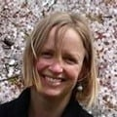
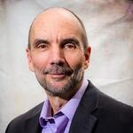
Today’s Speakers
Devinder Chaudhary Aiāna Restaurant Collective
Dr. Anna Barford Cambridge Institute for Sustainability Leadership
Ken Tigchelaar
New Economy Roundtable

Slide 5




Resources
REPORT | The Case for Living Wages
FACTSHEET | Business for Inclusive Growth: What’s the B.I.G. Idea?
FACTSHEET | Doing Better by Being Better

Slide 6


Resources
BOOK | 10 – A Guide for Businesses Reducing Poverty
PUBLICATION | Ending Working Poverty In Canada: How to Get it Done
PUBLICATION | The End of Poverty: Eight Pathways That Are Ending Poverty in Canada

Slide 7

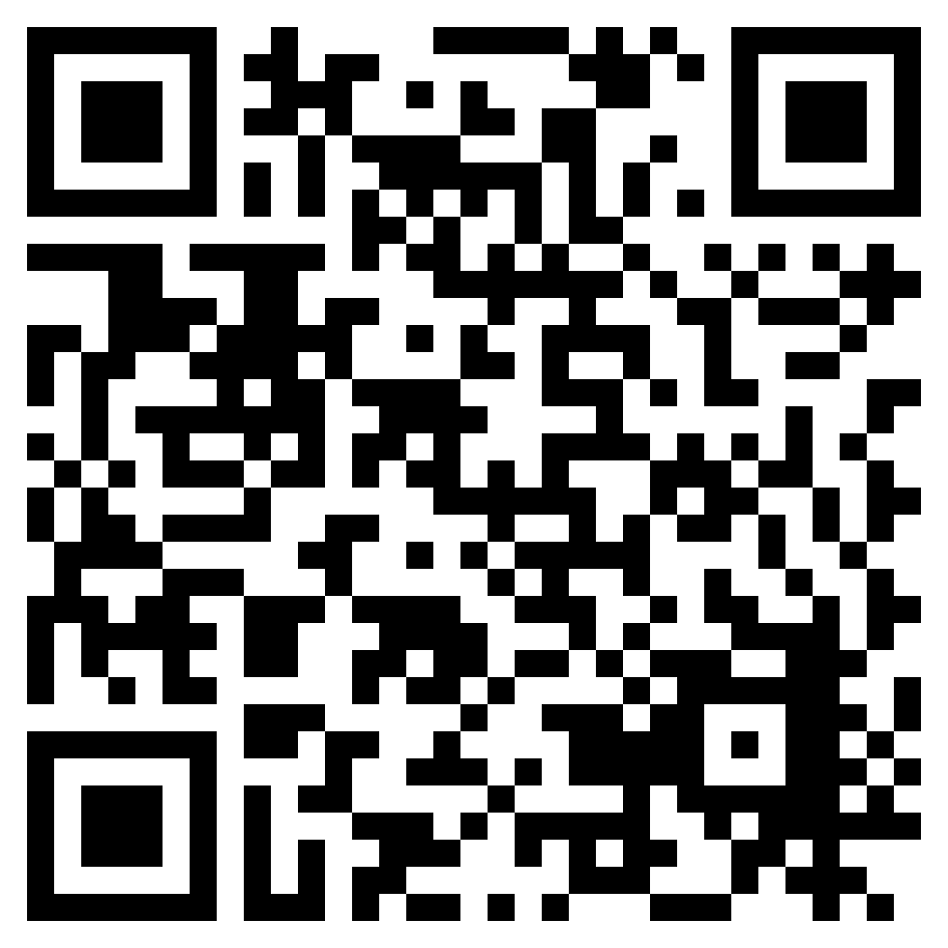
The New Economy Roundtable (NERT) is a network of public, private and non-profit organizations working together to increase decent work and create a more inclusive economy in Ontario.
Hosted by the Canadian Poverty Institute, the group represents business, non-profits, and academia. NERT builds and shares knowledge, influences public policy and discourse, and catalyzes collaboration.
We meet every second month over Zoom.
Interested in joining, or want more information?
Contact povertyinstitute@ambrose.edu or visit our website:
https://www.povertyinstitute.ca/new-economy-roundtable

Slide 8
Thank you!
Please send your questions, comments and feedback to alison@tamarackcommunity.ca

