Slide 1
A Tamarack Workshop
Imagination and Design
With Cameron Norman and Liz Weaver

Slide 2
Gratitude & Acknowledgement
We begin this workshop by acknowledging that we are meeting on Indigenous land. As settlers, we are grateful for the opportunity to meet, and we thank all the generations of Indigenous peoples who have taken care of this land.
As settlers, this recognition of the contributions and historic importance of Indigenous peoples must be clearly and overtly connected to our collective commitment to make the promise and the challenge of Truth and Reconciliation real in our communities.
Please share in the chat box your name and location.
We didn’t hear back from the community after we left

Slide 3
Technical Considerations
We’ve got you covered - You will receive a full recording of the call, the slides as well as a collection of links & resources.
Join the conversation - Use the Q&A panel on your Zoom client to submit and vote for questions you’d like us to discuss.
Technical Support - You can use the chat panel to ask for technical support throughout the webinar.
We didn’t hear back from the community after we left

Slide 4
We didn’t hear back from the community after we left
Cameron Norman
Liz Weaver

Slide 5
Poll: There are 8 Imagination types. Which type do you use most often?
Effectuate Imagination – combining ideas together to synergize concepts
Intellectual Imagination – developing a hypothesis or pondering ideas
Imaginative Fantasy Imagination – create and develop stories, pictures, poems, etc.
Empathy Imagination – weaving in the emotions of others
Strategic Imagination – evaluating opportunities through mental scenarios
Emotional Imagination – manifesting emotional dispositions and scenarios
Dreams – unconscious form of imagination made up of ideas, images, emotions and sensations
Memory Reconstruction – retrieving memories of people, objects and events
Source: https://www.teachthought.com/learning/types-of-imagination/

Slide 6
Imagination and Design
What is the role of imagination in the process of design?
We didn’t hear back from the community after we left

Slide 7
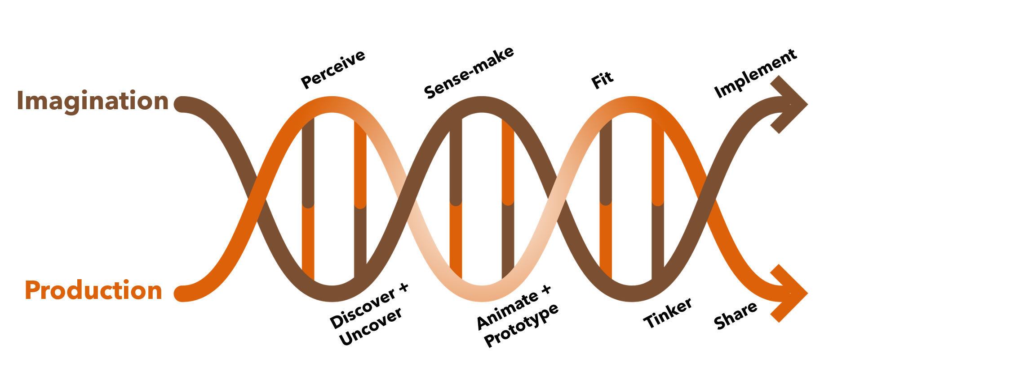

Slide 9
Imagination and Creativity
How does imagination and creativity go together? Why is this of importance to those looking to create change?

Slide 10
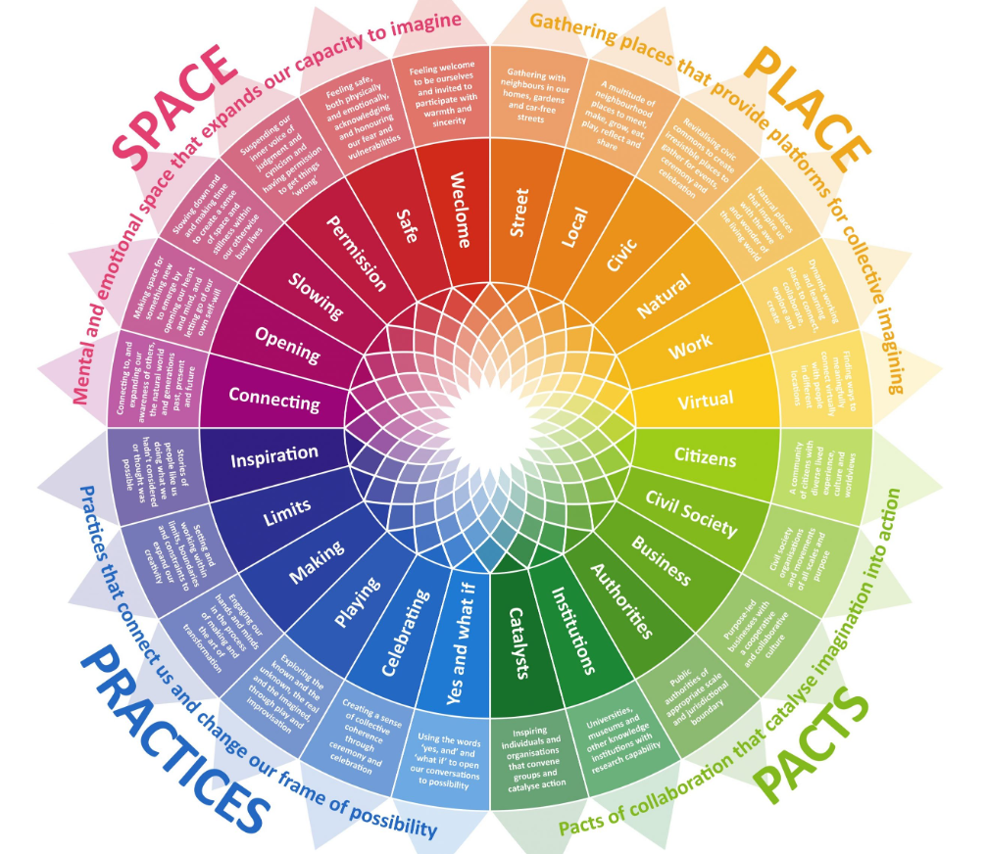
The Imagination Sundial
How can the sundial help us to design better and use our imaginations more fully?
Source: Peter Fisk – The Imagination Sundial

Slide 11
Leveraging Imagination
What can individuals and organizations do to leverage the power of imagination in their work?
We didn’t hear back from the community after we left

Slide 12
Futures and Foresight
What is futures and foresight and how does this fit with design?

Slide 13
The Webinar Series
Imagination and Design – December 7, 2021
Design Production and Solutions – January 12, 2022
Design: Application and Lessons Learned – February 2, 2022
Sign up for the webinar series.
We didn’t hear back from the community after we left

Slide 14
Poll: There are 8 Imagination types. Which type of Imagination would you like to explore further?
Effectuate Imagination – combining ideas together to synergize concepts
Intellectual Imagination – developing a hypothesis or pondering ideas
Imaginative Fantasy Imagination – create and develop stories, pictures, poems, etc.
Empathy Imagination – weaving in the emotions of others
Strategic Imagination – evaluating opportunities through mental scenarios
Emotional Imagination – manifesting emotional dispositions and scenarios
Dreams – unconscious form of imagination made up of ideas, images, emotions and sensations
Memory Reconstruction – retrieving memories of people, objects and events
Source: https://www.teachthought.com/learning/types-of-imagination/

Slide 16
Build your skillset through Tamarack’s Foundation Online Learning Courses
We didn’t hear back from the community after we left
Courses are available in French and English
To learn more visit: https://www.tamarackcommunity.ca/online-courses

