Slide 1
Emergency Preparedness & Social Capital
Adam Conway

Slide 2
After a disaster
MOST SEARCHAND RESCUE IS DONE BY UNTRAINED CITIZENS

Slide 3
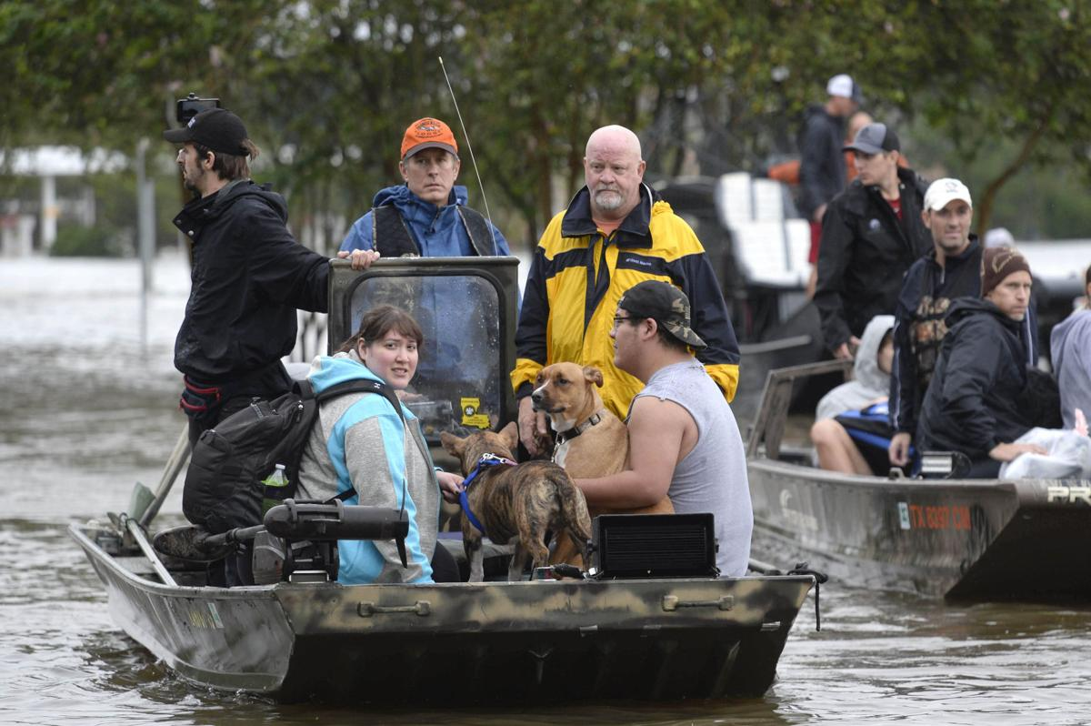
THE CAJUN NAVY HURRICANE HARVEY

Slide 4
After a disaster
MOST MEDEVAC IS DONE BY UNTRAINED CITIZENS

Slide 5
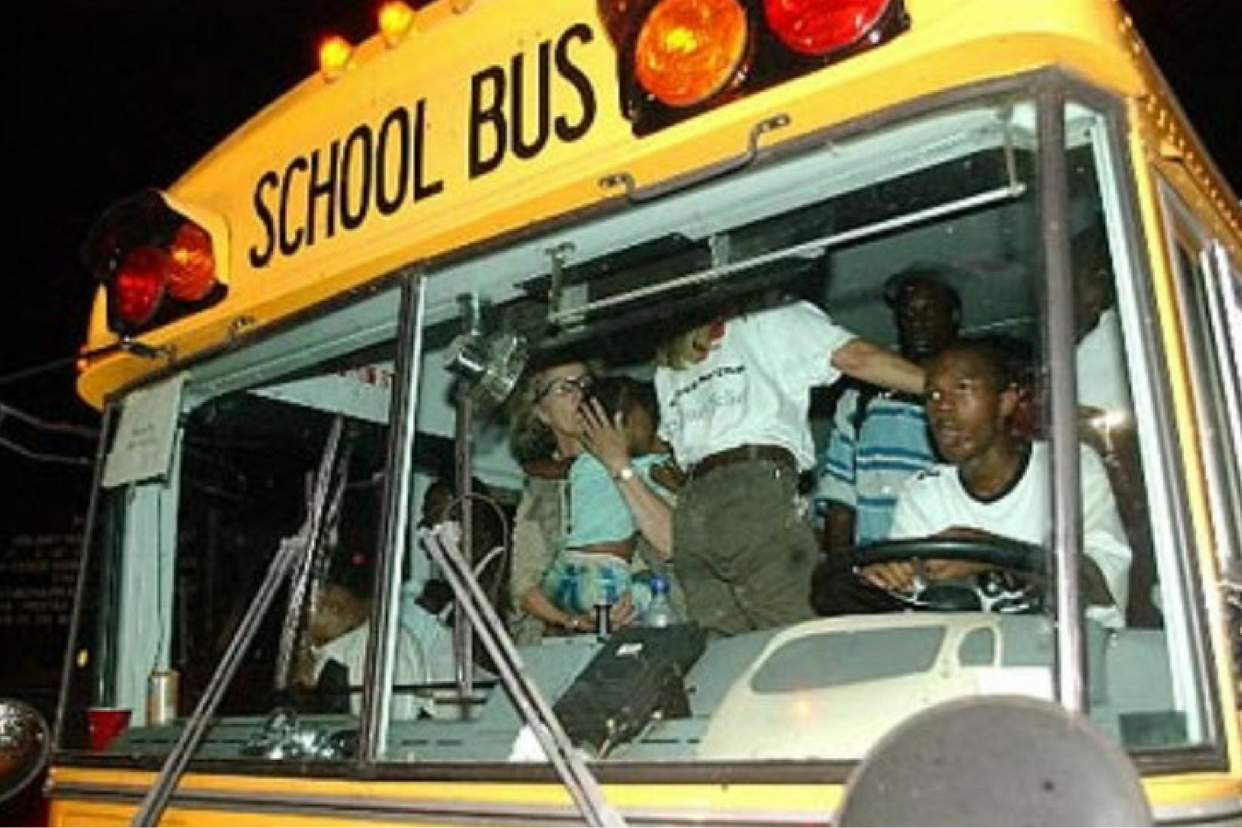
JABBAR GIBSON AND HIS BUS HURRICANE KATRINA

Slide 6
After a disaster
MOST FIRST AID IS DONE BY CITIZENS

Slide 7
MUSKETEER

Slide 8
After a disaster
GAS SHUT OFFS

Slide 9
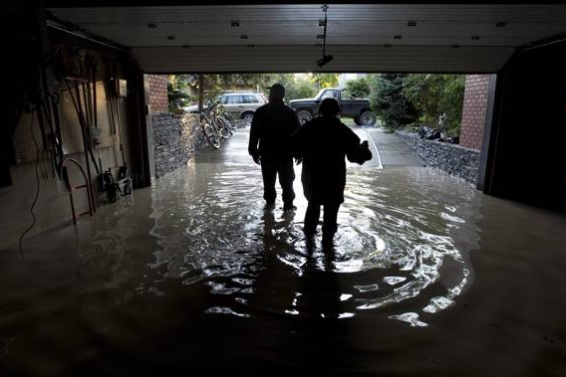
CALGARY CLEAN UP VOLUNTEERS 2013 FLOODS

Slide 10
After a disaster
UNTRAINED CITIZENS ARE ESSENTIAL FOR NAVIGATION

Slide 11
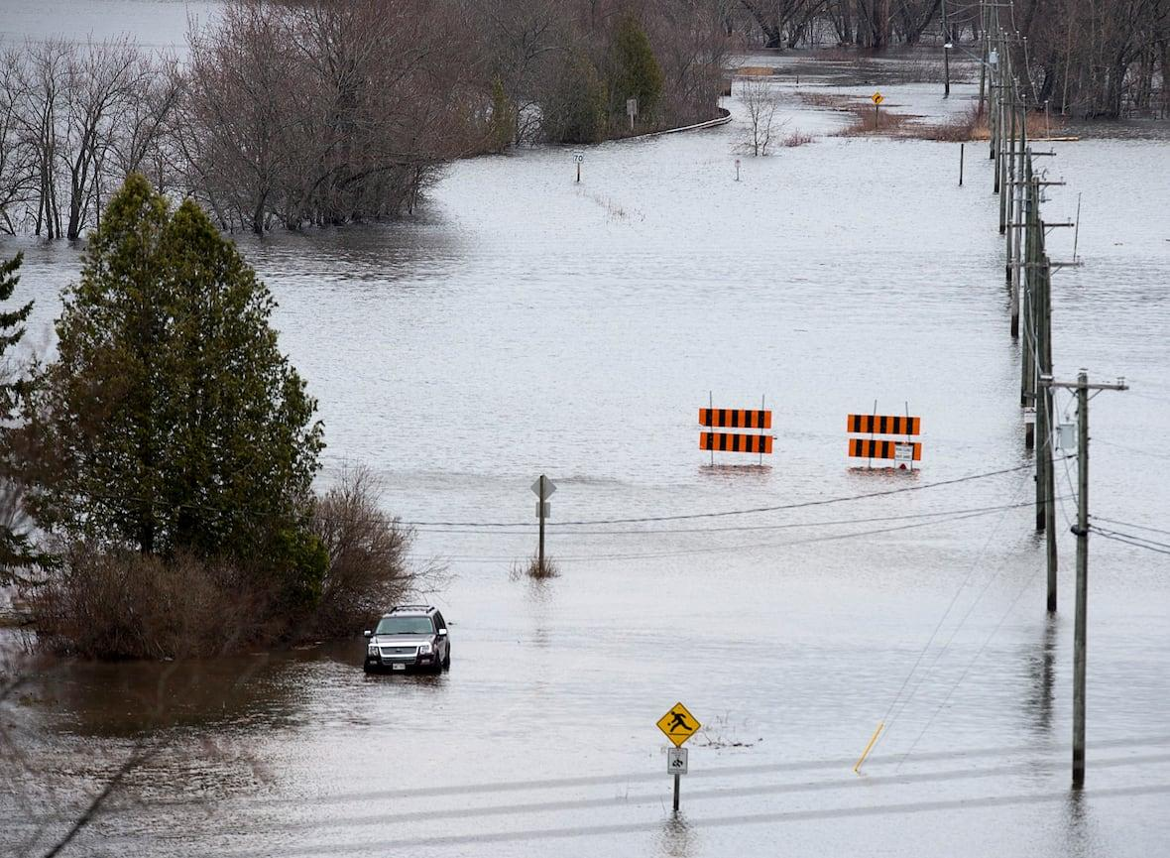
WHERE’S THE ROAD? NEW BRUNSWICK FLOODING

Slide 12
After a disaster
UNTRAINED CITIZENS ARE ESSENTIAL FOR LOCATING VULNERABLE POPULATIONS

Slide 13
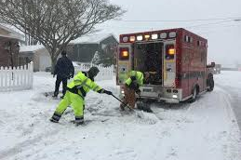
SHOVEL BRIGADE NEW BRUNSWICK FLOODING

Slide 14
After Hurricane Katrina and Pine Lake and Fort McMurray and and ...
SURVIVAL WAS DETERMINED BY THE EXISTENCE OF SOCIAL SUPPORTS

Slide 15
The Thorhild Project
First Aid
Search
Rescue
Damage Assessment
Risk Assessment
Disaster Social Services
Food
Lodging
Reunification

