Slide 1
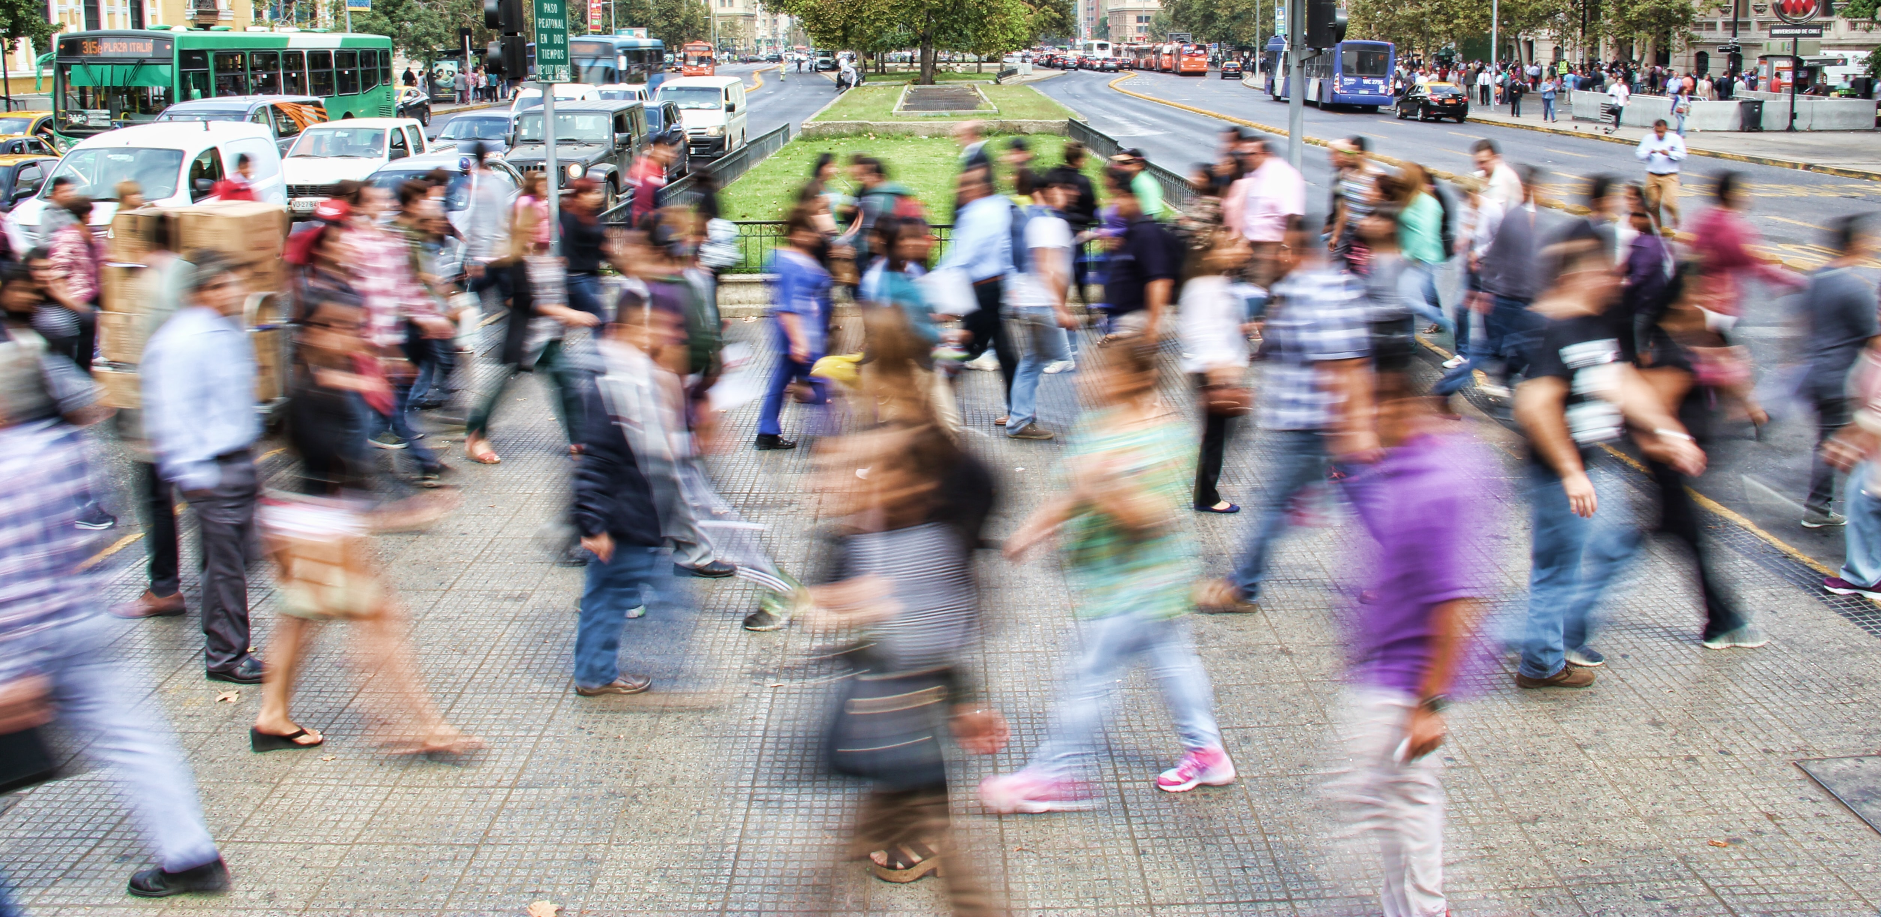
Building Equitable Economies
A Participatory Grantmaking Pilot
Launching meeting – Peel community
October 28, 2021 – 2:00 – 3:00 pm

Slide 2
Gratitude & Acknowledgement
We begin this session by acknowledging that we are meeting on Indigenous land. As settlers, we are grateful for the opportunity to meet and we thank all the generations of Indigenous peoples who have taken care of this land.
As settlers, this recognition of the contributions and historic importance of Indigenous peoples must be clearly and overtly connected to our collective commitment to make the promise and the challenge of Truth and Reconciliation real in our communities.
We didn’t hear back from the community after we left

Slide 3
Agenda
Announcement and Congratulations to the Peel community!
Introduction: WES Mariam Assefa Fund, Tamarack and Peel Newcomer Strategy Group
Information about the Participatory Grantmaking project and the People’s Panel
Questions & Answers
Seeking your Advice on the Community’s Priorities and the People’s Team
Thank you for your Engagement !
Reimaging Collaboration
November 18, 2020
1:00 – 2:15 pm ET
Reinventing Engagement
December 2, 2020
1:00 – 2:15 pm ET
Notes:
Present background information about the Participatory Grantmaking Pilot
Explain how participatory grantmaking can help community members directly impact funding decisions that concern their community
Seek your advice about the recruitment process of community representatives for the co-design and grantmaking panels.
Provide you with information about how community representatives might express interest to take part in this innovative funding model.

Slide 4
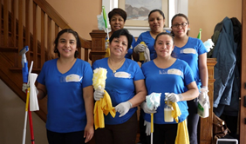
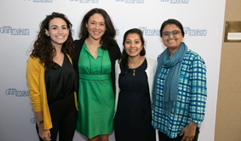
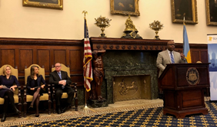
WES Mariam Assefa Fund
Our north star is an economy and society where immigrants and refugees thrive and can achieve their aspirations.
1) Catalyze solutions that advance equitable economic mobility for immigrants and refugees
2) Accelerate the uptake of worker-centered innovations and practices
3) Deepen the bench of leaders from immigrant communities and communities of color
4) Grow the movement to foster welcoming, inclusive, and equitable workplaces, communities, and society

Slide 5
Why participatory grantmaking project?
Inform the Fund’s Evolving Approach
Shift Power to Communities
Build a Movement with Other Funders
What approaches can the Fund start using in its ongoing grantmaking work?
What would be required for the Fund to more fully move to participatory grantmaking?
What creates an enabling environment for this type of work?
What approaches can truly shift power to communities, and what approaches might be extractive?
What are the key prerequisites for effective community participation?
How is the community’s view of its needs and priorities different from the Fund’s initial view?
How can the Fund encourage other funders to move to participatory grantmaking using this experience?
What lessons learnt by the Fund can be useful for other funders as they move towards more community participation?

Slide 6
In Vibrant Communities, we support cities and local leaders to implement large-scale change initiatives to reduce poverty, deepen community, build youth futures and support a just and equitable climate transition.

Slide 9
What is Participatory Grantmaking?
Participatory Grantmaking opens up the grantmaking process to shift power, control, and voice to communities.
This process privileges the experience and needs of the community
How can it help community members directly impact decisions that concern their community?
By giving agency to people from the community to define the strategy and criteria behind funding decisions
By ceding decision-making power about funding from foundation staff to the very communities that funders aim to serve
By supporting community members to build capacity
Adapted from Grantcraft: Deciding Together: Shifting Power and Resources through Participatory Grantmaking
Reimaging Collaboration
November 18, 2020
1:00 – 2:15 pm ET
Reinventing Engagement
December 2, 2020
1:00 – 2:15 pm ET

Slide 10
Key Milestones of the Participatory Grantmaking Project
Connect with potential Ontario communities and seek their input (e.g., on criteria for selection) through a community information session
Receive letters of interest from communities (criteria: population make-up, community readiness, assets and opportunities, recognized needs)
Identify the geographic community for the participatory pilot and key partners
Recruit key community representatives for the People’s Panel to identify the needs of immigrants and refugees in the Peel community and funding priorities & process for this pilot
Engage community representatives to help make funding decisions
Disburse the grants to selected organizations
Provide supports to funded projects
Share learnings and insights on participatory grantmaking to help advance this form of grantmaking
Reimaging Collaboration
November 18, 2020
1:00 – 2:15 pm ET
Reinventing Engagement
December 2, 2020
1:00 – 2:15 pm ET

Slide 11
Building Equitable Economies - The Participatory Grantmaking Pilot
Initial Timelines
August 2021 – Community Engagement Session
September- October 2021 – Community Identified & Launch
November 2021 – Recruitment for the People’s Panel
November 2021 – January 2022 – Identify Grantmaking Priorities and Process
February – March 2022 – Invite PGP proposals
March-April 2022 – Funding provided to Community groups
April 2022 – March 2023 – Community Engagement, Support and Learning
Reimaging Collaboration
November 18, 2020
1:00 – 2:15 pm ET
Reinventing Engagement
December 2, 2020
1:00 – 2:15 pm ET

Slide 12
People’s Panel
Main Responsibilities:
Define the Community’s needs and priorities for this project
Determine the application process (e.g., funding streams, criteria, amount…)
Make decisions about funded projects/organizations with available funds (up to 600k)
Contribute to evaluation & learning of the project
Engagement:
Work collaboratively with all members of the People’s Panel and Tamarack
Respect the values/principles defined by the group
Contribute to the process in the best interest of the Peel community
Conflict of interests :
If this situation arises, it should be declared by members of the panel before engaging in the grantmaking part of the process
Notes:
Commitment
Engagement
Compensation
Conflict of interest
Selection process
Deadline for letters of interest
Email to those not selected regarding potential other ways to contribute and thanking them for their interest – possible recognition for submitting letter of interest
Session 1: Introduction to the panel, meet each other, review community data, early ideation o Session 2: Deeper discussion about community priorities and beginning to narrow priorities o Session 3: Final selection of priorities and advice on funding allocation
Identify the community funding priorities · Determine funding allocations if multiple funding lines – multi-year, innovation, collaborative, etc

Slide 13
People’s Panel
Panel’s composition
10 members (seeking a balance: 5 individuals, 5 organizations)
Aim to represent a diversity of experiences in the Peel community in terms of:
Geography
Ethnicity & cultural background
Gender & identity
Age
Lived experience of being immigrant, refugee and/or racialized
Working in the immigrant-serving sector/other sectors of activity
Commitment :
Attend 4 virtual planning and design meetings (2h each meeting for 4 consecutive weeks)
Proposed dates and times:
Nov. 25, Dec. 2, Dec. 9, Dec. 16, 2021
4:30-6:30 pm
Attend 2 grantmaking meetings
March-April 2022 (TBD)
Compensation:
Members of the People’s Panel will receive compensation (GTA living wage rate)

Slide 14
Next Steps – recruitment process for the People’s Panel
Community members are invited to express their interest by:
Filling in a simple application form
Explaining shortly why they should be selected for the People’s Panel and what experiences/expertise they bring to this work (250-500 words)
Applications should be sent to Myriam@tamarackcommunity.ca by 5 pm on November 15, 2021. Please reach out to Myriam if you need support with the application process.
All applicants will be notified of the decision by Nov. 19, 2021
Reimaging Collaboration
November 18, 2020
1:00 – 2:15 pm ET
Reinventing Engagement
December 2, 2020
1:00 – 2:15 pm ET
Notes:
We encourage immigrant-serving organizations to reach out to their clients and staff to let them know of this opportunity

Slide 15
Questions & Answers | Seeking your advice
From your knowledge of Peel region’s needs:
What are the most pressing priorities to support immigrants’ economic mobility?
Who should be proactively invited to apply to the People’s Panel?
What criteria are most important for selection?
We didn’t hear back from the community after we left
Notes:
What are the most pressing priorities to support immigrants’ economic mobility?
Who should be proactively invited to apply to the People’s Panel
What criteria are most important for selection?

Slide 16
Thank You
We didn’t hear back from the community after we left

Slide 17
tamarackcommunity.ca
Building a connected force for community change.
Online Learning Communities
Communities of Practice
Monthly online seminars
A monthly online journal – Engage! magazine
Face to face learning events
To learn more email: learnmore@tamarackcommunity.ca

