Slide 1
Employer Practices – Community of Practice
Series 2: Future Proofing Your Organization
Session 3: Telling your impact story

Slide 2
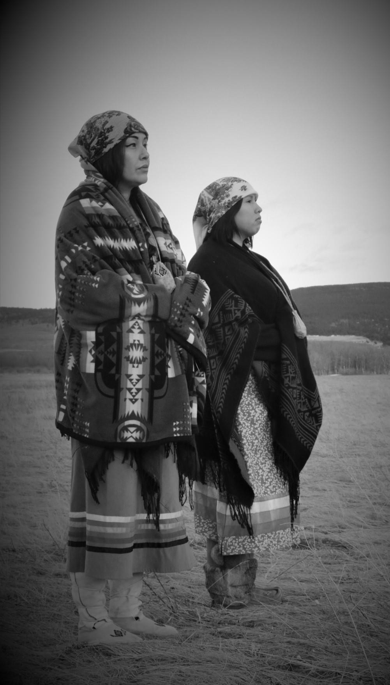
Gratitude and Commitment
By Chataya Holy Singer
By Rutendo Sanganza
By Jeena Leigh Hill

Slide 3
In Vibrant Communities, we support cities and local leaders to implement large-scale change initiatives to reduce poverty, deepen community, build youth futures and address climate transitions.

Slide 4
Workforce Transitions - Employer Practices Community of Practice
Session 1: How to Navigate your theory of change in a shifting employment space October 4, 2023
1:00 – 2:00 pm EST
Session 2: Evaluating Your Impact
October 25, 2023
1:00 – 2:00 pm EST
Session 3:Telling Your Impact Story
April 27, 2023
Register Here for Individual Community of Practice Calls or the Whole Series

Slide 5
Session 3: What does your organization do to tell your impact story?
Getting to Know Each Other
Introduce yourself
Introduce your organization

Slide 6
Session 3: Telling your impact story
Agenda for Today
Welcome, Land Acknowledgement and Setting the Context for the Session – 10 Minutes
Setting the context: Telling your impact story.
Crystal Kalaitzakis, The Momentum Centre – 15 Minutes
Question and Conversations – 30 minutes
Next Session in the Series – Thank you and evaluation – 5 minutes

Slide 7
Community of Practice
A community of practice (CoP) is a group of people who share a common concern, a set of problems, or an interest in a topic and who come together to fulfill both individual and group goals.
Communities of practice often focus on sharing best practices and creating new knowledge to advance a domain of professional practice. Interaction on an ongoing basis is an important part of this.
The Employer Practices - Community of Practice will be a web-based collaborative environment to communicate, connect and conduct community activities.

Slide 8
Workforce Transitions - Employer Practices Community of Practice
Session 1: How to Navigate your theory of change in a shifting employment space October 4, 2023
1:00 – 2:00 pm EST
Session 2: Evaluating Your Impact
October 25, 2023
1:00 – 2:00 pm EST
Session 3:Telling Your Impact Story
November 15, 2023
1:00 – 2:00 pm EST
Register Here for Individual Community of Practice Calls or the Whole Series

Slide 9
Employer Practices - Co-Design Team
The Employer Practices Community of Practice Co-Design Team
Bassel Ramli – Jump Start Refugee
Crystal Kalaitzakis – The Momentum Centre
Tom Strong - The National Fund for Workforce Solutions
Carolyn Yang -TechEquity Collaborative
Rochelle T. Cooks – The Welcoming Center
Kannyka Pouk – Centre for South-East Asians
Abdulla Daoud – The Refugee Centre

Slide 10
Crystal Kalaitzakis
The Momentum Centre
Session 3: Telling your impact story

Slide 11
Session 3: Telling your impact story
Crystal Kalaitzakis
The Momentum Centre
Crystal Kalaitzakis leads IntegrateIT and IntegratED with The Momentum Centre. As a social impact entrepreneur, she has extensive experience in the technology, business and workforce development space, having held many progressive leadership roles within the public, private and not-for-profit sectors. She spent twelve years as a director with the Government of Manitoba overseeing policy and program development for the Canada-Manitoba Labour Market Development Agreements. Prior to this she spent twelve years as an Internet pioneer, advancing ICT adoption and workforce development among rural and Indigenous communities in Canada. A serial collaborator, Crystal enjoys working with a variety of stakeholder groups crafting innovative solutions to complex social challenges.

Slide 13
Humans love a narrative...
Source: https://speakingthatconnects.com/whats-your-story/

Slide 14
Visual Storytelling
65% of people are visual learners
Process visuals 60,000 x faster than text
Retain visual info better than text and for longer
Source: Classification of Visual and Non-visual Learners Using Electroencephalographic Alpha and Gamma Activities

Slide 15
Source: Maxime Hupe Post | LinkedIn

Slide 16
Why are Infographics So Effective?
Capture the audience’s attention
Distill complex information
Improve learning & understanding
Leave an impression

Slide 17
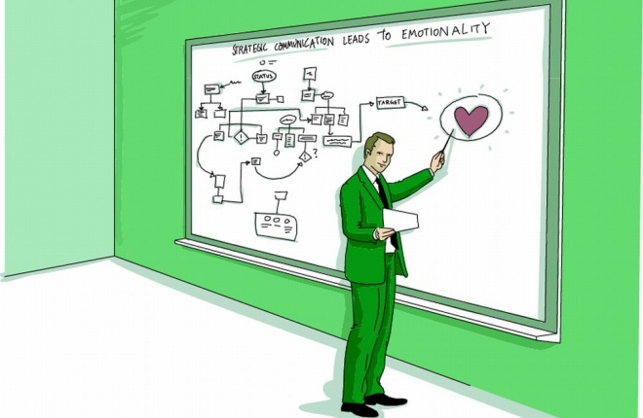
Boundary Spanning Tools
They can be used for:
Monitoring
Evaluation
Learning
Across a variety of mediums:
Monthly, Quarterly & Annual Reporting
Newsletters & Stakeholder Updates
Workshops & Presentations
Websites & Social Media

Slide 18
How to Create Infographics that Tell Compelling Stories
A fascinating narrative is the cornerstone of a great storytelling infographic:
Think about your intended audience
What’s the point you’re trying to get across
Emphasize the problem you’re trying to resolve or challenge to overcome
Include milestones, triumphs or journey to getting there
Review templates for inspiration
Formulate your ideas around the preferred options

Slide 19
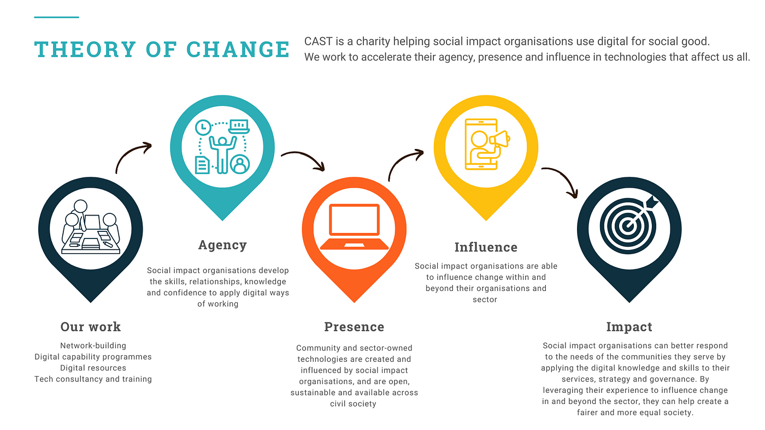
Story Telling and the Theory of Change
Theory of Change is a tool to help describe:
The need
The change, and
The plan to do it
We all have great stories to tell!

Slide 20
Elements of a Great Story
Follows a distinct path or storyline
A title and short introduction
Good flow and cohesion
Plotline or journey map
Pull your data and create a wireframe
Build your story around that, fill in the blanks
Create the connection and logical flow
A satisfying conclusion (where applicable)
Call to action (where applicable)

Slide 21
Bringing it all Together
Story
Data
Impact
Relatable to evoke empathy & connection
Establishes credibility & depth
Choose data that strengthens your story & emphasizes your impact

Slide 22
Makings of a Great Infographic
The layout should be visually cohesive
Follows a distinct path or storyline
Combine text, graphics, pictures & icons
Work with suitable and available templates
Notes:
The layout should be visually cohesive (a bunch of graphics and data is not necessarily unified)
As mentioned previously, it should follow a distinct path, storyline or theme
Use a Combination of Text, Graphics, Pictures and Icons
Work within the available templates. I like to review my datasets and then browse available templates to see what resonates. It’s a creative endeavor, not a perfect science. I find it to be quite iterative.

Slide 23
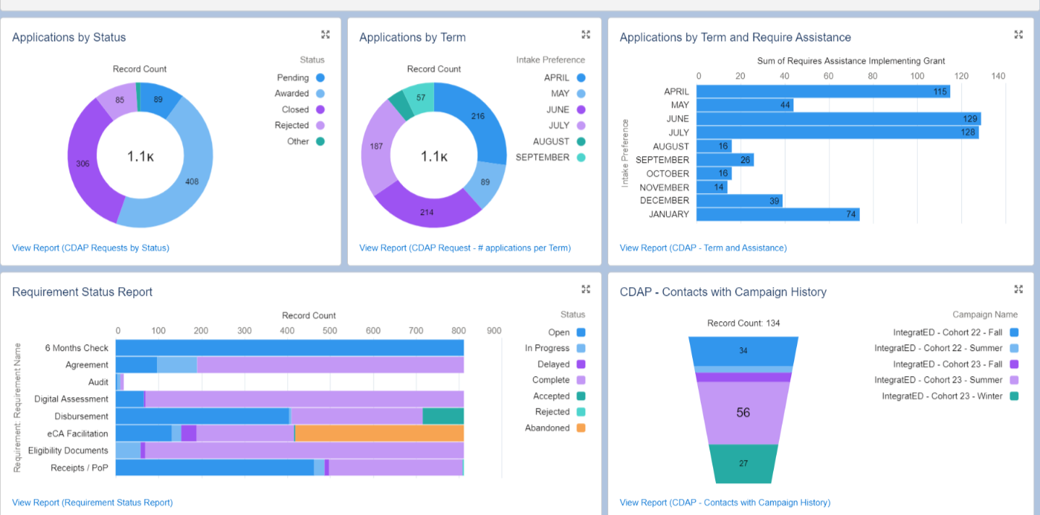
Examples of a Dashboard
Purpose: Internal
Monitoring Dashboard
A lot of data, no story

Slide 24
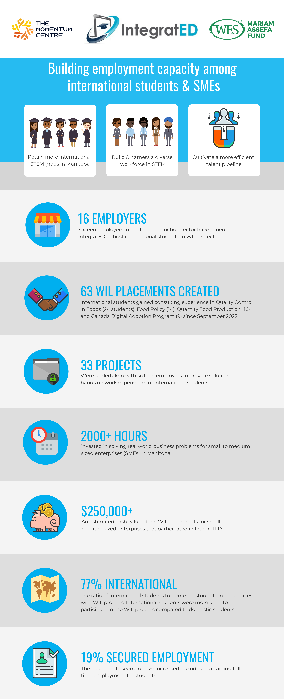
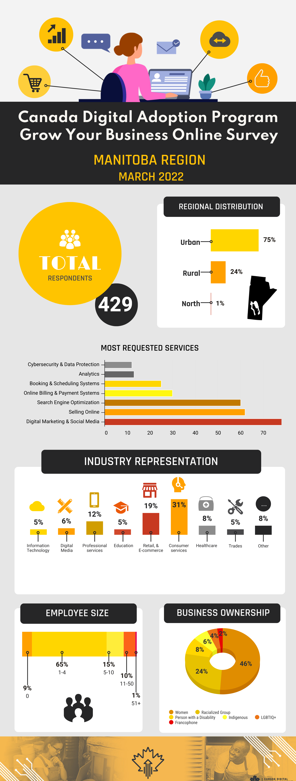
Examples of Dashboard Infographics
Purpose: Brief stakeholder update

Slide 25
Recommended Tools & Resources
Other Instructional Tools - Center for Teaching & Learning Design | Stockton University

Slide 26
Best in Show
Great for newsletters, reports, infographics. Easy to use and collaborate. Free for non-profits!!
Best for infographics, non-profit discount, easy to use and collaborate
Incorporates AI functionality, great for those wanting custom designs and quick outputs

Slide 27
You can tell a great story using infographics mixing:
Visuals
Data
Information
Design

Slide 28
Discussion

Slide 29
THANK YOU!

