Slide 1
The ART of Hope
Healing the wounded city
Notes:
Good afternoon and thank you for joining us today. I’m speaking to you today from Treaty 7, the traditional territory of the Blackfoot Confederacy and Metis Nation of Alberta Region 3.
I would like to share with you the ideas that have been formed by my life and work over the years as I have grappled with this question of poverty personally, professionally, intellectually and spiritually.
It is common for people to consider ending poverty a hopeless and utopian task. After all, it is said that the poor will be with us always.
What I hope to do is present an alternative way of thinking about poverty that can break us out of the cycle of poverty we seem to be stuck in and challenge our acceptance of its inevitability.

Slide 2
We can't solve problems by using the same kind of thinking we used when we created them.
- Albert Einstein
Notes:
Albert Einstein once famously stated that we can’t solve problems by using the same kind of thinking we used when we created them.
I believe this is certainly true of poverty where we have failed to challenge the assumptions that underlie it.

Slide 3
POVERTY: A Multi-Dimensional Problem
Material
(Scarcity)
Social
(Vulnerability)
Spiritual
(Fear)
Notes:
Most often when we think about poverty we think about it as a material condition. This is evident in a lack of things: money, food, shelter … Scarcity, then, is the primary experience of poverty.
But poverty is much more complex. Inasmuch as it is a material condition, it is equally a social one. It is a condition of being cut off from others and community. This produces an experience of profound vulnerability.
Finally, I believe poverty is also a spiritual condition. By spiritual, I don’t necessarily mean a religious connection. Rather, that it involves a lack of meaning, purpose and hope. And this produces an experience of fear.
So poverty is a multidimensional condition that is characterized by the experience of scarcity, vulnerability and fear.

Slide 4
Two Foundational Myths
The Myth of Scarcity
Economic paradigm: limited resources and unlimited needs.
Implications:
Life is a zero-sum game.
Social and economic relationships are rooted in competition.
Notes:
Underlying this condition, I believe, are two fundamental myths that drive modern society.
The first is the myth of scarcity.
Our economic system is predicated on the idea that there are limited resources and unlimited needs. The role of the economy is to efficiently allocate those limited resources to meet as many of those unlimited needs as possible.
This has some profound implications.
First – if there are limited resources then by definition there is not enough for everyone. As a result, life becomes a zero sum game where anything you have means less for me.
This leaves us hopelessly pitted against each other with all our social and economic relationships governed by competition.

Slide 5
Two Foundational Myths
The Myth of Autonomy
Social paradigm: the independent, rational, competitive individual seeking their own material self-interest.
Implications:
Isolation.
Reduced social cohesion.
Cognitive dissonance.
Powerlessness.
Vulnerability.
Notes:
The second foundational myth is the myth of the autonomous individual.
We prize the independent, rational, competitive individual who is primarily concerned with seeking first their own material self-interest. Modern economics too relies on this paradigm for the system to function.
But this too has important implications.
Increased isolation where we are cut off from each other.
Reduced social cohesion as the bonds of community weaken.
Cognitive dissonance that arises when we hold up this ideal persona while knowing intuitively that this is not who we are.
This produces a sense of powerlessness that leaves us feeling profoundly vulnerable.

Slide 6
Fear
Awareness of our vulnerability in the context of scarcity produces fear.
Fear responses:
Withdrawal (turning away).
Aggression (turning against).
Implications:
Reduced access to resources (scarcity).
Increased isolation (vulnerability).
Increased fear.
Notes:
So our awareness of our vulnerability in the context of scarcity produces a deep sense of fear.
In the face of fear, we have two possible responses:
To withdraw and narrowly focus on securing for ourselves what we need for our own survival.
To turn against each other, finding others to blame for our experience of scarcity, vulnerability and fear.
Both of these responses have important social and economic implications.
First, they reduce access to resources thereby increasing scarcity.
Second, they disrupt our relationships and diminish trust in each other and our institutions. This increases our isolation and vulnerability.
Finally, increased scarcity and vulnerability serve to exacerbate rather than alleviate our fear.

Slide 7
The Scarcity Cycle
Scarcity
Vulnerability
Fear
Withdrawal
Aggression
Myths
Powerlessness
Notes:
This then is the Scarcity Cycle:
The perception of scarcity increases our sense of vulnerability due to the operation of these foundational myths.
Our awareness of our vulnerability produces a sense of powerlessness which results in fear.
In the face of this fear we react with either withdrawal or aggression which ultimately increases our scarcity.
This vicious cycle, I argue, is the essence of poverty.

Slide 8
Poverty
“Poverty is a social wound characterized by compromised relationships arising from a scarcity-based socio-economic system.”
Notes:
So poverty is not primarily a material condition. Rather, it is primarily and social and spiritual one.
I propose that we define poverty as a social wound characterized by compromised relationships arising from a scarcity-based socio-economic system.
Because we all operate according to these foundational myths that compromise all of our relationships, poverty is a condition that affects every single one of us.
The work of ending poverty, therefore, is not primarily about helping “the poor” but of healing those wounds in an effort to heal ourselves.

Slide 9
Healing Poverty
To break the Scarcity Cycle begin by positing the opposite conditions:
Scarcity
Abundance
Vulnerability
Resilience
Fear
Trust
Notes:
But how do we break out of that cycle?
To come back to the advice of Einstein, I propose we start by thinking about the problem differently. And we can do that by positing the opposite conditions.

Slide 10
Trust
It all begins with trust
Humans are social beings.
Species survival related to our ability to cooperate, not compete.
Cooperation - the third possible response to fear.
Cooperation requires trust.
Trust is the foundation of resilience.

Slide 11
Resilience
The ability to adapt to stresses and recover from shocks.
Types of Resilience:
Individual
Systemic

Slide 12
Individual Resilience
Material
Personal factors: Health, Education, Skills …
Access to and control of resources
Social
Supportive relationships
Supportive systems
Spiritual
Sense of meaning / purpose
Worldview: comprehensibility, predictability, trust
Notes:
Just as poverty has material, social and spiritual dimensions, so too does resilience.

Slide 13
Systemic Resilience
Resilient systems characterized by:
Diversity
Decentralized leadership
Shared decision-making
Social capital
Cooperation
Risk taking
Tolerance of dissent
Trust

Slide 14
Resilience
Fear-based responses of withdrawal or aggression are contrary to what is needed for resilience.
Overcoming those fear-based responses builds resilience.
Resilience creates the conditions for abundance.

Slide 15
Abundance and the Myth of Scarcity
Abundance is the opposite of scarcity: unlimited resources and limited needs.
Why is scarcity a myth?
Both are true:
4 million Canadian households experience food insecurity.
$31B of food is wasted in Canada every year.

Slide 16
Abundance
Scarcity is a created condition, not a natural one.
Scarcity is created by the fear-based maladaptive responses of withdrawal and aggression that limit development of and access to resources.
Trust and resilience counteract these maladaptive responses, unlocking resources and generating abundance.

Slide 17
Abundance
Trust-based resilience creates abundance by:
Increasing access to networks of social and economic resources.
Increasing capacity for resource sharing.
Increasing productivity and innovation.
Strengthening social networks and supportive relationships.
Increasing capacity for collective action.

Slide 18
Abundance
Abundance fosters a re-imagined sense of self and others:
Inter-dependent, cooperative, spiritual, seekers of meaning.
An alternative self-understanding increases our capacity for trust in ourselves and others.
Notes:
Rather than the independent, rational, competitive seeker of our own material self-interest, we can embrace instead a more authentic self-understanding.
Rather than independent beings, we are profoundly inter-dependent, deeply reliant on each other for our material, social and spiritual needs.
Rather than competitive beings, we are rather cooperative social beings who are hard-wired for community.
Rather than primarily rational, I would argue that we are first and foremost spiritual creatures who are primarily interested in seeking meaning and purpose in our lives.

Slide 19
The Abundance Cycle
Trust
Resilience
Abundance
Re-imagined Self
Cooperation
Notes:
With this renewed self-understanding, then, we can posit an alternative to the scarcity cycle: the abundance cycle.
The abundance cycle begins with trust which enables cooperation.
Cooperation builds resilience which increases our access to resources.
Increased access to resources generates abundance.
Freed from the fear of scarcity we are also free to re-imagine a more authentic version of ourselves and others.
This serves to increase trust which further drives this virtuous cycle.

Slide 20
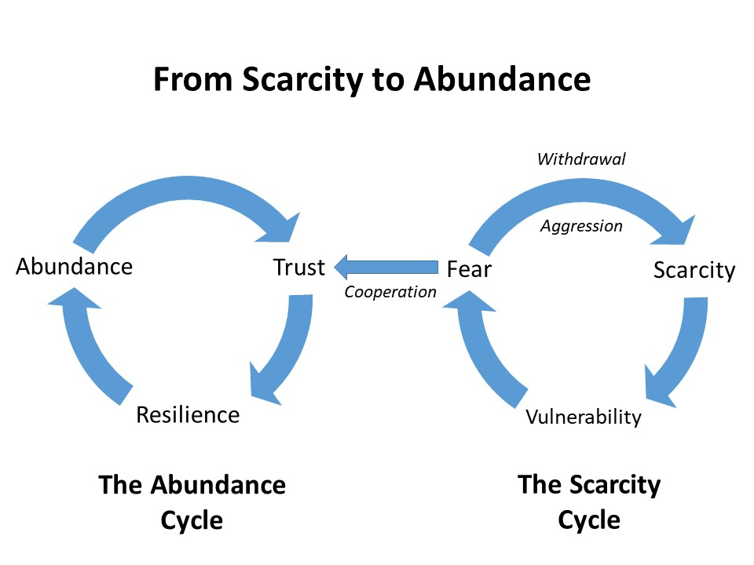

Slide 21
Abundance, Resilience, Trust
Where Do We Start?
Building community
A commitment to justice (rights)
A renewed social welfare system
An inclusive economy
Notes:
Building Community: Creating opportunities and spaces for people to interact, share their stories and enjoy one another.
Justice: A commitment to building the institutions that respect our human dignity and guarantee our rights.
Building a renewed Social Welfare system that is generative and trust-based rather than punitive and suspicious.
Transitioning to an inclusive economy where these principles are embedded in our workplaces and economic lives.

Slide 22
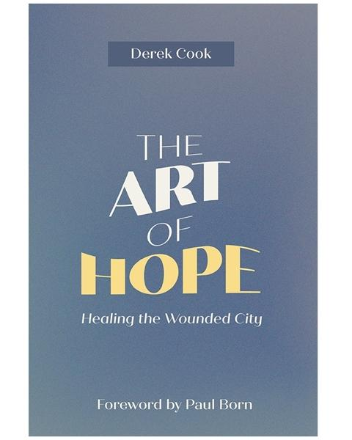
Thank You
Notes:
In this way I believe we can transition from a society governed by the myths of scarcity and autonomy that keep us trapped in a cycle that diminishes our human potential to one where we all can flourish.
It is in this virtuous cycle of Abundance, Resilience and Trust that I believe hope can take root.

Slide 23
The Canadian Poverty Institute
Ambrose University
150 Ambrose Circle SW
Calgary, Alberta
T3H 0L5
www.povertyinstitute.ca
povertyinstitute@ambrose.edu
@cndpovertyinst
Derek Cook
Derek.Cook@ambrose.edu
@ARTofHope

