Slide 1


A Tamarack Workshop
The Power of Place
With Emily Sun, Jo Blundell, John Hitchin and Liz Weaver

Slide 2

Gratitude & Acknowledgement
We begin this workshop by acknowledging that we are meeting on Indigenous land. As settlers, we are grateful for the opportunity to meet and we thank all the generations of Indigenous peoples who have taken care of this land.
As settlers, this recognition of the contributions and historic importance of Indigenous peoples must be clearly and overtly connected to our collective commitment to make the promise and the challenge of Truth and Reconciliation real in our communities.
We didn’t hear back from the community after we left

Slide 3

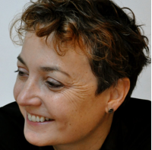
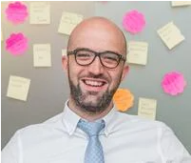
We didn’t hear back from the community after we left
Emily Sun
Jo Blundell
John Hinchin

Slide 4
Place-Based Change Research
Project Place and your partners in the UK have been on a learning journey about place-based change. Can you share some of the highlights of that research?

Slide 5
Place-Based Change
Your research has also looked at international approaches to place-based change? What have you drawn from the international research and what is unique about the UK context?

Slide 6
Centre for Place-Based Transformation
Your research is proposing a Centre for Place-Based Transformation in the UK. What key themes have you drawn from the international research?
We didn’t hear back from the community after we left

Slide 7
Delivery
Enable
Communities of Practice
Learning
Platform
Research and evaluation
Learning and connection.
Inform
Develop and curate
Knowledge & expertise
Coaching
Centre for
Place Based Transformation
Positive funding and
commissioning environment.
Expert network
Share learning with funders, policy makers
Influence
Curate global and UK sources of knowledge
Policy advocates for the sector
Give a Voice to the sector
Notes:
So we have distilled this into a model that has 3 interconnected components. To the point of what is different about us – it is the interconnection between this elements that we think makes us distinctive.
Enable – in our research we heard a lot about the value of connection and learning from peers. People also wanted help navigating the complexity, but but learning from their own and other experience rather than advice or guidance. Our response to this is first to focus on connection and peer learning through communities of practice. The second is to build a network of coaches – people with experience who, by working across projects, will accelerate insight and connect the learning between them. Their role will be to both support projects on the ground and also to distil those insights into materials accessible via our knowledge portal.
Inform – we see the valuing of learning as being core to the way the centre works. In helping projects capture and codifying their own learning, to sharing learning across peers, to creating an evidence base for the practice. This is a whole system of learning.
Influence – we need to think and work systemically as a centre to be effective, so recognising this system and connecting to it to the benefit of making it work better at all levels is an important challenge.

Slide 8
Organisation Model
Notes:
So to the question of how the centre works and what it is.
First, we don’t want to set ourselves up in competition with consultancies or other organisations supporting place-based work. We are looking to find a space that enables the whole system rather than owns a method and a set of resources. We know this creates a set of financial challenges around how the centre is funded and we’d welcome your views on the options.
Essentially the centre is a backbone team that engages other organisations and people around a shared agenda and convenes place-based projects to learn and be supported by that network. What the backbone will “own” is a platform for learning and the relationships it creates with places and the network of expertise. We envisage those that work with us will contribute learning (as well as receive it) and enable us to build evidence over time. We see projects as “members” in the sense that they co-own the centre and use their experience to contribute learning as they develop.
The backbone is owned by a core partnership who hold the responsibility for obtaining funding and governing the development of the Centre. We are keen that this includes Anchor funders with a long term interest in the centre. We also see a role for government as a funder, but how that relationship is constituted and the optics of having a blended model of funding needs to be considered.

Slide 9
Renaisi
Renaisi has been in the business of supporting place-based approaches across the UK since 1998. Can you describe a bit about Renaisi and your work?
To Learn more about Renaisi - https://renaisi.com/

Slide 10
Working Collectively on Place-Based Transformation
What has drawn Renaisi into this collaborative space? What are the potential benefits from a collective approach to place-based change?

Slide 11
Waves of policy in the UK
Neighbourhoods
Impact
Lived experience
Personalisation
What Works
Relationships
Commissioning
Scaling
Collaboration
Notes:
What we have just been through isnt the only thing that focus what happens next - i.e. history
Where we are now and what has changed (so that we don’t reinvent the wheel) - Responding to opportunities and shifts
Political drivers
Business model and balance sheet drivers (austerity etc)
Era drivers
Collab – across the system
WW – piecemeal, public management
Cuts - defensiveness

Slide 12
Roles and Contributions of Partners and Stakeholders
Based on your individual and collective experiences to date, why is place-based change and transformational so pivotal to communities? What roles should key stakeholders such as government, philanthropy and community organizations play?
We didn’t hear back from the community after we left

Slide 13


Slide 14
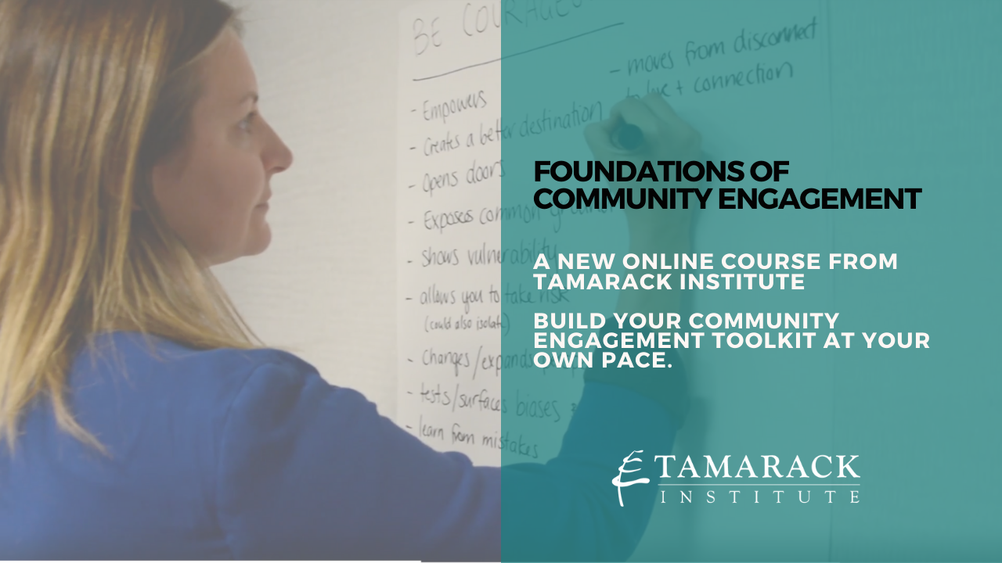

Slide 15


Slide 16


