Slide 1
Title Slide – Filled in by Tamarack CA/Other

Slide 2
Gratitude & Acknowledgement
We begin this workshop by acknowledging that we are meeting on Indigenous land. As settlers, we are grateful for the opportunity to meet and we thank all the generations of Indigenous peoples who have taken care of this land.
As settlers, this recognition of the contributions and historic importance of Indigenous peoples must be clearly and overtly connected to our collective commitment to make the promise and the challenge of Truth and Reconciliation real in our communities.
We didn’t hear back from the community after we left

Slide 3
Technical Considerations
We’ve got you covered - You will receive a full recording of the call, the slides as well as a collection of links & resources.
Join the conversation - Use the Q&A panel on your Zoom client to submit and vote for questions you’d like us to discuss.
Technical Support - You can use the chat panel to ask for technical support throughout the webinar.
We didn’t hear back from the community after we left

Slide 4
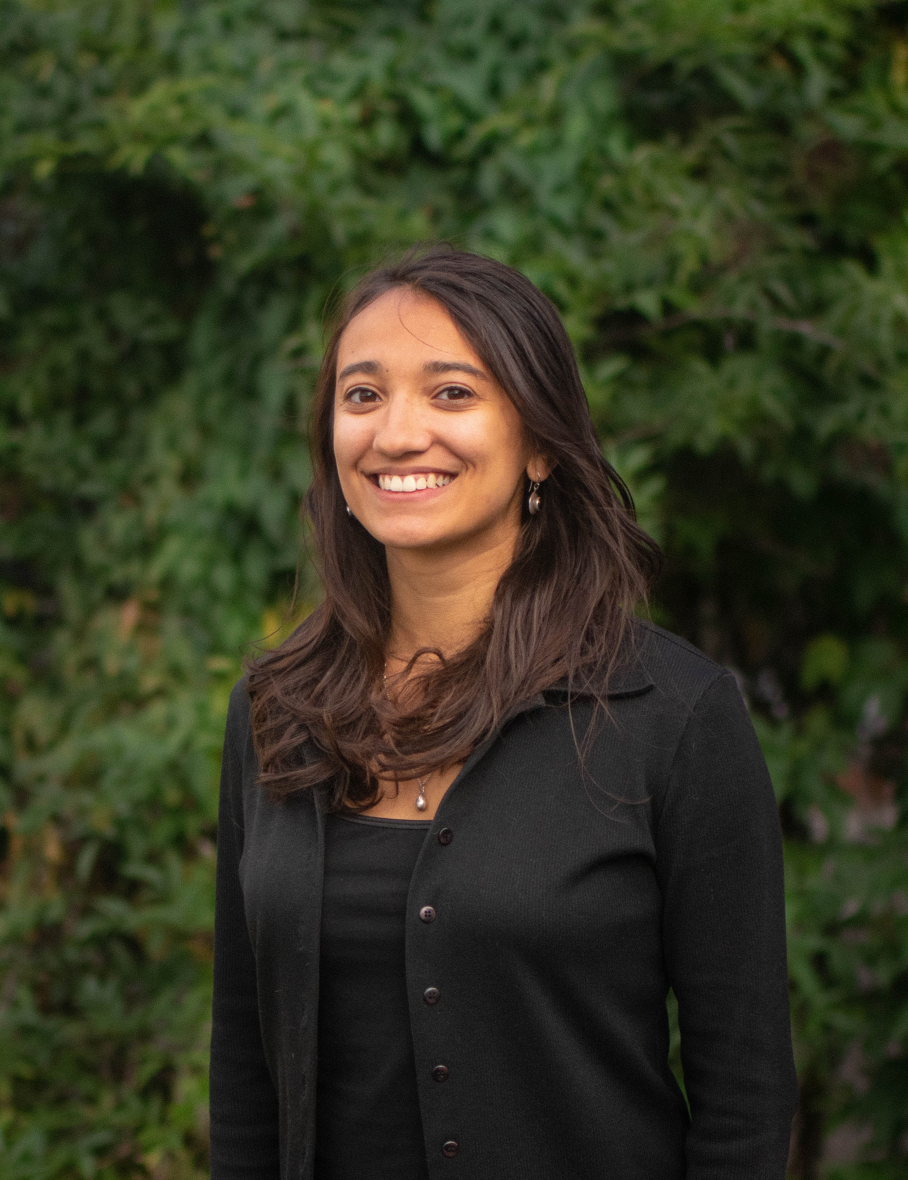
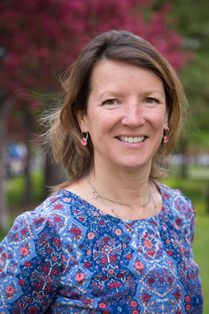
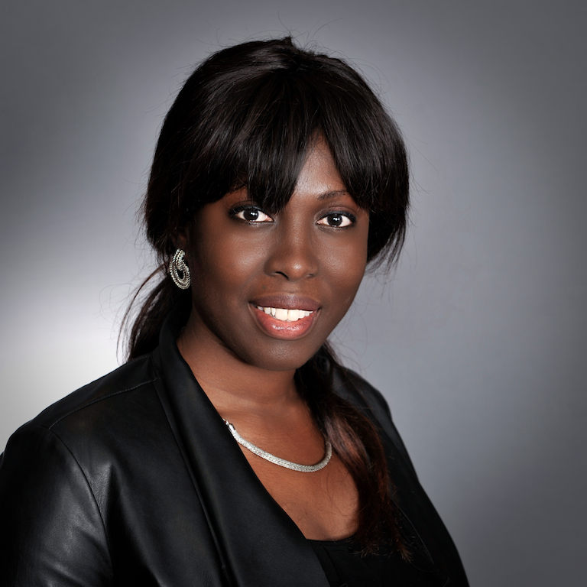
We didn’t hear back from the community after we left
Layla Belmahi
Alena Ziuleva
Vanessa Sykes
Ramana Zanfongnon
Myriam Bérubé

Slide 5
THE NEIGHBOURHOOD ROUNDTABLE MODEL IN MONTREAL
Can you explain what is unique about the round table model ?

Slide 6
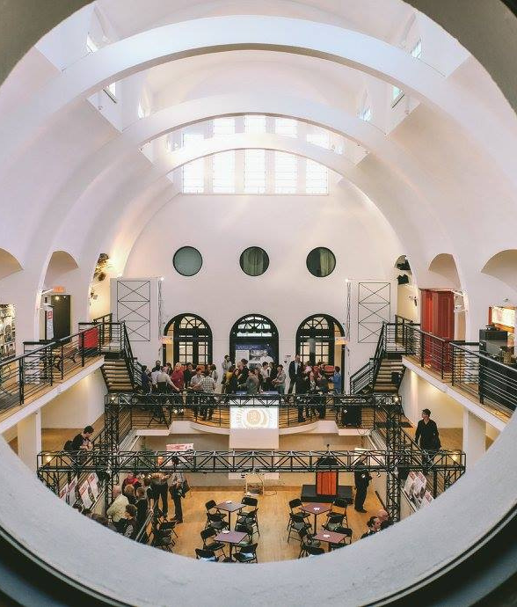
The Montreal Neighbourhood Round Tables Coalition
Layla Belmahi
Development and Communications Coordinator layla@cmtq.org

Slide 7
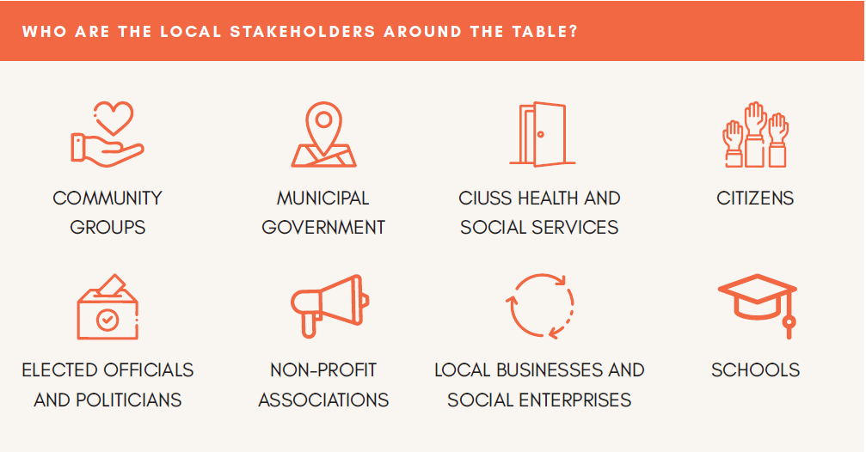
What's a Neighbourhood Round Table ?
A definition

Slide 8
What's a
Neighbourhood
Round Table ?
Examples of actions
Unites local stakeholders and encourages public participation
Assesses local issues to better support collective action
Helps the community to identify and prioritize local issues to implement an action plan

Slide 9
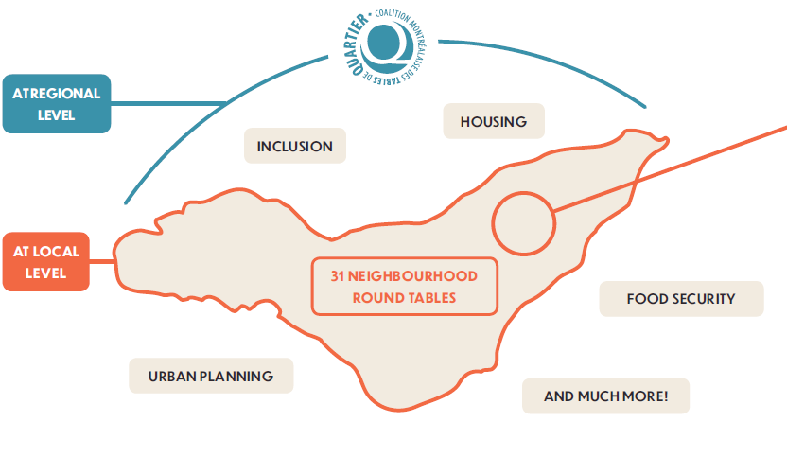
Being a Coalition
What we do as a Coalition and our learnings from the past years
Bringing together the 31 Neighbourhood Round Tables on key issues
Advocating for issues at the regional level to influence public policies
Providing spaces for support and exchanges among the Neighbourhood Round Tables

Slide 10
A few historical milestones
in becoming a Coalition
And some learnings we made throughout the years
Official launch of the IMSDSL
2006
1995
1998-2002
2003 - 2009
2021
Birth of the CMTQ
Strategic evaluation processes
+
First reflexion towards the establishment of the Montreal Initiative for Local Social Development (in French: IMSDSL), a joint program of Centraide of Greater Montreal, the City of Montreal and the Montreal Public Health Department
The Coalition becomes an official organization and hires a full-time employee dedicated to give more structure to its actions and make representations at the regional level
The CMTQ is a key actor in Montreal's social development and gathers 31 Neighbourhood Round Tables

Slide 11
Contact
info@cmtq.org or layla@cmtq.org
Our Website
@LaCMTQ
@LaCMTQ

Slide 12
IMPACT
Can you share a local round table achievement you are proud of?
What are some of the impacts?
We didn’t hear back from the community after we left

Slide 13
NEED FOR CHANGE
RAISING AWARENESS
COMMUNITY EMPOWERMENT
ENGAGED RESIDENTS
3 out of 8 tenant households spend more than 30% of their income on shelter (2016).
People understand their stake in creating a healthy community and the importance of housing
Our Housing Stories
Collecting lived experiences
Housing Webinars
Sharing local knowledge
Community Housing Tours
Challenging stigma
Housing for All Newsletter
Latest news, research and
practices
Housing Forum
Mobilizing towards collective action
Valois Pop-up
Consultation with residents on their
perspectives for change
PIC Ideation
Collectively identifying and
selecting housing solutions
Areas facing up to a 23% yearly increase in the price of a single-family home (2020).
Education
Participation
Volunteering
Advocacy
Homelessness is a growing concern, especially among youth.
VISION FOR CHANGE
PARTNERSHIPS AND COLLABORATION
Involving residents and the community in the diagnostic of local needs.
TQSOI
Collective Impact
Partners are committed to mutual learning, support and collaborative housing solutions
Building a global portrait of the southern West Island.
Developing a shared vision for collective action: Adequate and appropriate affordable housing responding to the needs of residents in the southern West Island.
Monitoring Communication Dialogue
Co-creation
Comité logement
Establishment Project
Establishing the first tenants’ rights
organization for the West Island
PIC Prototyping
Collectively working on local housing
solutions
Supporting existing, developing and new community housing projects
Facilitating partnerships and encouraging emerging opportunities
“Bringing Affordability to the
Suburbs” Workshops
Empower and equip elected officials
to support housing affordability
Policy briefs
Municipal, provincial and federal housing
policy recommendations
Municipal housing needs assessments
Research and analysis of housing needs
PATH TO CHANGE
LOCAL SYSTEMS
Committee discusses and makes decisions on the actions, strategies and steps that must be taken.
Working with existing housing resources while creating and leveraging new ones
Assessment process to measure feasibility, desirability and sustainability.
Mapping Understanding Adapting Innovating
Evaluation of actions and strategies implemented to determine impact and adapt.
POLICY INFLUENCE
CAPACITY BUILDING

Slide 14
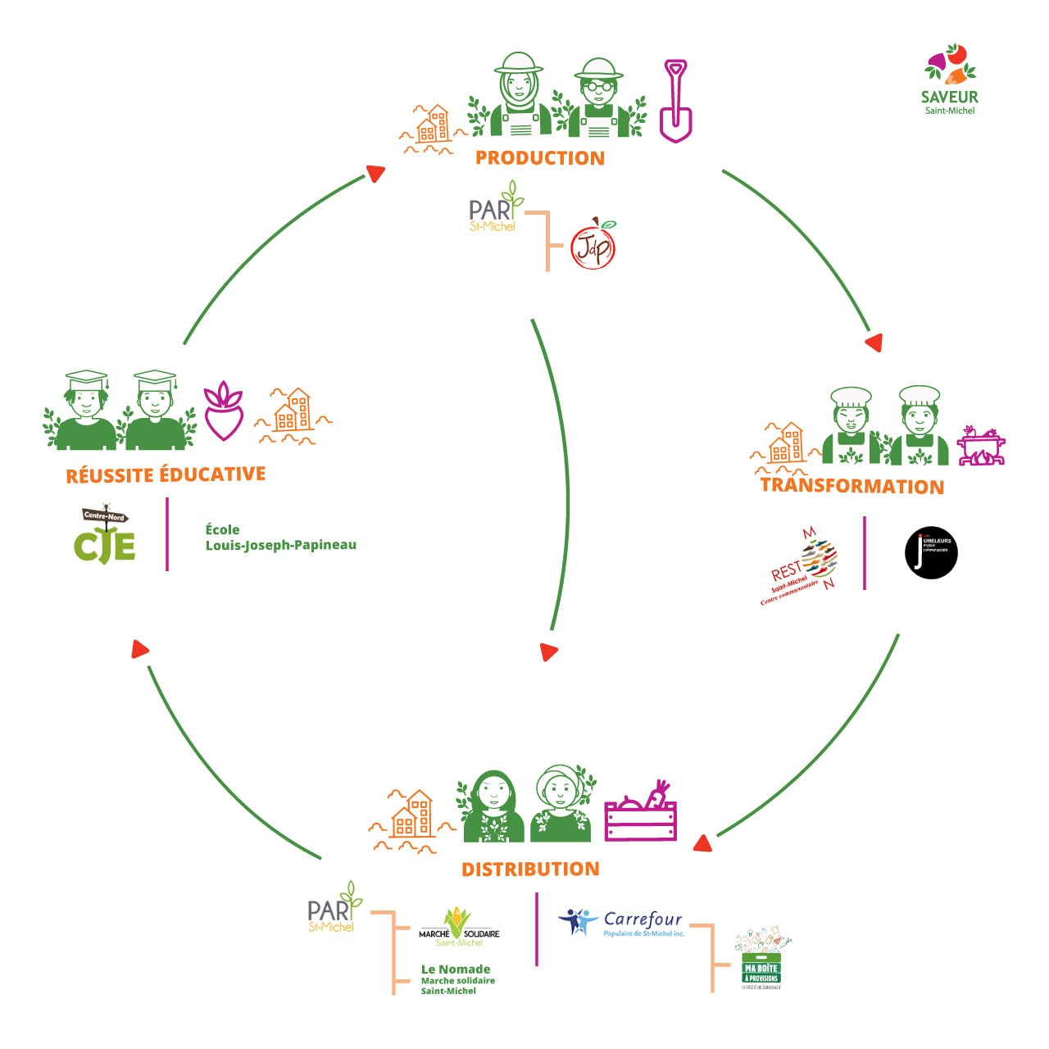
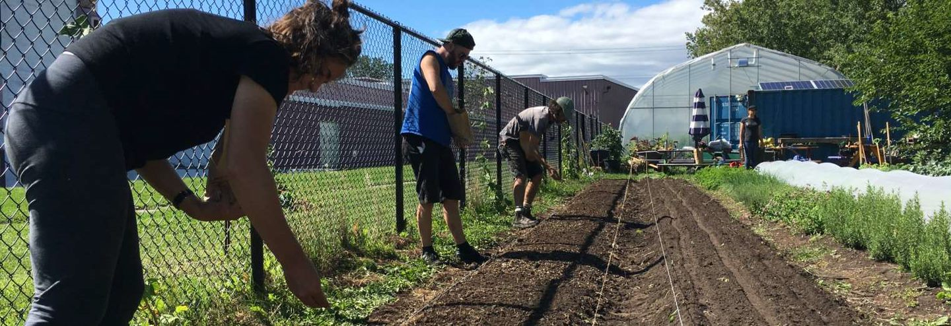
Food system of Saint-Michel = SAVEUR Système Alimentaire Valorisant l’Éducation, l’Unité et le Rayonnement de Saint-Michel
Notes:
SAVEUR = Système alimentaire valorisant l’éducation, l’unité et le rayonnement de SM
Food system in Saint-Michel has been build over the years by various partners. Since 2016, with the help of the Impact collectif program, it has reached a different level and today it has the name SAVEUR. A logo, webpage and FB is being developped.
It combines two main needs:
to have access to fresh and affordable products as well as
increase the level of graduation & raise awareness abot health living habits
SM is one pf the poorest districts in Canada, the population is young, multicultural and composed of sometimes large families. One of the main local schools is known as the school with no windows (buils in the 70’s and now protected). The graduation level is fairly poor and the need to get some light high. Also, the best way to change habits in a family is to work with the kids.
The steps were:
To build a 3 season greenhouse
To get the ministry of education to approve a curriculum in urban agriculture (EAU)
To recrute staff
To engage student (1st group in 2020-2021)
RESULTS for 2020-2021:
Over 1 ton of vegetables and herbs produced in our gardens
1500 kg of food transformed as we received from various donors
60 workshops in food transforamtion and urban agriculture
A market with decent prices
A market with a school bus that goes around the district acoording to a fixed schedule (eg parking lots or parks)
1 community organisation that offers bulk purchase with members who receive a box
THE FUTURE
A winter version of the mobile market
An increase in production and transformation
A pilot project with an entreprise (Keurig based in SM)
A 2nd group of 25 students and eventually 125 students who will be able to continue at the horticultural school of Mtl
A 4 season greenhouse!!!

Slide 15
A KEY PARTNERSHIP
Who are the partners supporting Montreal’s round table model? Why is the City involved in this partnership?

Slide 16
SUSTAINABILITY
What are some ingredients for success that have sustained the round table’s work over the years?

Slide 17
TAKEAWAYS
What piece of advice do you have for our participants involved in local collaboratives or collective impact initiatives?
We didn’t hear back from the community after we left

Slide 18
LOOKING TO THE FUTURE
What are your hopes for the future of Montreal’s round table model?

Slide 20
October 13th – Place-based Participatory Evaluation for Strategic Learning
November 10th – Place-based Philanthropy for City-wide Change
December 8th – Place-based Social Innovation through Living Labs

