Slide 1
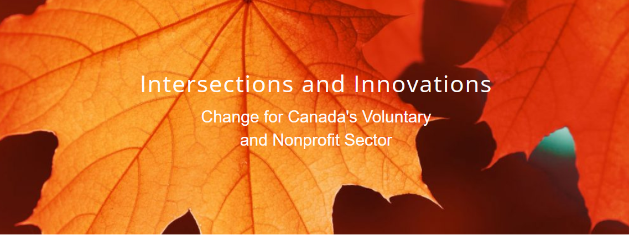
A Tamarack Institute Webinar with
Bob Wyatt, Dr. Susan Phillips and Liz Weaver

Slide 2
Gratitude & Acknowledgement
We begin this workshop by acknowledging that we are meeting on Indigenous land. As settlers, we are grateful for the opportunity to meet and we thank all the generations of Indigenous peoples who have taken care of this land.
As settlers, this recognition of the contributions and historic importance of Indigenous peoples must be clearly and overtly connected to our collective commitment to make the promise and the challenge of Truth and Reconciliation real in our communities.
We didn’t hear back from the community after we left

Slide 3
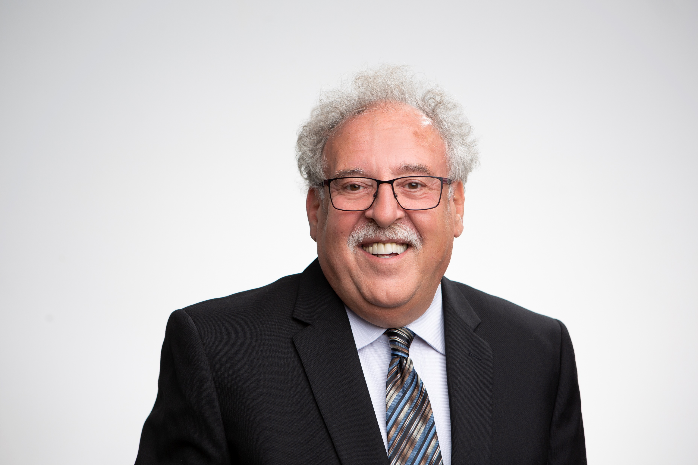
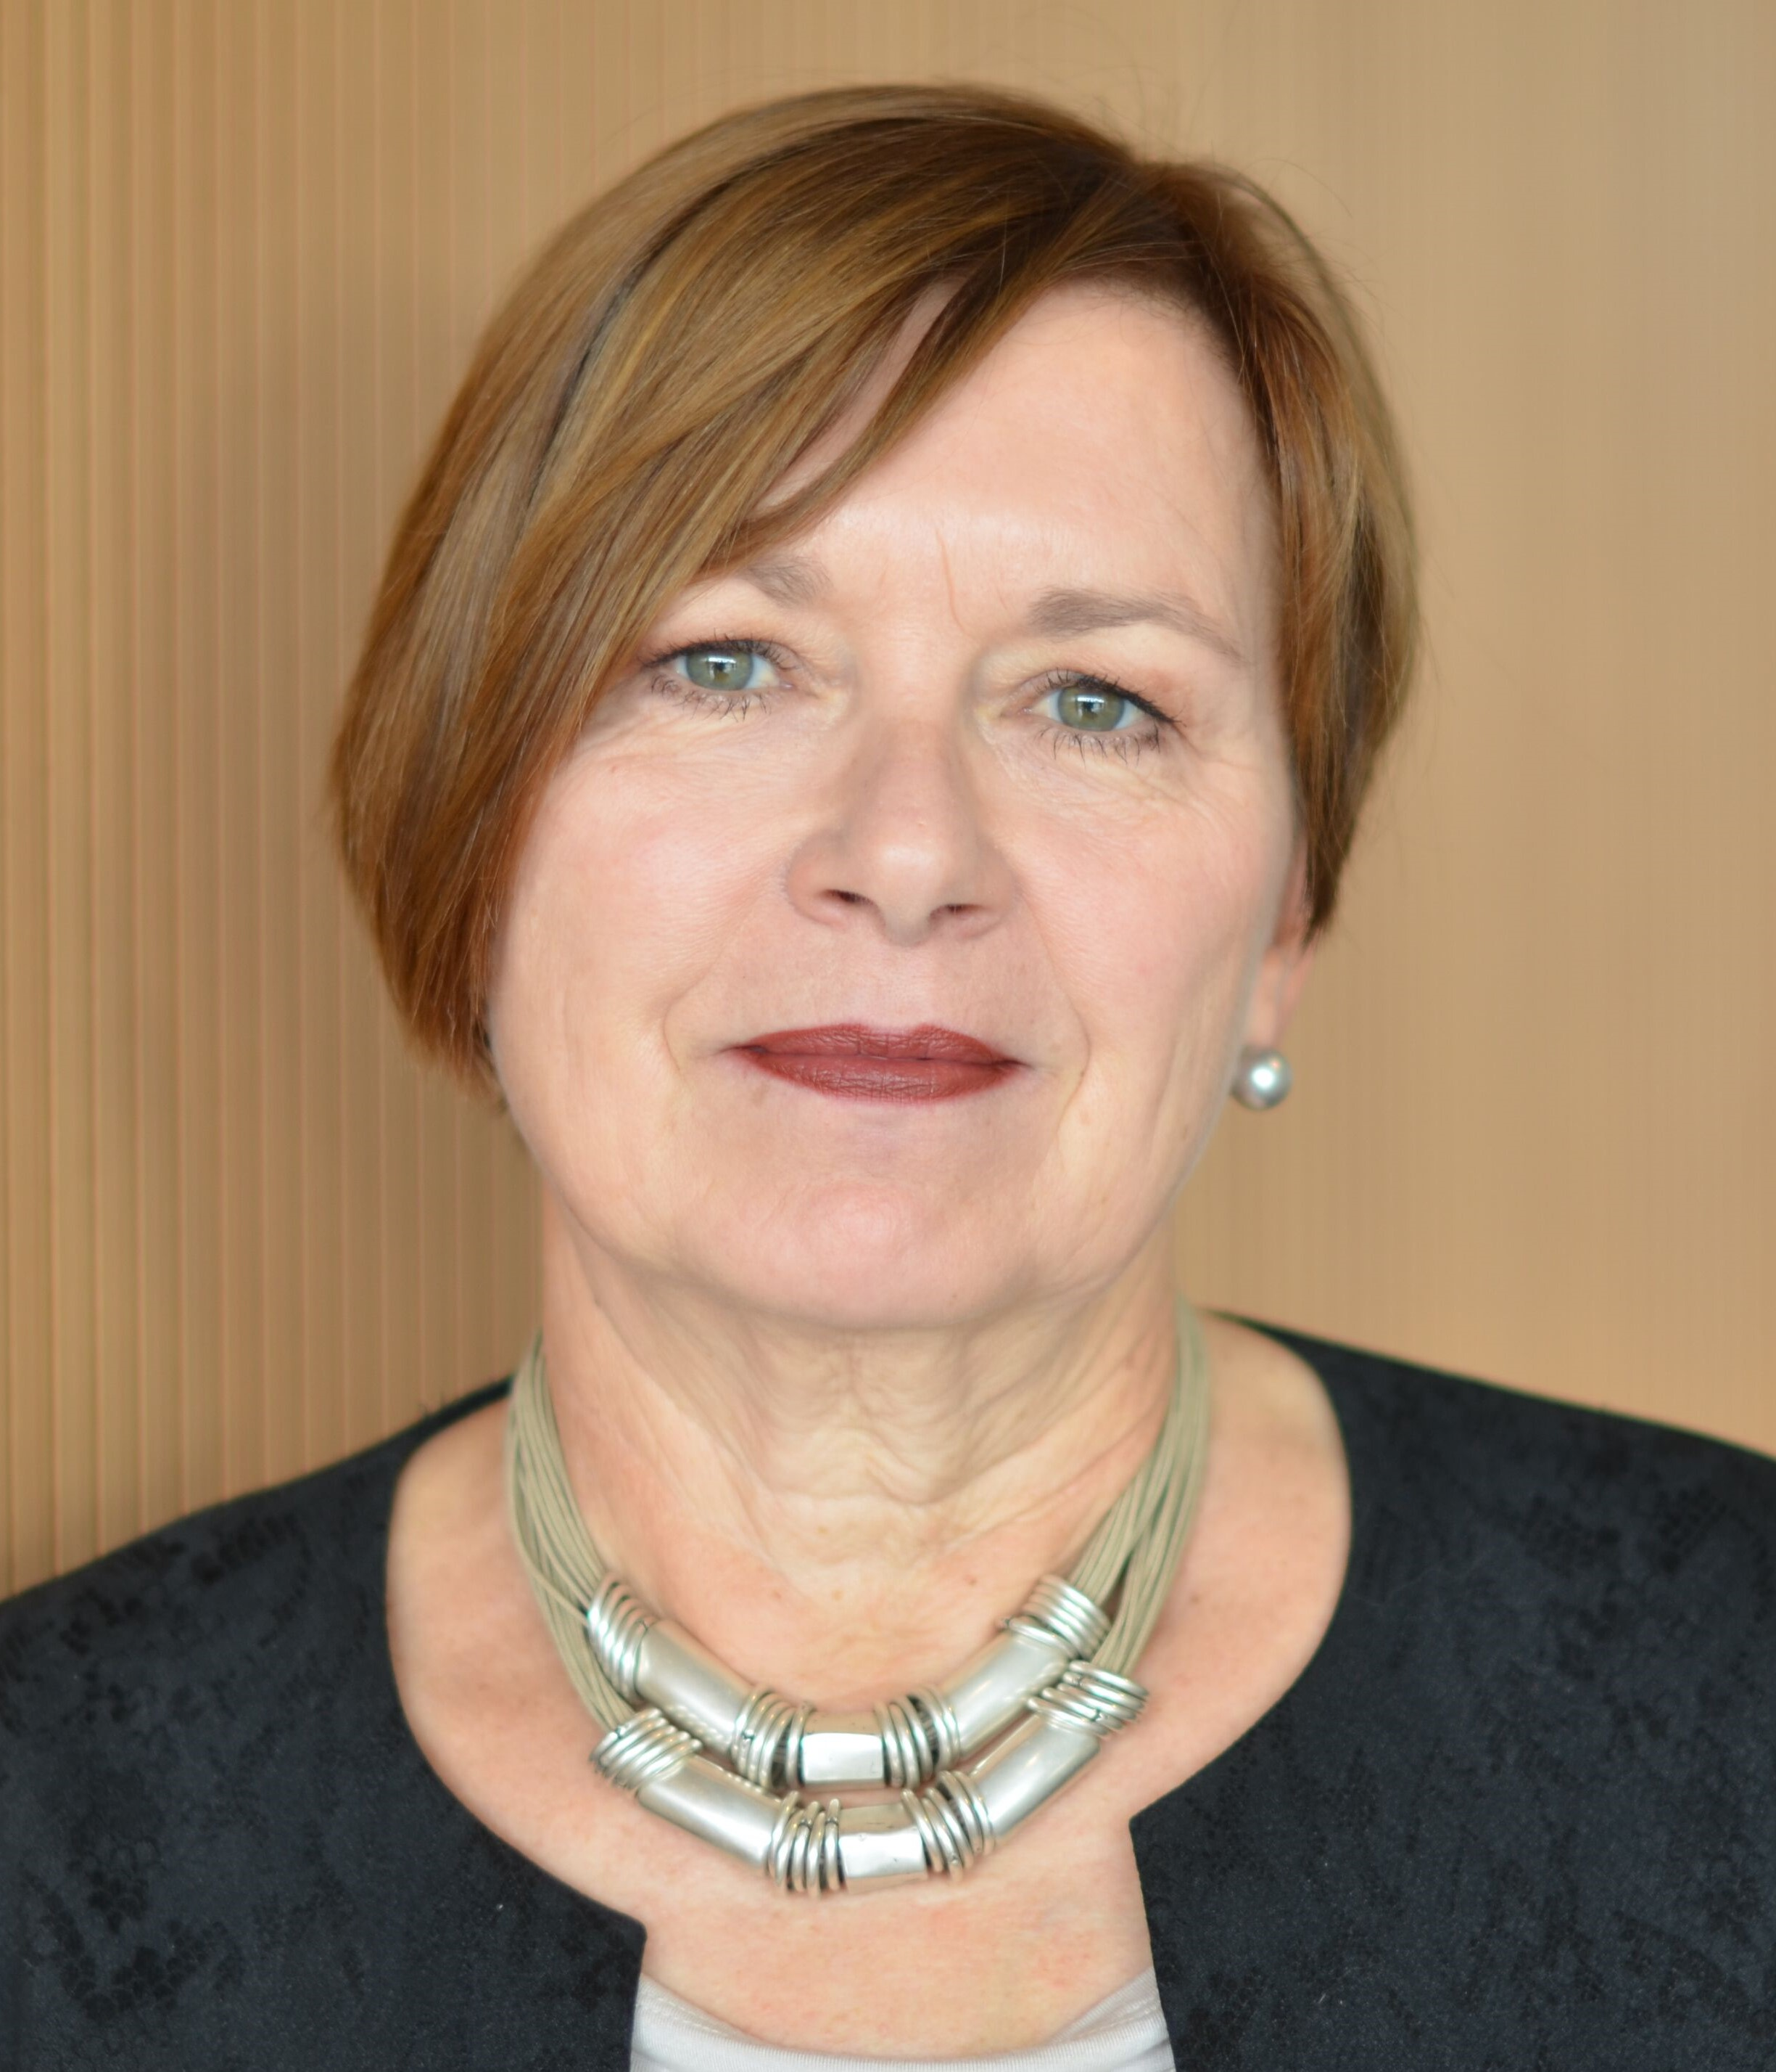
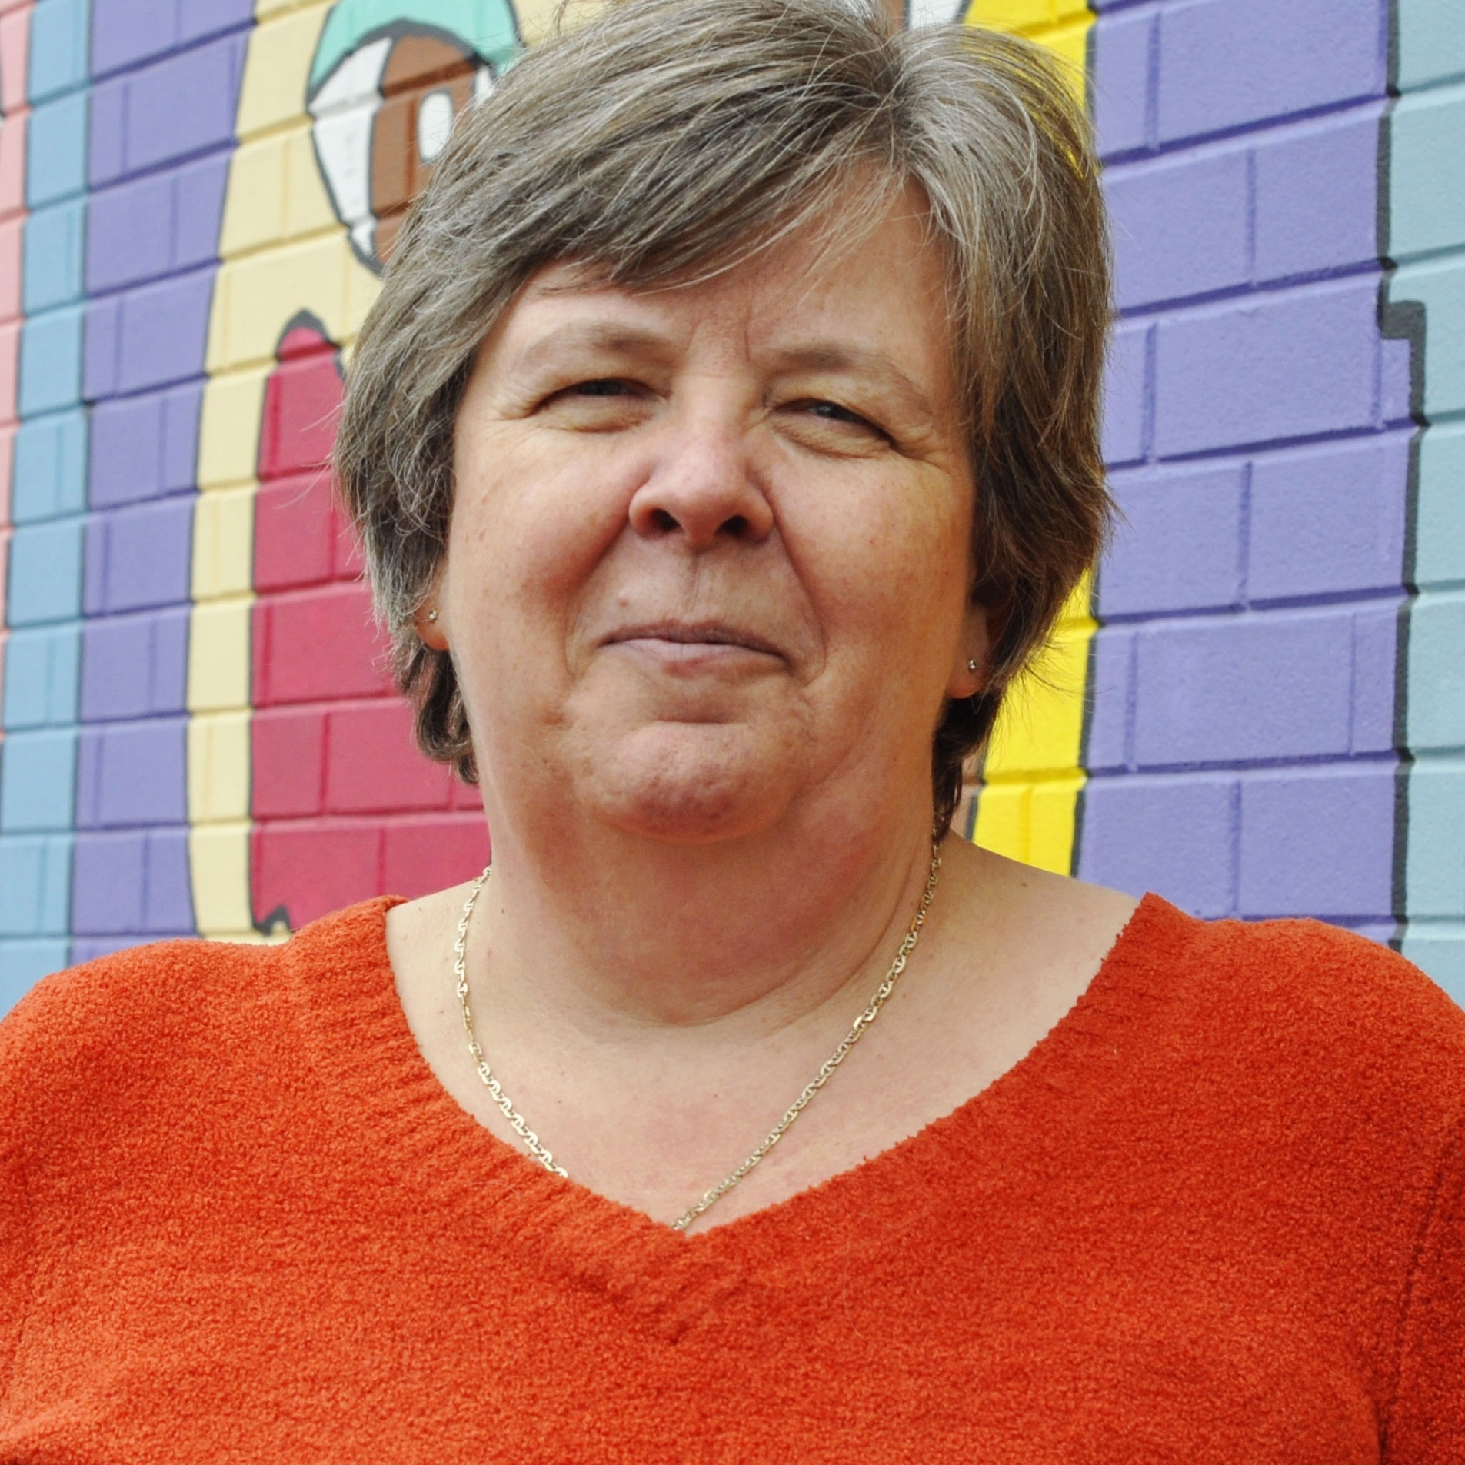
We didn’t hear back from the community after we left
Bob Wyatt
Dr. Susan Phillips
Liz Weaver

Slide 4
INTERSECTIONS AND INNOVATIONS
Why did the Muttart Foundation invest in the development of this publication?

Slide 5
VOLUNTARY SECTOR HISTORY AND ROOTS
What did you uncover about the unique roots and history of Canada’s voluntary sector and how has this shaped the current state of the voluntary sector in Canada?
We didn’t hear back from the community after we left

Slide 6
CURRENT OR EMERGING CHALLENGES FOR CANADA’S VOLUNTARY SECTOR
What are some of the current or emerging challenges facing organizations?

Slide 7
PANDEMIC AND POST-PANDEMIC WORLD
What do these challenges mean to organizations, especially when navigating a pandemic and post pandemic world ?
We didn’t hear back from the community after we left

Slide 8
OPPORTUNITIES FOR VOLUNTARY SECTOR ORGANIZATIONS
What opportunities have emerged? How can organizations position themselves to take advantage of these opportunities?

Slide 9
FINAL REFLECTIONS
Do you have any final reflections or advice for philanthropic, government or business leaders to consider?
We didn’t hear back from the community after we left

