Slide 1


A Tamarack Workshop
Imagining What’s Next
With Cameron Norman and Liz Weaver

Slide 2

Gratitude & Acknowledgement
We begin this workshop by acknowledging that we are meeting on Indigenous land. As settlers, we are grateful for the opportunity to meet, and we thank all the generations of Indigenous peoples who have taken care of this land.
As settlers, this recognition of the contributions and historic importance of Indigenous peoples must be clearly and overtly connected to our collective commitment to make the promise and the challenge of Truth and Reconciliation real in our communities.
Please share in the chat box your name and location.
We didn’t hear back from the community after we left

Slide 3
Technical Considerations
We’ve got you covered - You will receive a full recording of the call, the slides as well as a collection of links & resources.
Join the conversation - Use the Q&A panel on your Zoom client to submit and vote for questions you’d like us to discuss.
Technical Support - You can use the chat panel to ask for technical support throughout the webinar.
We didn’t hear back from the community after we left

Slide 4
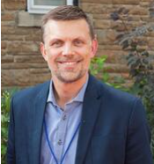
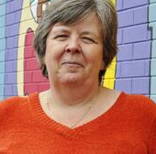
We didn’t hear back from the community after we left
Cameron Norman
Liz Weaver

Slide 5
Poll
What best describes your organization’s experience of the past 18 months?
1. We survived and not much else
2. We lost staff and projects, but we’re managing
3. We stayed about the same
4. We grew and are thriving as an organization and individuals

Slide 6
Guided Meditation
When you think back over the last 18 months, what have you noticed and surprised you the most?
Share your thoughts in the chat box.

Slide 7
Navigating the Pandemic
It’s been a time of remarkable change since the start of last year. What has captured your attention? What surprised you?
We didn’t hear back from the community after we left

Slide 8
Design
Why should we pay attention to design? What does it bring to us at this time in our history?

Slide 9
Designing for Humans
How can Designing for Humans be applied to move past the pandemic?

Slide 10
The Power of One
Why should we consider designing for the smallest visible system? Why is this important in designing for what’s next?

Slide 11
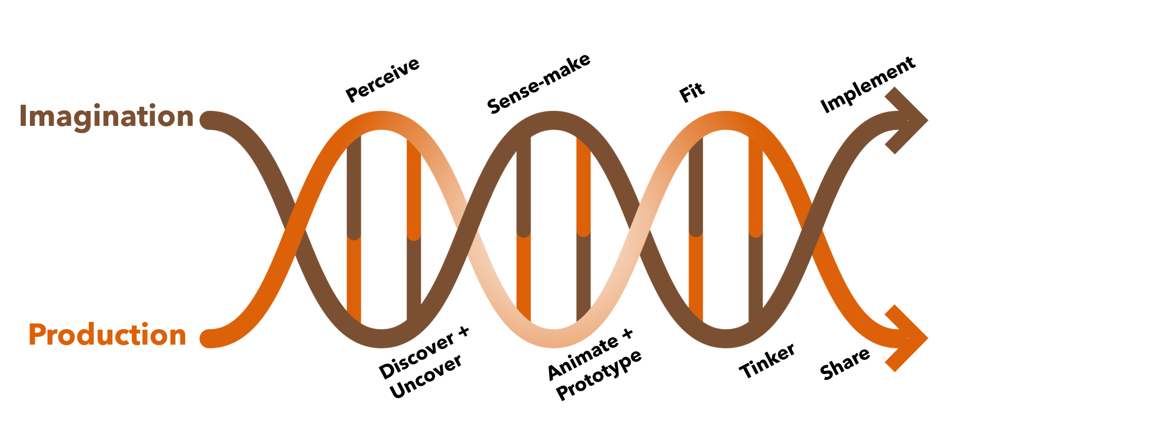

Slide 12


Slide 13
Designing for What’s Next
Why should individuals enhance their design skills, particularly as we enter into a post-pandemic world?

Slide 14
Designing What’s Next Series
What will we cover in the September webinar and in the two workshops? What will we be able to apply?
We didn’t hear back from the community after we left

Slide 15
Closing Poll
What best describes how you see yourself and your organization in the next 18 months?
1. Trying to stay afloat and keep surviving
2. Managing and coping with the losses we’ve sustained
3. Keeping ourselves consistent and stable
4. Growing and thriving as an organization and as individuals

Slide 16


Slide 17
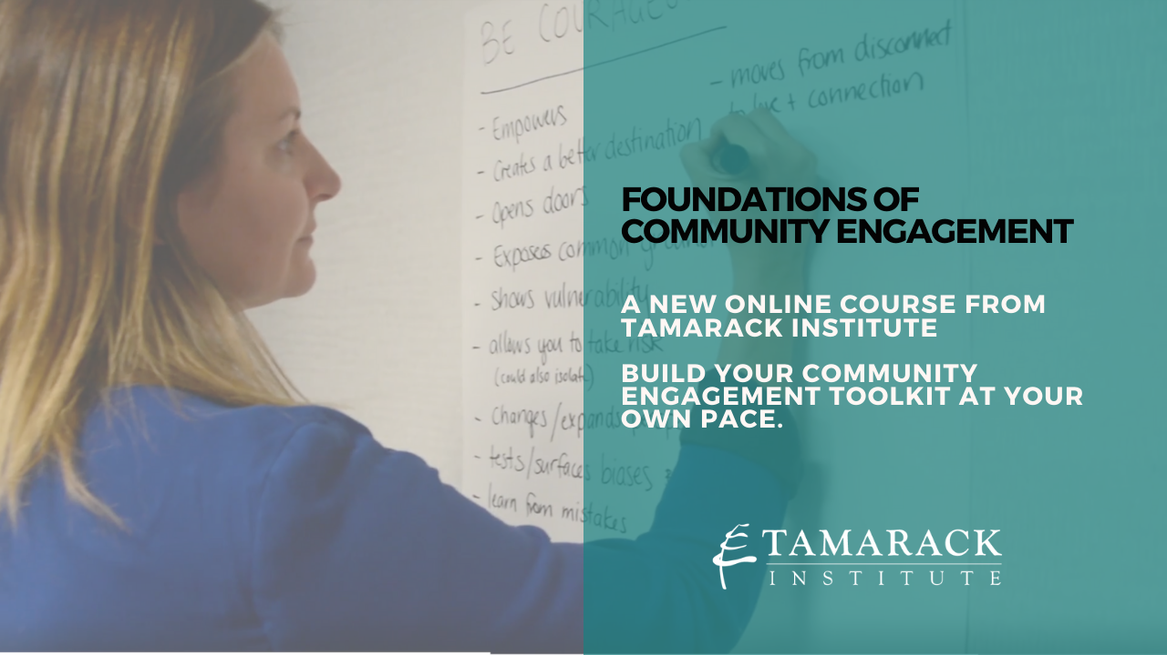

Slide 18


Slide 19


